Slide 1
Principios de contraste de fase (XPCI)
Dithering and Super-resolution in X-ray PCI
Límite teórico de super-resolución
David Jurado HEP Uniandes
Universidad de los Andes
Caso experimental
Conclusiones

Slide 2
Dithering and Super-resolution in X-ray PCI
Principles of X-Rays phase contrast Imaging (XPCI)
Principles of Edge Illumination (EI)
David Jurado
Universidad de los Andes
Dithering considerations
Experimental results and Conclusions

Slide 3
Principles of X-Rays phase contrast Imaging (XPCI)
Edge
Illumination (EI)
Límite teórico de super-resolución
X-Rays detection and their interactions with matter can be understood by using the field interpretation
We can deduce the way waves travel through matter and vacuum
Caso experimental
$$∂_{α}F^{αβ}=μ_{o}J^{β}$$
$$∂_{μ}D^{μν}=J_{free}^{ν}$$
$$∎^{2}φ^{′}=\frac{ρ}{ε_{o}}$$
$$∂_{α}\left(\frac{1}{2}ε^{αβγδ}F_{γδ}\right)=0$$
$$μ_{o}D^{μν}=η^{μα}F_{αβ}η^{βν}$$
$$∎^{2}A^{′}=μ_{o}J$$
Conclusiones
In-line
Vacuum
L-M Interaction
Lorentz Gauge (KeV)

Slide 4
$$Δz$$
$$Ψ\left(\vec{r},t\right)$$
$$∎^{2}φ=\frac{ρ}{ε_{o}}$$
$$∎^{2}A=μ_{o}J$$
$$∂_{α}F^{αβ}=μ_{o}J^{β}$$
Lorentz Gauge (KeV)
$$d$$
$$z_{o}$$
$$∂_{α}\left(\frac{1}{2}ε^{αβγδ}F_{γδ}\right)=0$$
Vacío
Principios de detección de rayos X
We can deduce the way waves travel through matter and vacuum
Geometría del problema
$$Ψ\left(\vec{r},t\right)=\sqrt{I\left(\vec{r},t\right)} e^{i φ\left(\vec{r},t\right)}=ψ_{ω}\left(\vec{r}\right)e^{−iωt}$$
$$∎^{2}φ=\frac{ρ}{ε_{o}}$$
$${(k^{2}+∇}^{2})ψ_{ω}\left(\vec{r}\right)=0$$
$$∎^{2}A=μ_{o}J$$
$$\left({ n_{ω}^{2}\left(\vec{r}\right)k^{2}+∇}^{2} \right)ψ_{ω}\left(\vec{r}\right)=0$$
$$n_{ω}= 1−δ+i β$$
Lorentz Gauge (KeV)
X-Rays detection and their interactions with matter can be understood by using the field interpretation
$$∂_{α}F^{αβ}=μ_{o}J^{β}$$
$$∂_{μ}D^{μν}=J_{free}^{ν}$$
$$∎^{2}φ^{′}=\frac{ρ}{ε_{o}}$$
$$∂_{α}\left(\frac{1}{2}ε^{αβγδ}F_{γδ}\right)=0$$
$$μ_{o}D^{μν}=η^{μα}F_{αβ}η^{βν}$$
$$∎^{2}A^{′}=μ_{o}J$$
Vacuum
L-M Interaction
Lorentz Gauge (KeV)

Slide 5
Principios de detección de rayos X
Toy model
$$Ψ\left(\vec{r},t\right)$$
$$Δz$$
$$I_{source}$$
$$y$$
$$Ψ\left(\vec{r},t\right)=\sqrt{I\left(\vec{r},t\right)} e^{i φ\left(\vec{r},t\right)}=ψ_{ω}\left(\vec{r}\right)e^{−iωt}$$
$$source$$
$${(k^{2}+∇}^{2})ψ_{ω}\left(\vec{r}\right)=0$$
$$Ψ\left(\vec{z},t\right)$$
$$I_{sample}$$
$$∎^{2}φ=\frac{ρ}{ε_{o}}$$
$$z$$
$$Δφ\left(x,y;λ\right)=−k ∫δ_{ω}\left(x,y,z\right)dz$$
$$\left({ n_{ω}^{2}\left(\vec{r}\right)k^{2}+∇}^{2} \right)ψ_{ω}\left(\vec{r}\right)=0$$
$$x$$
$$T\left(x,y;λ\right)=e^{−(2 π/λ)\int{β(x,y,z;λ)} dz }$$
$$∎^{2}A=μ_{o}J$$
$$n_{ω}= 1−δ+i β$$
Lorentz Gauge (KeV)
$$d$$
$$I_{source}$$
$$z_{o}$$

Slide 6
Principios de detección de rayos X
Toy model
$$Δφ\left(x,y;λ\right)=−k ∫δ_{ω}\left(x,y,z\right)dz$$
$$T\left(x,y;λ\right)=e^{−(2 π/λ)\int{β(x,y,z;λ)} dz }$$
$$ψ_{ω}\left(Δz\right)=Exp\left[−ki\int_{z=0}^{z=z_{o}}{δ_{ω}\left(z\right)−i β\left(z\right)} dz \right]ψ(z_{o})$$
$$Δz$$
$$Ψ\left(\vec{r},t\right)=\sqrt{I\left(\vec{r},t\right)} e^{i φ\left(\vec{r},t\right)}=ψ_{ω}\left(\vec{r}\right)e^{−iωt}$$
$$Ψ\left(x,y;λ\right)=\sqrt{T\left(x,y,λ\right)} e^{i φ\left(\vec{r},t\right)}$$
$$Ψ\left(\vec{r},t\right)$$
$${(k^{2}+∇}^{2})ψ_{ω}\left(\vec{r}\right)=0$$
$$∎^{2}φ=\frac{ρ}{ε_{o}}$$
Hence
$$\left({ n_{ω}^{2}\left(\vec{r}\right)k^{2}+∇}^{2} \right)ψ_{ω}\left(\vec{r}\right)=0$$
$$∎^{2}A=μ_{o}J$$
$$Ψ_{detected}=Ψ\left(x,y;λ\right)⋅m\left(y\right)∗H_{z} (x,y,λ)$$
$$n_{ω}= 1−δ+i β$$
Lorentz Gauge (KeV)
$$z_{o}$$
$$d$$

Slide 7
$$Δφ\left(x,y;λ\right)=−k ∫δ_{ω}\left(x,y,z\right)dz$$
$$T\left(x,y;λ\right)=e^{−(2 π/λ)\int{β(x,y,z;λ)} dz }$$
$$ψ_{ω}\left(Δz\right)=Exp\left[−ki\int_{z=0}^{z=z_{o}}{δ_{ω}\left(z\right)−i β\left(z\right)} dz \right]ψ(z_{o})$$
$$Ψ\left(x,y;λ\right)=\sqrt{T\left(x,y,λ\right)} e^{i φ\left(\vec{r},t\right)}$$
$$I_{detected}=Ψ\left(x,y;λ\right)⋅m\left(y\right)∗H_{z} (x,y,λ)$$
Principles of Edge Illumination (EI)
Edge
Illumination (EI)
XPCI allows the detection of phase signal of deflected beams that interact with the sample
In X-rays, there are two main techniques that achieve consistent XPCI
In-line

Slide 8
Principles of Edge Illumination (EI)
Edge
Illumination (EI)
2
1
XPCI allows the detection of phase signal of deflected beams that interact with the sample
In-line
In X-rays, there are two main techniques that achieve consistent XPCI

Slide 9
Edge
Illumination (EI)
$$p⋅Δy$$
$$z_{2}$$
$$a$$
$$Δφ\left(x,y\right)$$
$$Δφ\left(x,y\right)$$

Slide 10
Edge
Illumination (EI)
Detector
$$l_{p}$$
Máscara
$$T_{mask}$$
$$l_{m}$$
$$255px$$
$$255px$$

Slide 11
Edge
Illumination (EI)
Detector
Even
$$100\%$$
Odd
$$0\%$$
Even
$$100\%$$
Máscara
$$255px$$
Odd
$$0\%$$
Even
$$100\%$$
Odd
$$0\%$$
Even
$$100\%$$
Odd
$$255px$$

Slide 12
Edge
Illumination (EI)
Detector
Even
$$50\%$$
Odd
$$50\%$$
Even
$$50\%$$
Máscara
Odd
$$50\%$$
Even
$$50\%$$
Odd
$$50\%$$
Even
$$50\%$$
Odd

Slide 13
Edge
Illumination (EI)
$$255px$$
Even
$$50\%$$
Odd
$$50\%$$
Even
$$50\%$$
Odd
$$50\%$$
odd
even
Even
$$50\%$$
Odd
$$50\%$$
Even
$$50\%$$
Odd

Slide 14
Edge
Illumination (EI)
$$255px$$
Even
$$50\%$$
Odd
$$50\%$$
$$z_{2}$$
$$M=1$$
Even
$$50\%$$
Odd
odd
$$50\%$$
Separable
$$k_{1}$$
$$k_{2}$$
Even
$$50\%$$
$$I_{detected}=\left[{\left[ Ψ\left(x;λ\right)∗h_{\frac{z_{2}}{M}} \left(x,λ\right)\right]}^{2}∗g\left(x\right)\right]⋅\left[{\left[m\left(y;λ\right)∗h_{\frac{z_{2}}{M}} \left(y,λ\right)\right]}^{2}∗g\left(y\right)\right]$$
even
Odd
$$50\%$$
Resolution parallel to mask lines
Even
$$k_{1}\left(x;λ\right)=T\left(x;λ\right)\left[1−\frac{z_{2}}{M k}\frac{∂ \dot{φ}}{∂ x}\right]∗g(x)$$
$$50\%$$
Odd
$$I_{detected}={\left|\left[Ψ\left(x,y;λ\right)⋅m\left(y\right)\right]∗H_{\frac{z_{2}}{M}} \left(x,y,λ\right)\right|}^{2}∗G(x,y)$$

Slide 15
$$M=1$$
$$I_{detected}={\left|\left[Ψ\left(x,y;λ\right)⋅m\left(y\right)\right]∗H_{\frac{z_{2}}{M}} \left(x,y,λ\right)\right|}^{2}∗G(x,y)$$
Separable
$$k_{1}$$
$$k_{2}$$
$$I_{detected}=\left[{\left[ Ψ\left(x;λ\right)∗h_{\frac{z_{2}}{M}} \left(x,λ\right)\right]}^{2}∗g\left(x\right)\right]⋅\left[{\left[m\left(y;λ\right)∗h_{\frac{z_{2}}{M}} \left(y,λ\right)\right]}^{2}∗g\left(y\right)\right]$$
Parallel to mask lines
$$k_{1}\left(x;λ\right)=T\left(x;λ\right)\left[1−\frac{z_{2}}{M k}\frac{∂ \dot{φ}}{∂ x}\right]∗g(x)$$

Slide 16
$$F=\frac{a^{2}}{Lλ}$$
Near field $F≪1$
$$M=1$$
$$I_{detected}={\left|\left[Ψ\left(x,y;λ\right)⋅m\left(y\right)\right]∗H_{\frac{z_{2}}{M}} \left(x,y,λ\right)\right|}^{2}∗G(x,y)$$
$$r_{near}≈\sqrt{{\left(4σ_{x}\right)}^{2}+{\left(\frac{Δ x}{M}\right)}^{2}}$$
Separable
$$k_{1}$$
$$k_{2}$$
$$I_{detected}=\left[{\left[ Ψ\left(x;λ\right)∗h_{\frac{z_{2}}{M}} \left(x,λ\right)\right]}^{2}∗g\left(x\right)\right]⋅\left[{\left[m\left(y;λ\right)∗h_{\frac{z_{2}}{M}} \left(y,λ\right)\right]}^{2}∗g\left(y\right)\right]$$
Far field $F≫1$
Resolution parallel to mask lines
$$r_{far}≈\sqrt{2⋅\max\left\{2σ_{x},\sqrt{λ\frac{z_{2}}{M}}\right\}+{\left(\frac{Δ x}{M}\right)}^{2}}$$
$$k_{1}\left(x;λ\right)=T\left(x;λ\right)\left[1−\frac{z_{2}}{M k}\frac{∂ \dot{φ}}{∂ x}\right]∗g(x)$$

Slide 17
$$F=\frac{a^{2}}{Lλ}$$
Near field $F≪1$
$$M=1$$
Dithering
$$I_{detected}={\left|\left[Ψ\left(x,y;λ\right)⋅m\left(y\right)\right]∗H_{\frac{z_{2}}{M}} \left(x,y,λ\right)\right|}^{2}∗G(x,y)$$
$$r_{near}≈\sqrt{{\left(4σ_{x}\right)}^{2}+{\left(\frac{Δ x}{M}\right)}^{2}}$$
Separable
$$k_{1}$$
$$k_{2}$$
Data is being “compressed” as $255×127$ blocks
$$I_{detected}=\left[{\left[ Ψ\left(x;λ\right)∗h_{\frac{z_{2}}{M}} \left(x,λ\right)\right]}^{2}∗g\left(x\right)\right]⋅\left[{\left[m\left(y;λ\right)∗h_{\frac{z_{2}}{M}} \left(y,λ\right)\right]}^{2}∗g\left(y\right)\right]$$
Far field $F≫1$
Resolution parallel to mask lines
$$r_{far}≈\sqrt{2⋅\max\left\{2σ_{x},\sqrt{λ\frac{z_{2}}{M}}\right\}+{\left(\frac{Δ x}{M}\right)}^{2}}$$
$$k_{1}\left(x;λ\right)=T\left(x;λ\right)\left[1−\frac{z_{2}}{M k}\frac{∂ \dot{φ}}{∂ x}\right]∗g(x)$$
At least an aditional exposure step is necessary to collect the same information
$$Δy_{k}=\frac{k−1}{K} \frac{z_{2}}{M} l_{p}$$

Slide 18
$$255px$$
Dithering
$$F=\frac{a^{2}}{Lλ}$$
Near field $F≪1$
$$M=1$$
$$K=0$$
$$K=1$$
$$K=2$$
$$I_{detected}={\left|\left[Ψ\left(x,y;λ\right)⋅m\left(y\right)\right]∗H_{\frac{z_{2}}{M}} \left(x,y,λ\right)\right|}^{2}∗G(x,y)$$
$$r_{near}≈\sqrt{{\left(4σ_{x}\right)}^{2}+{\left(\frac{Δ x}{M}\right)}^{2}}$$
Separable
Data is being “compressed” as $255×127$ blocks
$$k_{1}$$
$$k_{2}$$
Odd
Even
Far field $F≫1$
At least an aditional exposure step is necessary to collect the same information
$$r_{far}≈\sqrt{2⋅\max\left\{2σ_{x},\sqrt{λ\frac{z_{2}}{M}}\right\}+{\left(\frac{Δ x}{M}\right)}^{2}}$$
Resolution parallel to mask lines
$$k_{1}\left(x;λ\right)=T\left(x;λ\right)\left[1−\frac{z_{2}}{M k}\frac{∂ \dot{φ}}{∂ x}\right]∗g(x)$$
$$Δy_{k}=\frac{k−1}{K} \frac{z_{2}}{M} l_{p}$$

Slide 19
$$K=0$$
$$K=1$$
$$K=3$$
Odd
Even
$$255px$$
Dithering
$$F=\frac{a^{2}}{Lλ}$$
Near field $F≪1$
$$M=1$$
$$r_{near}≈\sqrt{{\left(4σ_{x}\right)}^{2}+{\left(\frac{Δ x}{M}\right)}^{2}}$$
$$\frac{I}{I_{o}}=(L∗O)(y−p⋅Δy)$$
$$I_{detected}={\left|\left[Ψ\left(x,y;λ\right)⋅m\left(y\right)\right]∗H_{\frac{z_{2}}{M}} \left(x,y,λ\right)\right|}^{2}∗G(x,y)$$
Data is being “compressed” as $255×127$ blocks
Separable
$$L[n]\left(x\right)=\sum_{n=1}^{N}{\frac{A_{n}}{√2πσ_{n}^{2}} Exp\left[−\frac{{\left(x−μ_{n}\right)}^{2}}{2 σ_{n}^{2}}\right]}$$
$$k_{1}$$
$$k_{2}$$
Far field $F≫1$
$$\frac{I}{I_{o}}=\sum_{m=1}^{M}{\sum_{n=1}^{N}{ \frac{ A_{mn}}{√2πσ_{n}^{2}} Exp\left[−\frac{{\left(x−μ_{n}\right)}^{2}}{2 σ_{n}^{2}}\right]}}$$
At least an aditional exposure step is necessary to collect the same information
$$r_{far}≈\sqrt{2⋅\max\left\{2σ_{x},\sqrt{λ\frac{z_{2}}{M}}\right\}+{\left(\frac{Δ x}{M}\right)}^{2}}$$
Resolution parallel to mask lines
$$k_{1}\left(x;λ\right)=T\left(x;λ\right)\left[1−\frac{z_{2}}{M k}\frac{∂ \dot{φ}}{∂ x}\right]∗g(x)$$
Dithering is a fancy parameter estimation method
$$Δy_{k}=\frac{k−1}{K} \frac{z_{2}}{M} l_{p}$$

Slide 20
$$255px$$
Dithering
$$K=0$$
$$K=1$$
$$F=\frac{a^{2}}{Lλ}$$
$$K=2$$
Near field $F≪1$
$$M=1$$
$$I_{detected}={\left|\left[Ψ\left(x,y;λ\right)⋅m\left(y\right)\right]∗H_{\frac{z_{2}}{M}} \left(x,y,λ\right)\right|}^{2}∗G(x,y)$$
$$r_{near}≈\sqrt{{\left(4σ_{x}\right)}^{2}+{\left(\frac{Δ x}{M}\right)}^{2}}$$
Odd
Even
Separable
$$k_{1}$$
$$k_{2}$$
Far field $F≫1$
Resolution parallel to mask lines
$$K=2$$
$$r_{far}≈\sqrt{2⋅\max\left\{2σ_{x},\sqrt{λ\frac{z_{2}}{M}}\right\}+{\left(\frac{Δ x}{M}\right)}^{2}}$$
$$K=0$$
$$K=1$$
$$k_{1}\left(x;λ\right)=T\left(x;λ\right)\left[1−\frac{z_{2}}{M k}\frac{∂ \dot{φ}}{∂ x}\right]∗g(x)$$
$$Δy_{k}=\frac{k−1}{K} \frac{z_{2}}{M} l_{p}$$
At least an aditional exposure step is necessary to collect the same information

Slide 21
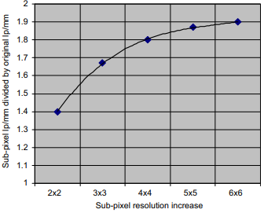
$$K=0$$
$$K=1$$
$$K=3$$
Odd
Even
This compression has a redundancy rate
Cramer Rao Bound
$$σ\left(θ\right)≥\frac{1}{I\left(θ\right)}=\frac{1}{−n E\left[θ\right] {\left(\frac{∂\log\left(f\left(I,θ\right)\right)}{∂ θ}\right)}^{2}}$$
Far field $F≫1$
$$r_{far}≈\sqrt{2⋅\max\left\{2σ_{x},\sqrt{λ\frac{z_{2}}{M}}\right\}+{\left(\frac{Δ x}{M}\right)}^{2}}$$

Slide 22
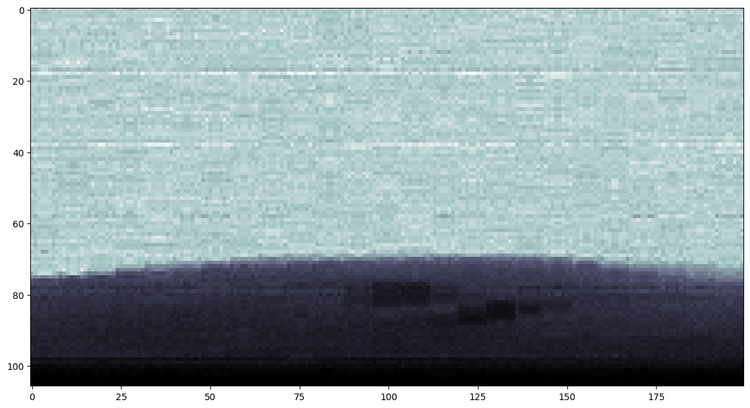
$$I_{detected}=\left[{\left[ Ψ\left(x;λ\right)∗h_{\frac{z_{2}}{M}} \left(x,λ\right)\right]}^{2}∗g\left(x\right)\right]⋅\left[{\left[m\left(y;λ\right)∗h_{\frac{z_{2}}{M}} \left(y,λ\right)\right]}^{2}∗g\left(y\right)\right]$$
$$F=\frac{a^{2}}{Lλ}$$
Near field $F≪1$
$$M=1$$
Experimental results and Conclusions
$$I_{detected}={\left|\left[Ψ\left(x,y;λ\right)⋅m\left(y\right)\right]∗H_{\frac{z_{2}}{M}} \left(x,y,λ\right)\right|}^{2}∗G(x,y)$$
$$r_{near}≈\sqrt{{\left(4σ_{x}\right)}^{2}+{\left(\frac{Δ x}{M}\right)}^{2}}$$
Separable
$$k_{1}$$
$$k_{2}$$
Asymptotic relation
K=4
K=8
K=16
Resolution parallel to mask lines
$$k_{1}\left(x;λ\right)=T\left(x;λ\right)\left[1−\frac{z_{2}}{M k}\frac{∂ \dot{φ}}{∂ x}\right]∗g(x)$$
doi:10.1016/j.nima.2010.06.179

Slide 23
Experimental results and Conclusions
Asymptotic relation
K=4
K=8
K=16
doi:10.1016/j.nima.2010.06.179

Slide 24
K=8
K=16
K=4
FWHM (IC)
$$1×2$$
$$1×4$$
$$1×8$$
Sub-pixel resolution increase

Slide 25
$$I_{detected}=\left[{\left[ Ψ\left(x;λ\right)∗h_{\frac{z_{2}}{M}} \left(x,λ\right)\right]}^{2}∗g\left(x\right)\right]⋅\left[{\left[m\left(y;λ\right)∗h_{\frac{z_{2}}{M}} \left(y,λ\right)\right]}^{2}∗g\left(y\right)\right]$$
$$F=\frac{a^{2}}{Lλ}$$
Near field $F≪1$
$$M=1$$
Remarks and further work
$$I_{detected}={\left|\left[Ψ\left(x,y;λ\right)⋅m\left(y\right)\right]∗H_{\frac{z_{2}}{M}} \left(x,y,λ\right)\right|}^{2}∗G(x,y)$$
$$r_{near}≈\sqrt{{\left(4σ_{x}\right)}^{2}+{\left(\frac{Δ x}{M}\right)}^{2}}$$
Separable
$$k_{1}$$
$$k_{2}$$
Quantum Cramer-Rao bound
Dithering can also be varied performed with energy resolving detectors
Dithering has a theoretical limit that depends on the illumination curve estimation
Dithering is also limited by mechanical constraints
Resolution parallel to mask lines
$$k_{1}\left(x;λ\right)=T\left(x;λ\right)\left[1−\frac{z_{2}}{M k}\frac{∂ \dot{φ}}{∂ x}\right]∗g(x)$$

Slide 26
$$I_{detected}=\left[{\left[ Ψ\left(x;λ\right)∗h_{\frac{z_{2}}{M}} \left(x,λ\right)\right]}^{2}∗g\left(x\right)\right]⋅\left[{\left[m\left(y;λ\right)∗h_{\frac{z_{2}}{M}} \left(y,λ\right)\right]}^{2}∗g\left(y\right)\right]$$
$$F=\frac{a^{2}}{Lλ}$$
Near field $F≪1$
$$M=1$$
$$I_{detected}={\left|\left[Ψ\left(x,y;λ\right)⋅m\left(y\right)\right]∗H_{\frac{z_{2}}{M}} \left(x,y,λ\right)\right|}^{2}∗G(x,y)$$
Remarks and further work
$$r_{near}≈\sqrt{{\left(4σ_{x}\right)}^{2}+{\left(\frac{Δ x}{M}\right)}^{2}}$$
Separable
$$k_{1}$$
$$k_{2}$$
Quantum Cramer-Rao bound
Dithering can also be varied performed with energy resolving detectors
Dithering has a theoretical limit that depends on the illumination curve estimation
Dithering is also limited by mechanical constraints
Thank you!
Resolution parallel to mask lines
$$k_{1}\left(x;λ\right)=T\left(x;λ\right)\left[1−\frac{z_{2}}{M k}\frac{∂ \dot{φ}}{∂ x}\right]∗g(x)$$

Slide 27
Bell MT
Mongolian Baiti

Slide 29
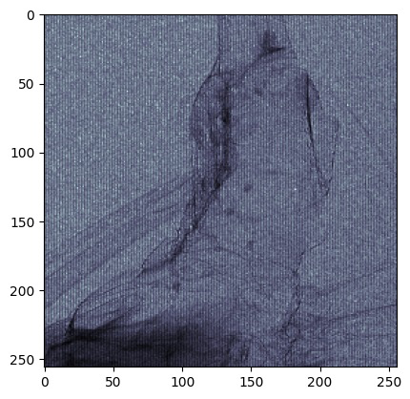

Slide 32
