Slide 1
Feasibility of X-ray phase contrast imaging for angiography
Autor: Camilo Rueda Pérez
Departamento de Física
Facultad de ciencias
Universidad de los Andes

Slide 2
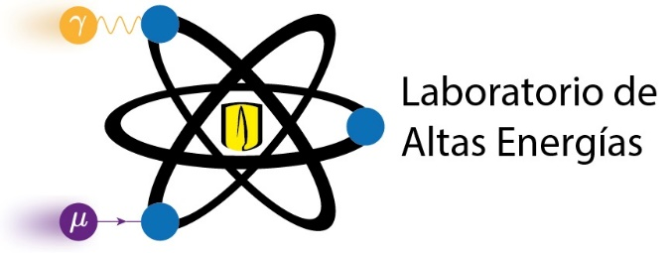
Objectives
General Objective:
To develop a laboratory and computational study in which propagation based X-ray phase contrast imaging method is applied for angiography
Specific objectives:
To design and image phantoms that emulate the constitution of an arteries by propagation based X-ray phase contrast imaging.
To apply Paganin’s phase retrieval algorithm in order to recover phase information of the analyzed samples.
To implement a Monte Carlo code on the McXtrace software which simulates attenuation and phase contrast effects in the evaluated samples analyzed at Universidad de los Andes High Energy Laboratory.

Slide 3
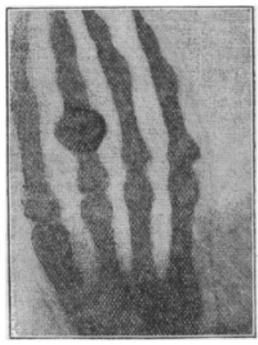
Introduction
X-ray imaging holds significant importance in the present day
1895 - Wilhelm Röntgen
High image quality is associated with acurrate diagnoses
New techniques as X-ray phase contrast imaging have been developed
These contributions bring substantial benefits to society
Figure 1. Hand of Wilhelm Röntgen’s wife. Image taken from: Röntgen, W (1896) On a new kind of rays. Science, Vol 111, No. 59

Slide 4
Complex nature of refractive index
Electrons are modelled as harmonic oscillators.
Incident electric field induces a forced oscillation
Refractive index can be deduced as:
(1)
(2)
(3)

Slide 5
X-ray imaging fundaments
Each component of both electric or magnetic field can be described as:
Where:
Propagation of electromagnetic waves throughout a material is given by Helmholtz’s equation:
(3)
(4)
(5)

Slide 6
X-ray imaging fundaments
The envelope of the spatial part of the electromagnetic field follows:
(6)
Figure 2. Schematic representation of the X-ray propagation throughout a given sample. The convention regarding z and z0 is also presented.

Slide 7
X-ray imaging fundaments
Attenuation X-ray imaging
X-ray intensity can be depicted as
Hence, intensity follows Beer-Lambert’s law:
Where
(7)
(8)

Slide 8
X-ray imaging fundaments
X-ray phase contrast imaging
As it was shown:
Therefore, phase shifts can be defined as:
(9)
(10)

Slide 9
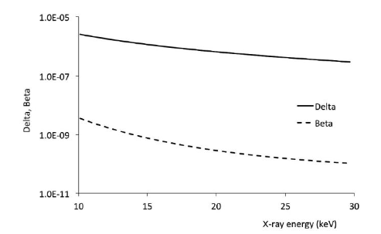
X-ray imaging fundaments
X-ray phase contrast imaging
Henceforth, the propagated wave will follow:
(11)
Figure 3. δ and β coffiecients in a range from 10 to 30 keV for PMMA.
Image taken from: Olivo, A and Castelli, E. (2014) X-ray phase contrast imaging: From synchrotrons to conventional sources, La Rivista del Nuovo Cimento, Vol 37

Slide 10
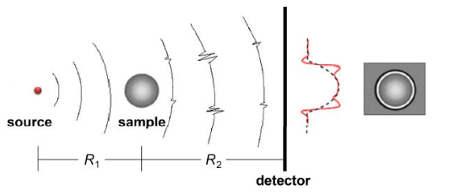
Propagation based imaging
Easiest and cheapiest way to implement XPCi
Requires great distances between sample and detector
Phase effects are amplified
Intensity variations are produced due to phase changes
Figure 4. Schematic representation of In-Line PCi. Image taken from: X. Guo et al (2011) Improving image quality of x-ray in-line phase contrast imaging using an image restoration method, Optic Express, Vol 19, No 23

Slide 11
Paganin phase retrieval algorithm
Transport-of-Intensity equation
Let’s recall that:
For free space:
Accordingly, the propagated wave is related with its intensity and pase variations as:
(12)
(13)
(14)

Slide 12
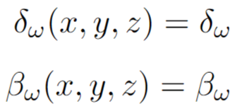
Paganin phase retrieval algorithm
Transport-of-Intensity equation
Paganin phase retrieval algorithm
Some assumptions are made, such as constant values for beta and delta:
With this in mind:
(15)
(16)

Slide 13
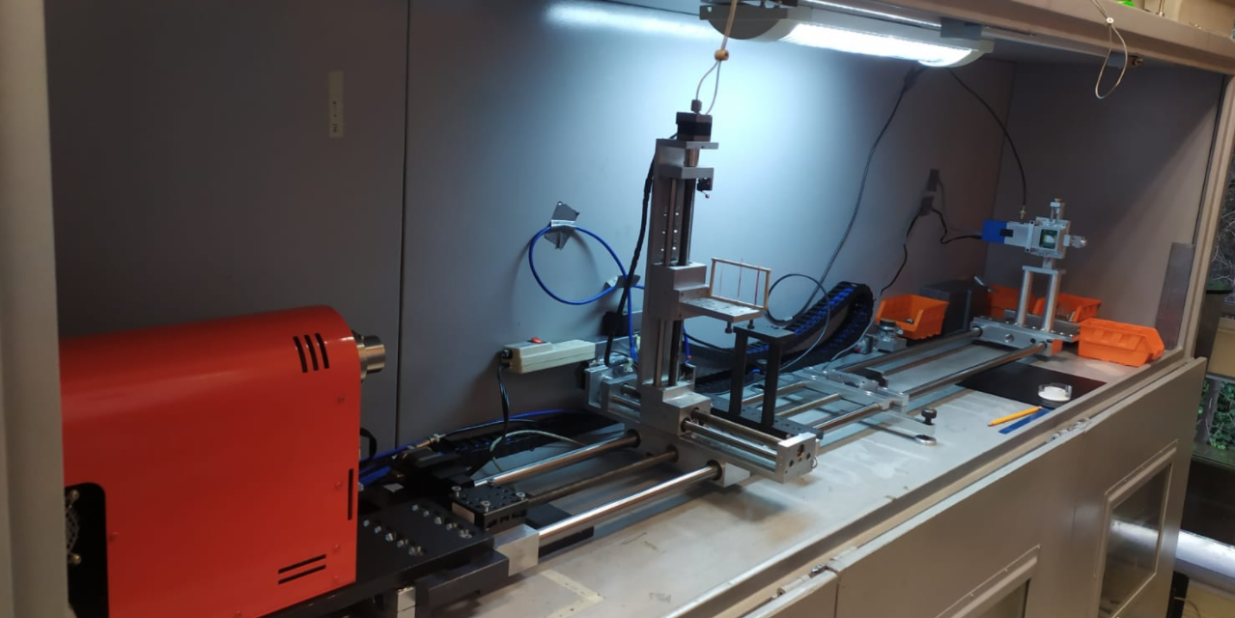
Experimental setup
Hamamatsu L6622-01
Medipix 3RXV1
Sample
Figure 5. Experimental set up

Slide 14
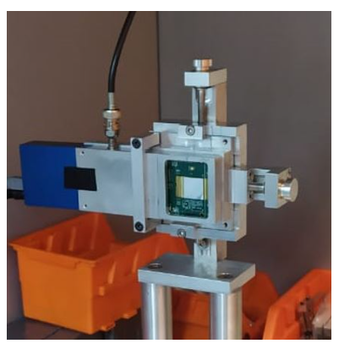
Experimental setup
X-Ray detector: Medipix 3RXV1
Silicon detector
256 x 256 pixel matrix
55 µm each side
-100 V
10 µA
1.8 m from the sample
Figure 6. Medipix 3RXV1 X-Ray detector.

Slide 15
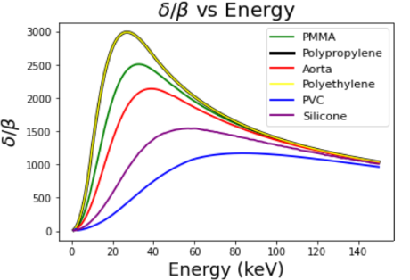
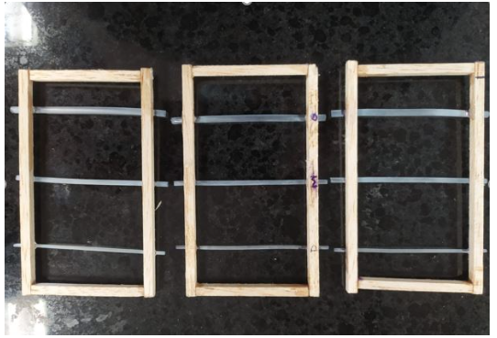
Samples
Artificial Samples
PMMA tubes of 1.94, 2.93 and 3.85 mm of external diameter
Tubes were filled with air, povidone-iodine and artificial blood
Samples were located at 0.6 m from the source
Figure 7. Designs phantoms for the data acquisition
Figure 8. Delta and beta quotient for different materials for a given energy range

Slide 16
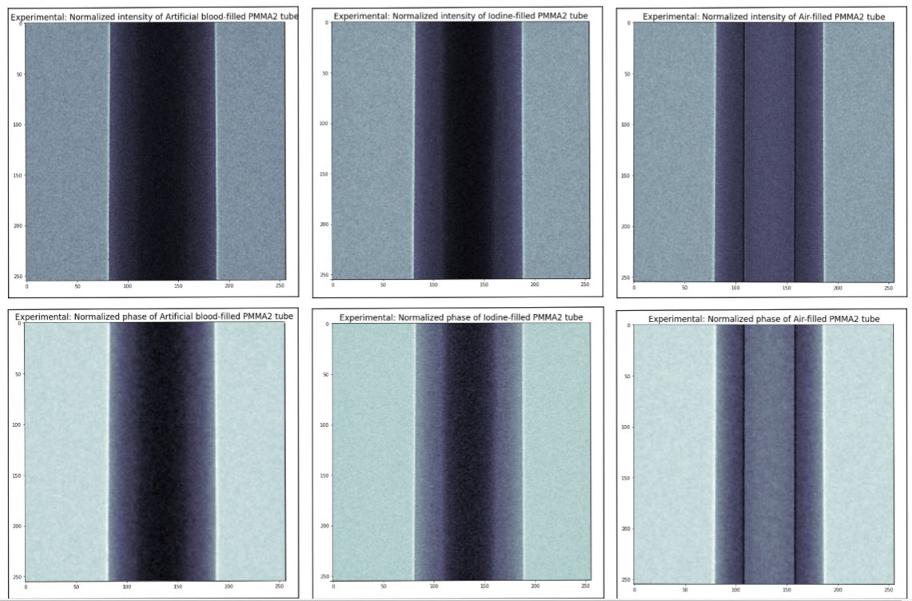
Experimental results
Blood
Iodine
Air

Slide 17
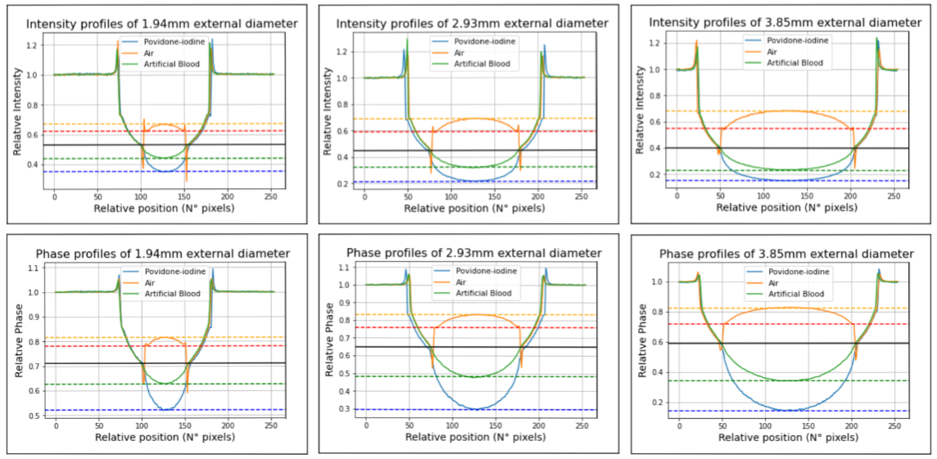
Experimental results
Blood
Iodine
Air

Slide 18
Experimental results
Figure 9. Height of concavities for phase contrast images and phase images when tubes of 1.94 mm, 2.93 mm and 3.85 mm are filled with air, blood and iodine
Figure 10. CNR of phase contrast images and phase images when tubes of 1.94 mm, 2.93 mm and 3.85 mm are filled with air, blood and iodine.

Slide 19
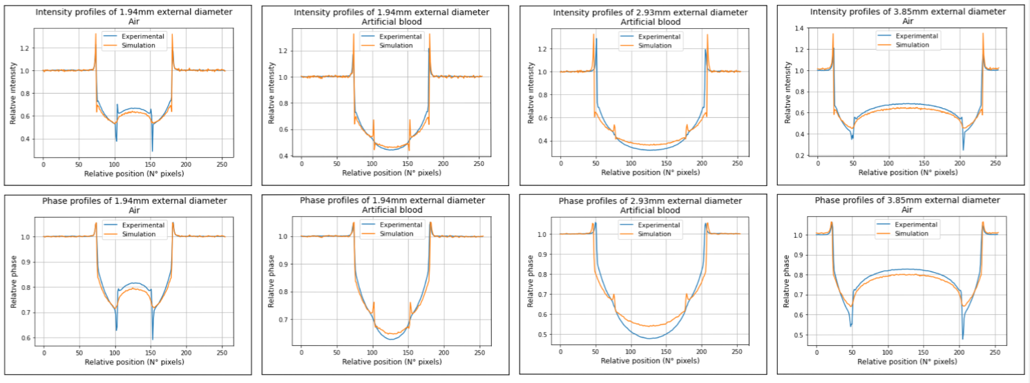
Experimental results
Compared results
Figure 11. Comparison of experimental and computational results

Slide 20
Conclusions
Propagation based X-Ray phase contrast imaging was performed computationally and experimentally for visualizing internal walls of phantom that simulated veins and arteries at the High energy laboratory in Universidad de los Andes.
Phase efects were both visualized and retrieved using Paganin algorithm, which permited to enhance the visualization of the internal walls as well as an increased CNR
Simulations that reproduced and validated the experimental results were carrieded out succesfully

Slide 21
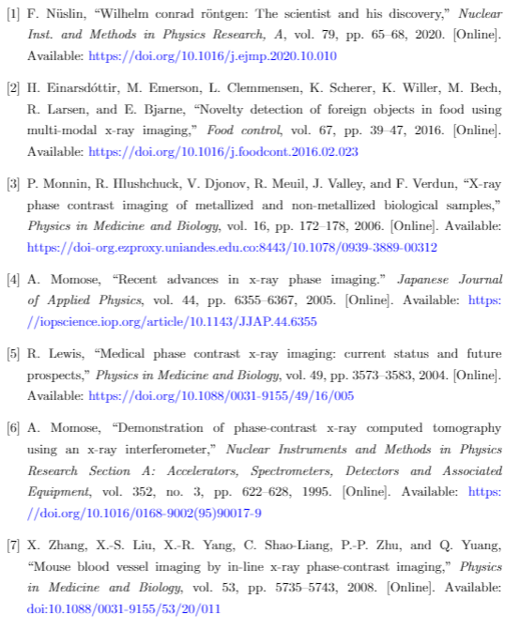
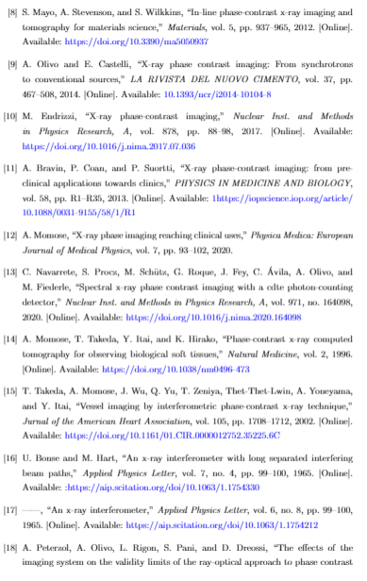
Bibliography

Slide 22
Thanks for your attention

Slide 23
BACK-UP

Slide 24
Complex nature of refractive index
Incident electric field is described as follows:
And, also, there will be a radiation los due to a dampling force effect described as:
(3)
(4)

Slide 25
Complex nature of refractive index
Bonding between electrons and atomic nuclei can be modelated by a potential given by:
Where the bonding force is described as:
(1)
(2)

Slide 26
Complex nature of refractive index
With this in mind, the total force is given by:
Where, assuming that the electric field frequency is grater tan the electron’s natural frequency:
(5)
(6)

Slide 27
Complex nature of refractive index
Furthermore, a summation over all frequencies can be performed and the total polarization can be described as:
Hence, electric susceptibility is given by:
(7)
(8)

Slide 28
Complex nature of refractive index
Which leads towards:
And, consequently, can be reduced as:
(9)
(10)

Slide 29
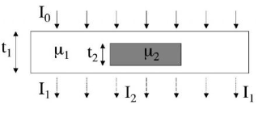
X-ray imaging fundaments
Attenuation X-ray imaging
Intensity variations lead towards contrast definition:
(18)
(19)
Figure 2. Intensities after passing through samples with different attenuation coefficients and thicknesses.
Image taken from: Olivo, A and Castelli, E. (2014) X-ray phase contrast imaging: From synchrotrons to conventional sources, La Rivista del Nuovo Cimento, Vol 37
(20)

Slide 30
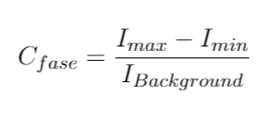
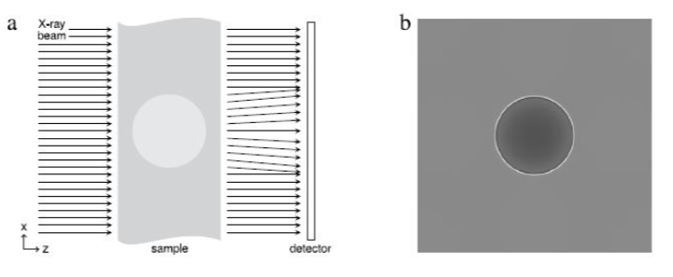
X-ray imaging fundaments
X-Ray phase contrast imaging
Intensity increase in the sample edges is obtained
A new contrast is defined
(27)
(28)
Figure 4. Schematic representation of XRPCi: (a) Sample plane and (b) Intensity distribution image. Image taken from: M. Endrizzi. (2017) X-ray phase contrast imaging, Nuclear Inst. and Methods in Physics Research, Vol 878

Slide 31
McXtrace software
X-ray simulator
Based on Monte-carlo
Quantitative and qualitative analysis
Figure 6. McXtrace. Image taken from: https://www.mcxtrace.org/

Slide 32
Propagation based imaging
Its implementation has been carried out since 1995 by Snigrev et al [34].
Both polychromatic and synchrotron X-Ray sources have benn implemented [36,37].
Investigations regarding the following points have been implemented:
Holotomographies [38].
Tomographies [39].
Coronary arteries [44].
Collagen fibers visualization [46].
Rodent lungs visualization [50].

Slide 33
XPCi Methods
There are 5 main methods for carrying out XPCi
These are:
Interferometric PCi
Propagation based imaging (free-space propagation / In line Pci)
Analyzer based imaging (Diffraction Enhanced imaging)
Grating based imaging
Tracking based methods
Edge Illumination has derived from this

Slide 34
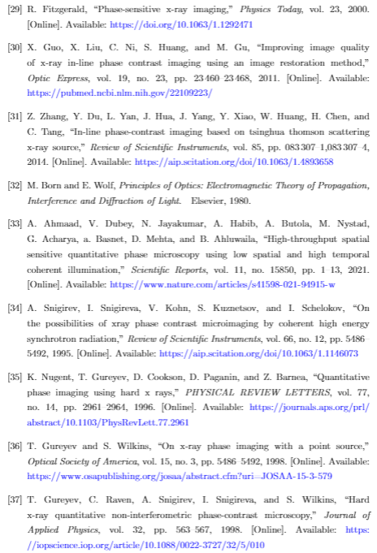
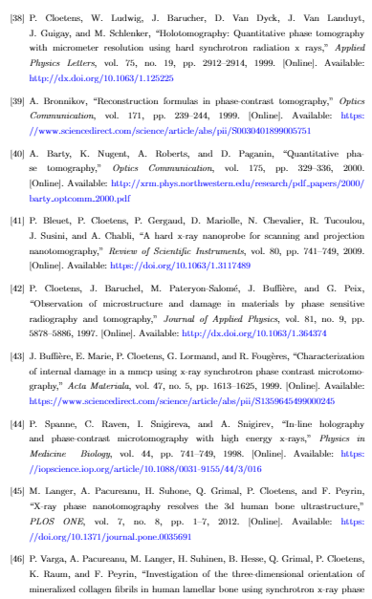
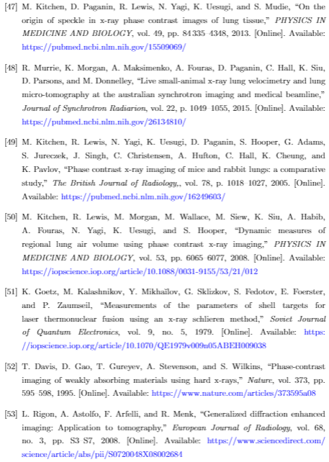
Bibliografía

Slide 35
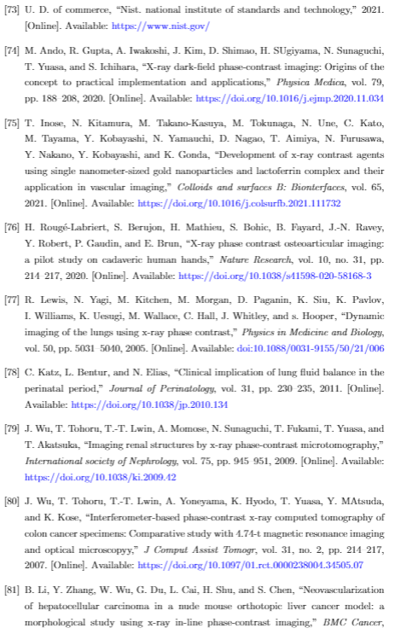
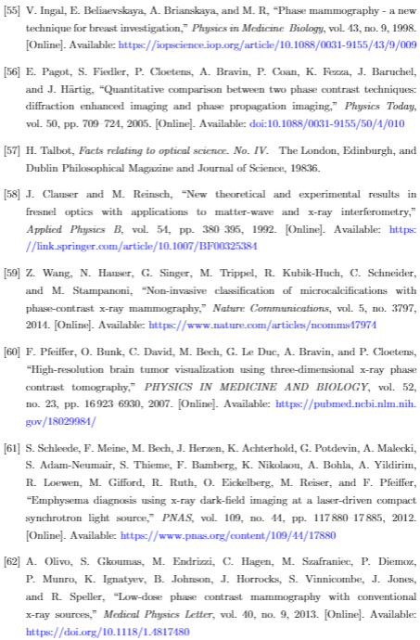
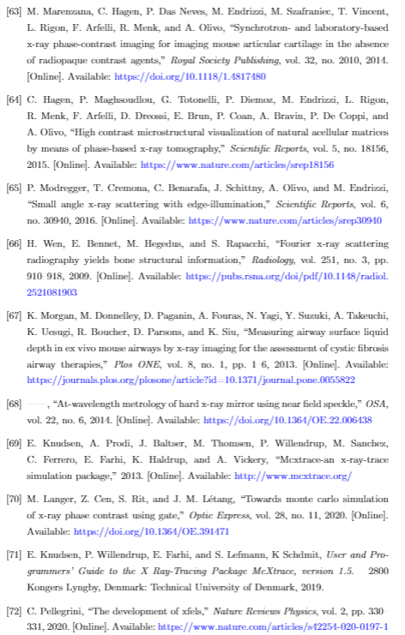
Bibliografía

Slide 36
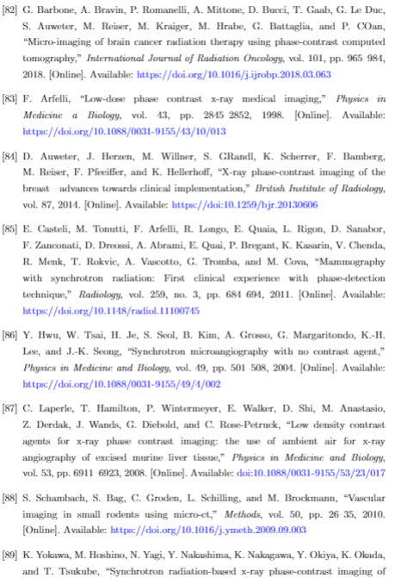
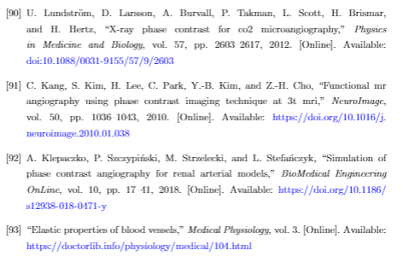
Bibliografía

Slide 37
X-ray imaging fundaments
Attenuation X-ray imaging
A three-dimensional generalization can be performed:
(21)
(22)
(23)

Slide 38
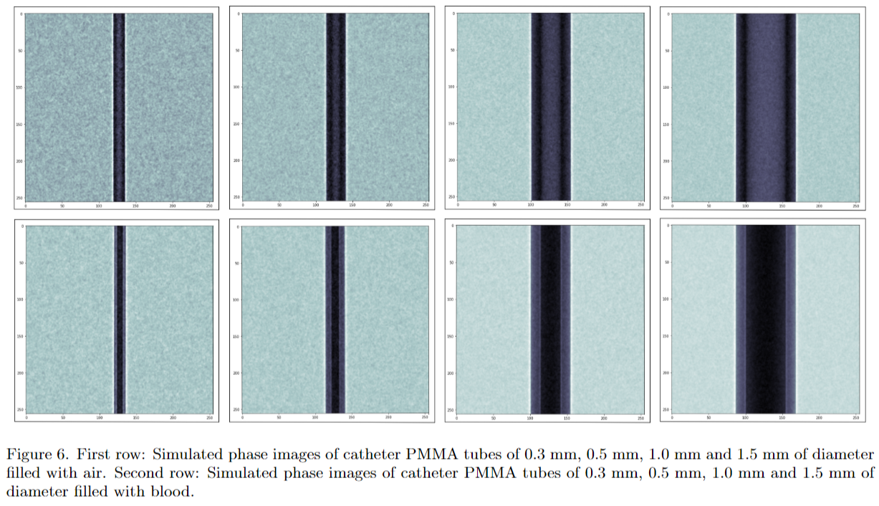
Other results

Slide 39
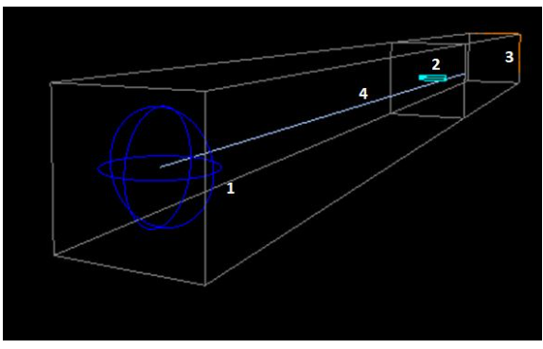
Simulated setup
Punctual X-Ray source
Detector: Pixel Matrix
Sample: Two concentric cylinders
Figure 11. Simulated set up

Slide 40
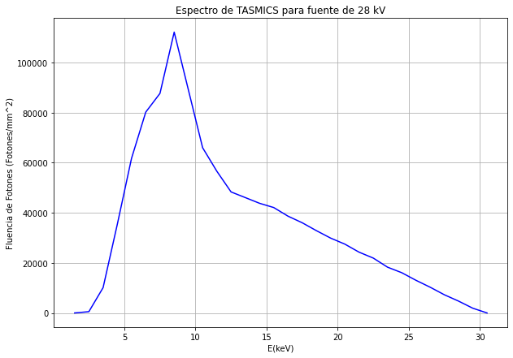
Resultados Computacionales
Muestra: Tubo de PMMA de diversos diámetros externos, lleno de sangre, 60 cm de la fuente
Fuente: Puntual, 30 keV con espectro, cubre ancho del detector
Detector: 256 x 256 píxeles, 55 µm de lado, 1.80 m de la fuente

Slide 41
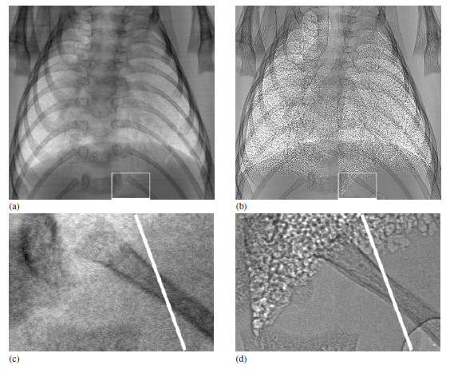
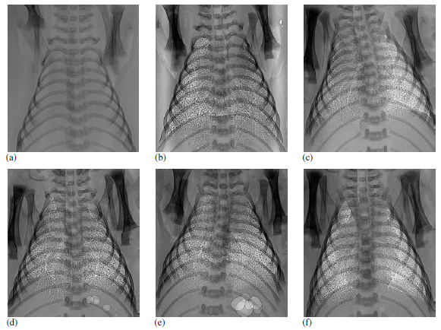
Estado del Arte
PCi en general:

Slide 42
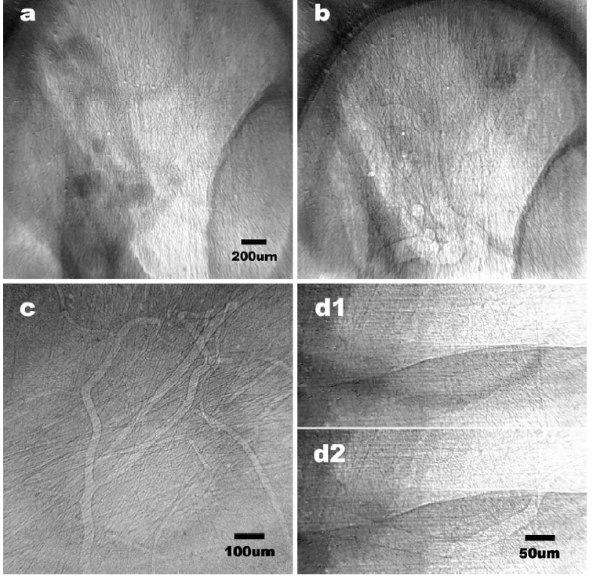
Estado del Arte
PCi en venas y arterias:
Arterias de 8 µm
Ausencia de agentes de contraste.

Slide 43
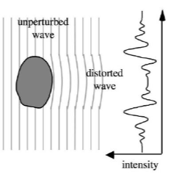
Creación de Imágenes por rayos X
Creación de imágenes por contraste de fase
Dos interpretaciones matemáticas para el contraste de fase
Frentes de onda
Figura 5. Frentes de onda que atraviesan una muestra con un factor δ menor al del medio que lo rodea. Imagen tomada de: Olivo, A and Castelli, E. (2014) X-ray phase contrast imaging: From synchrotrons to conventional sources, La Rivista del Nuovo Cimento, Vol 37

Slide 44
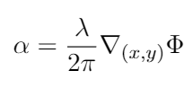
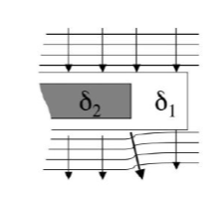
Creación de Imágenes por rayos X
Creación de imágenes por contraste de fase
Dos interpretaciones matemáticas para el contraste de fase
2. Rayos perpendiculares a frentes de onda
(14)
Figura 6. Representación de como los cambios en los frentes de onda pueden ser interpretados como cambios en la dirección de propagación de los rayos X. Imagen tomada de: Olivo, A and Castelli, E. (2014) X-ray phase contrast imaging: From synchrotrons to conventional sources, La Rivista del Nuovo Cimento, Vol 37

Slide 45
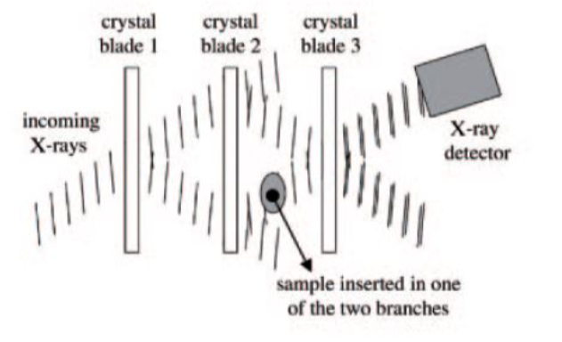
Interferometría en PCi
Propuesto por Bonse y Hart (1965)
Se basa en la interferencia de rX
Una muestra causa distorsiones en el frente de onda
Cambios de intensidades se interpretan como cambios en la fase
Figura 7. Efecto de una muestra sobre los frentes de onda en uno de los brazos de un interferómetro de rayos X. Imagen tomada de: Olivo, A and Castelli, E. (2014) X-ray phase contrast imaging: From synchrotrons to conventional sources, La Rivista del Nuovo Cimento, Vol 37

Slide 46
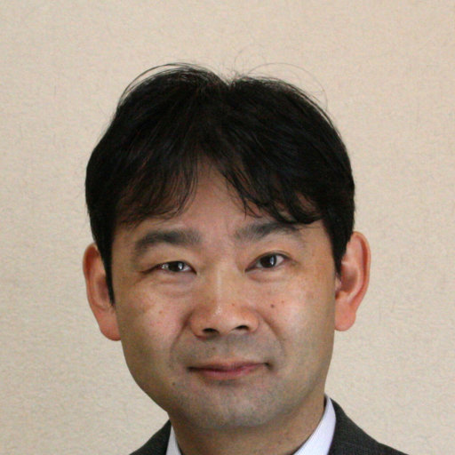
Interferometría en PCi
Su uso se masificó en años 90
A. Momose et al son promotores de esta
Ha tenido amplio desarrollo:
PCi en compuestos orgánicos
PCi en seres vivos
PCi en cerebros
Efectividad de PCi para sangre humana
Lesiones cancerígenas
Tejidos Blandos
Cáncer de mama
Figura 8. Atsushi Momose

Slide 47
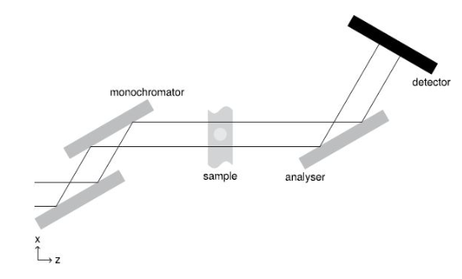
Analyzer Based PCi
Montaje más sofisticado y complejo
Uso de filtros angulares
Figura 10. Representación esquemática del método de Analyzer based imaging. Imagen tomada de: M. Endrizzi. (2017) X-ray phase contrast imaging, Nuclear Inst. and Methods in Physics Research, Vol 878.

Slide 48
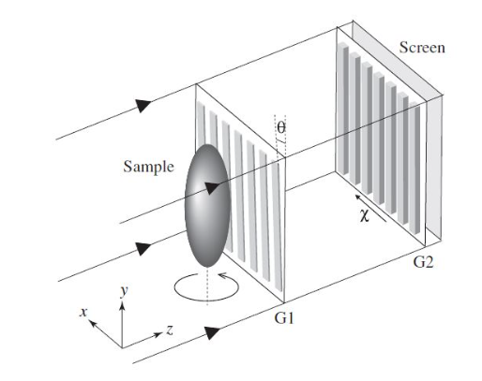
Grating Based PCi
Uso de rejillas que impiden el paso de cierta porción de fotones
Refracción de la muestra representa cambios en la intensidad
Figura 11. Representación esquemática del método de Grating Based imaging. Imagen tomada de: A. Momose, (2005) Recent advances in x-ray phase imaging, Japanese Journal of Applied Physics, Vol 44.

Slide 49
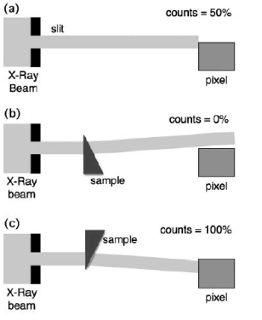
Edge Illumination
Uso de máscaras en detectores y previos a la muestra
Sin muestra, se quiere que detectores cuente 50% de fotones que atraviesan la primera muestra
Figura 12. Principio del método Edge Illumination. Imagen tomada de: M. Endrizzi. (2017) X-ray phase contrast imaging, Nuclear Inst. and Methods in Physics Research, Vol 878.

Slide 50
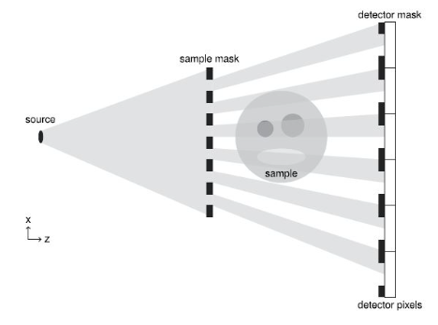
Edge Illumination
Con muestra, la refracción induce cambios de intensidad
Cambios de fase se miden gracias a cambios en intensidad
Figura 13. Representación esquemática del método de Edge Illumination. Imagen tomada de: M. Endrizzi. (2017) X-ray phase contrast imaging, Nuclear Inst. and Methods in Physics Research, Vol 878.

Slide 51
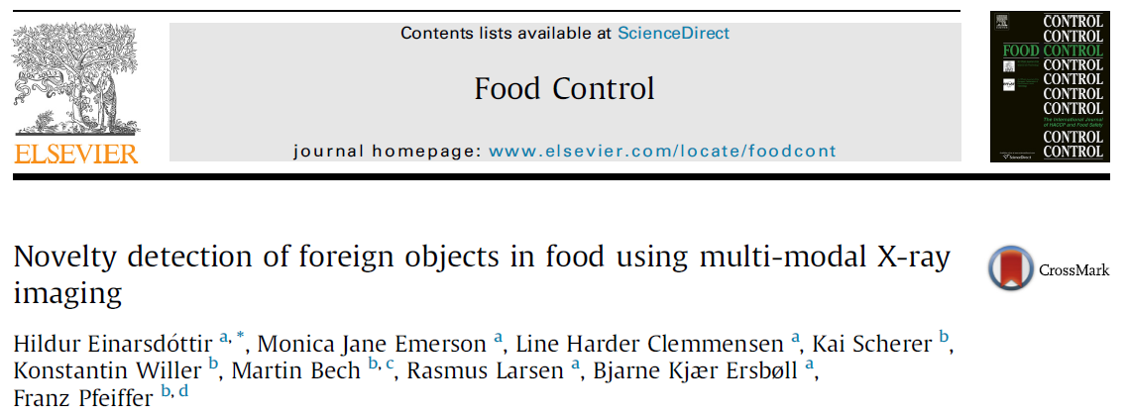
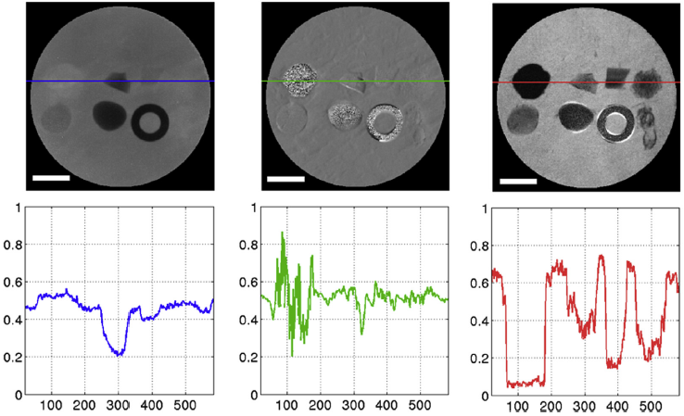
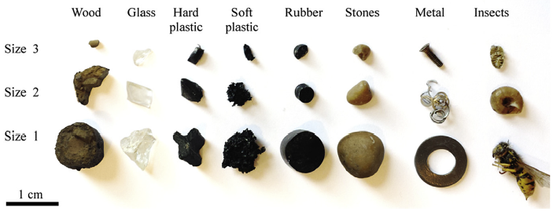
Estado del Arte
PCi en general:

Slide 52
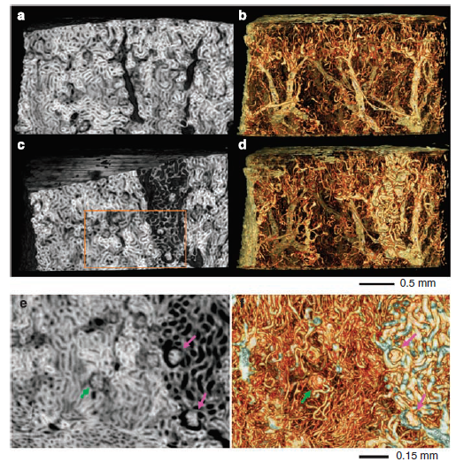
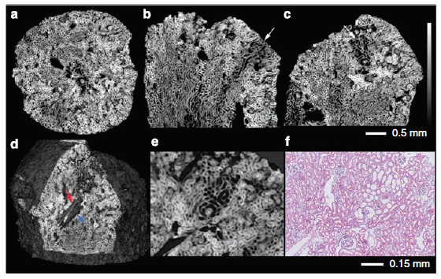
Estado del Arte
PCi en general:

Slide 53
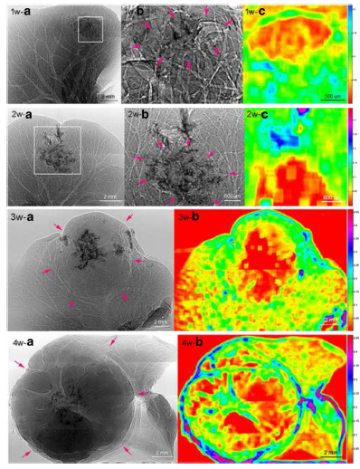
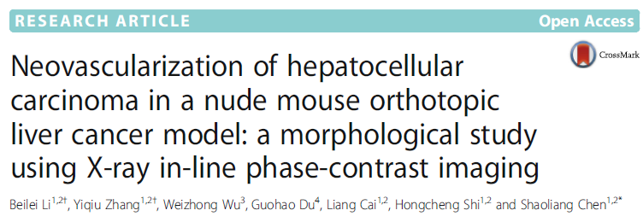
Estado del Arte
PCi en general:

Slide 54
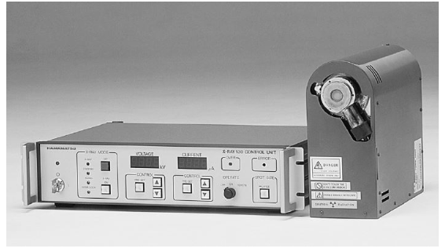
Montaje Experimental
Hamamatsu L6622-01
Punto focal de 10 µm
Ventana de Be 200 µm
Target de Tungsteno
20-130 kV
0-250 µA
3 mSv/h
Figura 15. Fuente de rayos X Hamamatsu L6622-01. Imagen tomada del datasheet de este mismo
.

Slide 55
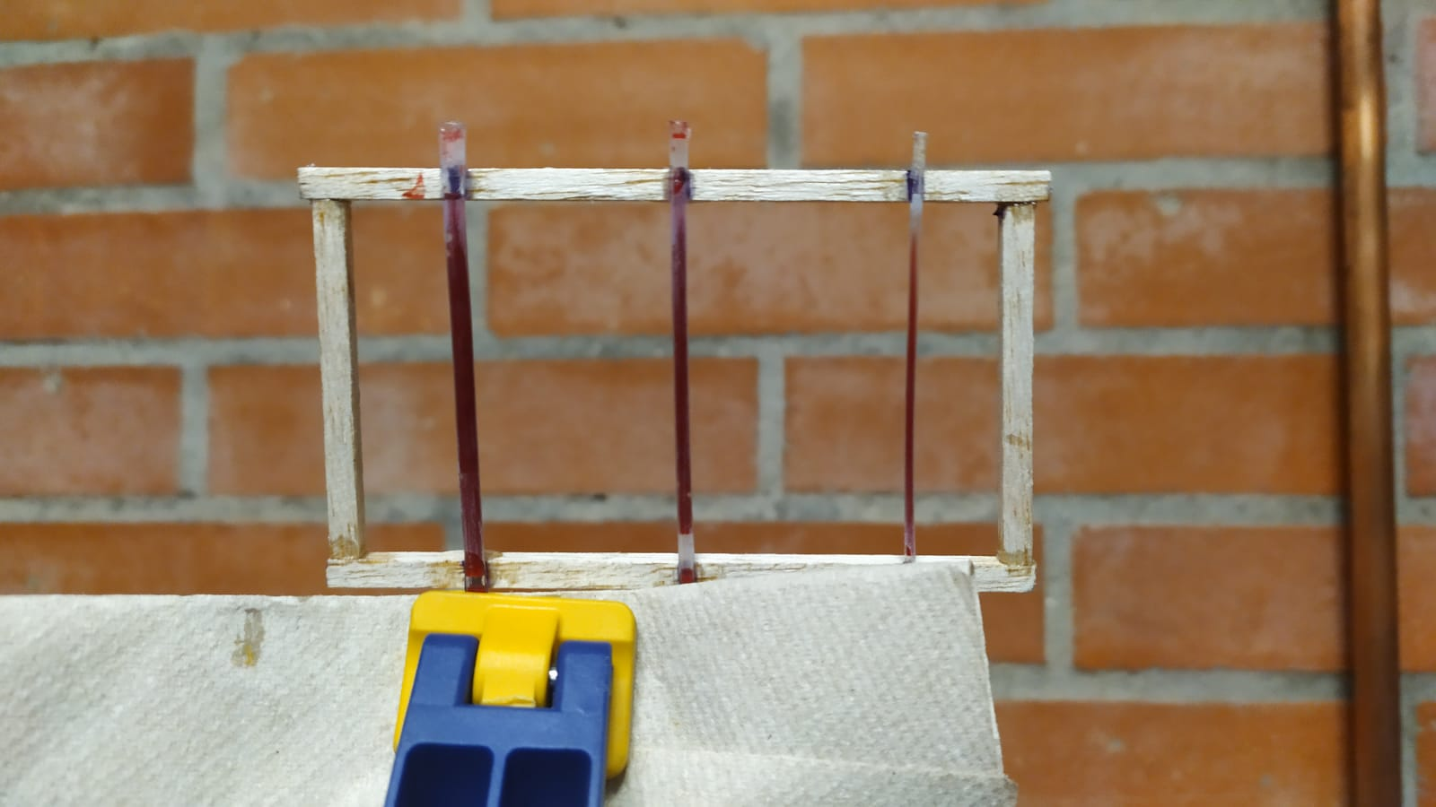
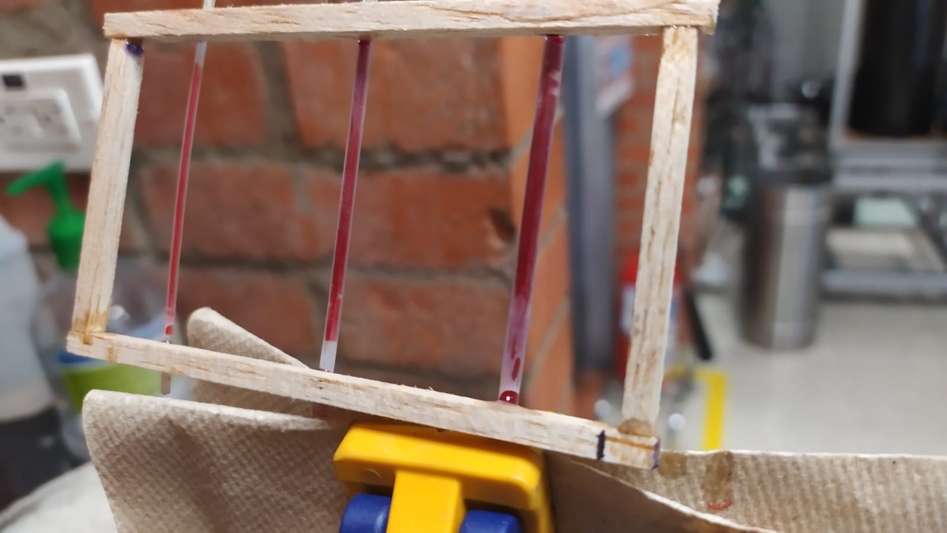
Preparación de Muestras

