Slide 1
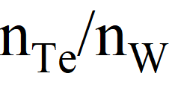






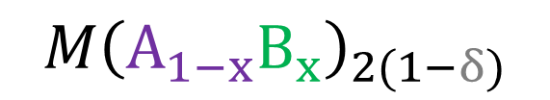

Defect-induced ferroic states in solid solutions of layered van der Waals materials
$$M{\text{A}}_{2}$$
$$M{\left(A_{1−x}B_{x}\right)}_{2(1−δ)}$$
$$M{\text{B}}_{2}$$
Ferromagnetic semiconductor
Multiferroic semiconductor
Ferroelectric
semimetal
$$W{\text{Se}}_{2}$$
$$W{\text{Te}}_{2}$$
$$W{\text{S}}_{2}$$
$$W{\text{Te}}_{2}$$
H. Rojas, PGG et al., arXiv:2603.08515 (2026)
G. Cardenas-Chirivi, PGG et al., npj 2D Mat. and Appl. 7 (2023) 54
Paula Giraldo-Gallo
Universidad de Los Andes
Bogotá, Colombia
5th Workshop on Statistical Physics- April of 2026
Notes:
All at room temperature

Slide 2

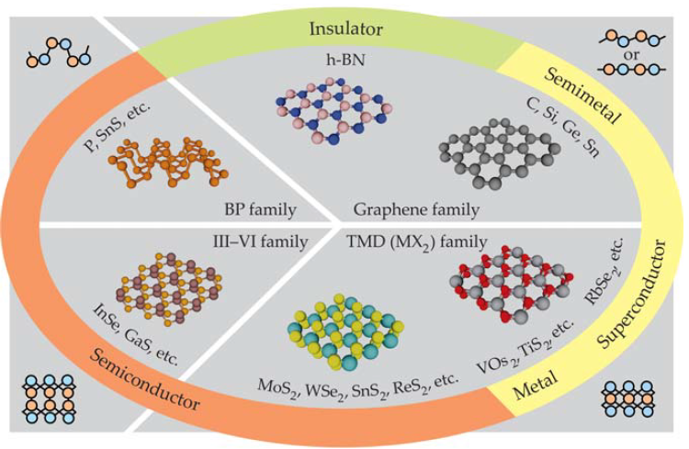
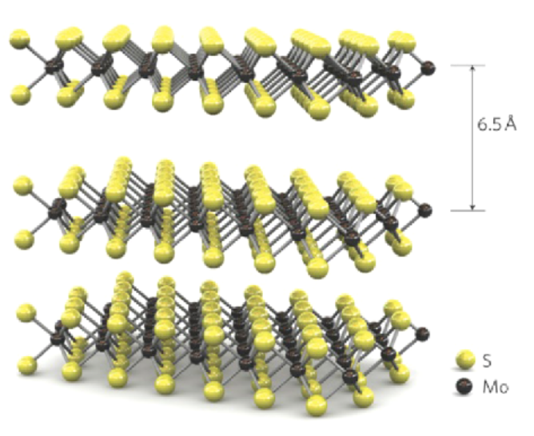


2D - Van der Waals materials
MX₂
Transition metal dichalcogenides
Semiconducting
MoS₂, MoSe₂ (2H)
WS₂, WSe₂
$$M{\left(A_{1−x}B_{x}\right)}_{2}$$
Metallic
NbS₂, NbSe₂ , NbTe₂, TaS₂, TaSe₂, WTe₂, MoTe₂ (1T’)
$$M{\left(A_{1−x}B_{x}\right)}_{2(1−δ)}$$
Promotes ferroic states which are robust to dimensional confinement!
P. Ajayan et al., Physics Today 69, 9, 38 (2016).
S. Manzeli et at., Nat. Rev. 2 (2017) 17033

Slide 3
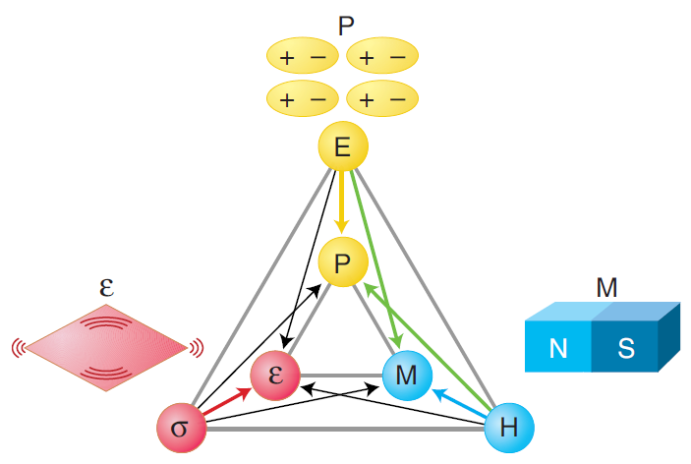
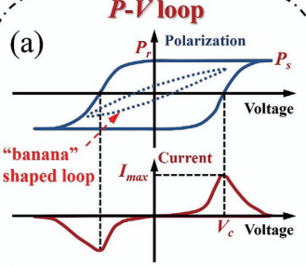
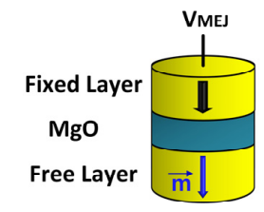
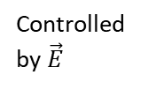
Ferroic orders and multiferroicity
Ferroelectricity
Individual ferroic states
Non-volatile data storage
FeRAM (ferro-electric RAM)
Ferroelasticity
Ferromagnetism
MeRAM (Magneto-electric RAM)
Magnetoelectric multiferroics
Electric-field controlled magnetic data storage
Magnetically modulated piezoelectrics
Multifunctional devices: single device, multiple tasks.
Controlled by $\vec{E}$
Spaldin N. & Fiebig M., Science 309 (2005) 391-392.

Slide 4
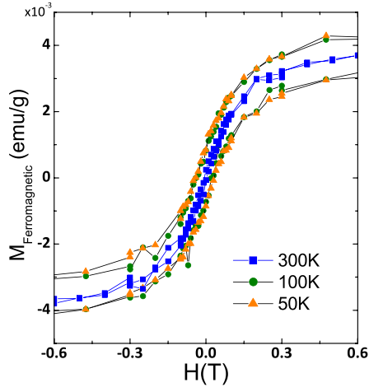
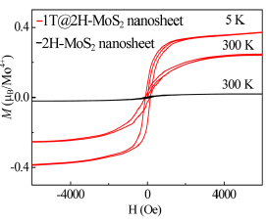
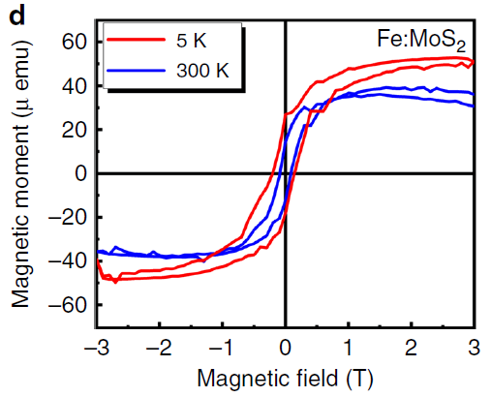
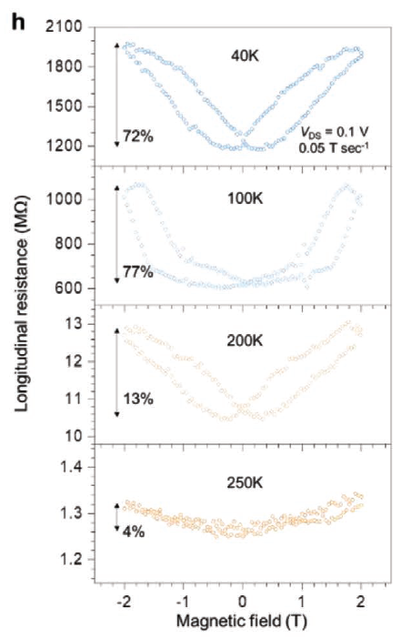
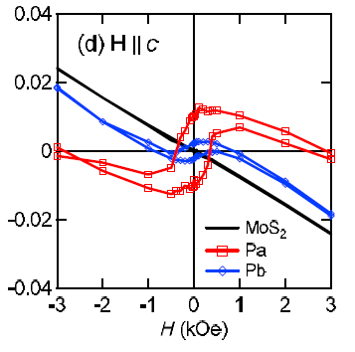
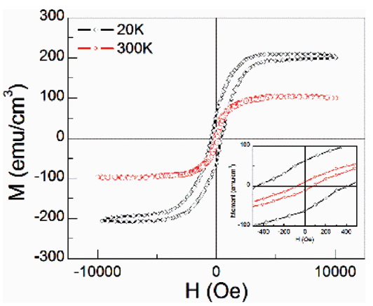
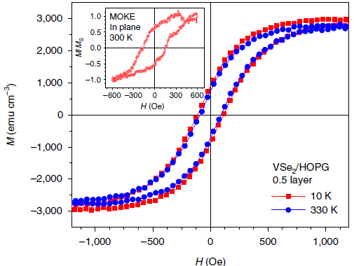
Ferroic orders in TMDs: Ferromagnetism
MoS₂ (bulk)
MoS₂ (nanosheets)
Fe-doped MoS₂ (monolayer)
V-doped WSe₂ (monolayer)
Appl. Phys. Lett. 101, 123105 (2012).
Adv. Mater. 34 (2022) 2106551
Nat. Comm.
11 (2020) 2034
J. Am. Chem. Soc. 2015, 137, 2622−2627
WSe₂ (nanosheets)
1T-VSe₂ (monolayer)
@RT, proton irr.
PRL 110, 247201 (2013)
Nanoscale 9 (2017) 4898
Nat. Nanotech.
13 (2018) 289

Slide 5
Ferroic orders in TMDs: Ferromagnetism
MoS₂ (bulk)
MoS₂ (nanosheets)
Fe-doped MoS₂ (monolayer)
V-doped WSe₂ (monolayer)
Appl. Phys. Lett. 101, 123105 (2012).
Adv. Mater. 34 (2022) 2106551
Nat. Comm.
11 (2020) 2034
J. Am. Chem. Soc. 2015, 137, 2622−2627
DEFECTS!
WSe₂ (nanosheets)
1T-VSe₂ (monolayer)
@RT, proton irr.
PRL 110, 247201 (2013)
Nanoscale 9 (2017) 4898
Nat. Nanotech.
13 (2018) 289

Slide 6
Ferroic orders in TMDs: Ferromagnetism
MoS₂ (bulk)
MoS₂ (nanosheets)
Fe-doped MoS₂ (monolayer)
V-doped WSe₂ (monolayer)
Appl. Phys. Lett. 101, 123105 (2012).
DOPANTS
Adv. Mater. 34 (2022) 2106551
Nat. Comm.
11 (2020) 2034
J. Am. Chem. Soc. 2015, 137, 2622−2627
CRYSTALLINE ENVIRONMENT → 1T!
DEFECTS!
WSe₂ (nanosheets)
1T-VSe₂ (monolayer)
@RT, proton irr.
PRL 110, 247201 (2013)
Nanoscale 9 (2017) 4898
Nat. Nanotech.
13 (2018) 289

Slide 7
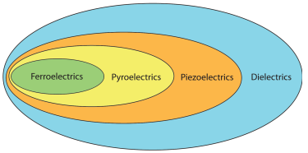
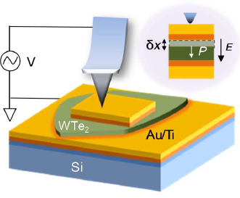
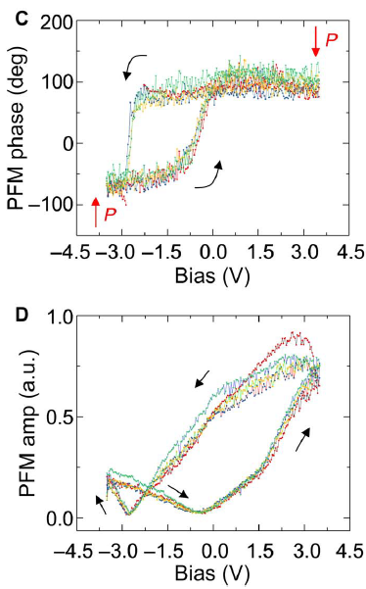
Ferroic orders in TMDs: Ferroelectricity
1Td-WTe₂ (bulk)
Piezoelectricity
SS-PFM
Science adv. 5 (2019) eaax5080
Khanbareh,, TU Delft (2016).
domain orientation
deformation
Notes:
Ss-pmf → switching spectroscopy PFM

Slide 8
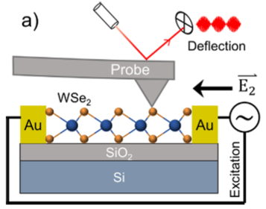
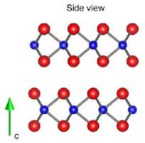
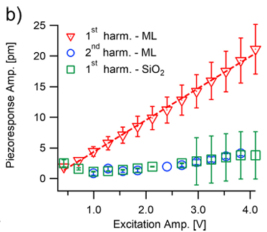
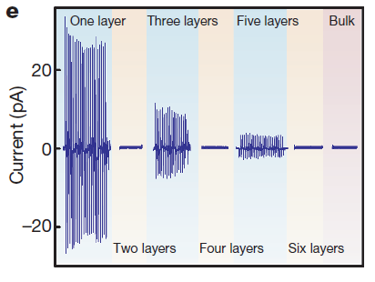
Ferroic orders in TMDs: Ferroelectricity
1Td-WTe₂ (bulk)
WSe₂ (monolayer)
Piezoelectricity
Science adv. 5 (2019) eaax5080
Khanbareh,, TU Delft (2016).
domain orientation
Nano Energy 52 (2018) 117
Non-centrosymmetric structures
deformation
Nature 514 (2014) 470
Notes:
Ss-pmf → switching spectroscopy PFM

Slide 9
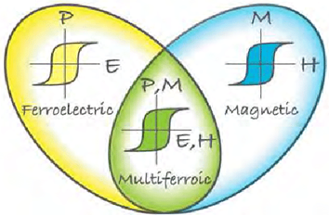
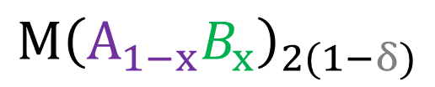



General Strategy
$${M\text{A}}_{2}$$
$${M\left(A_{1−x}B_{x}\right)}_{2}$$
$$M{\text{B}}_{2}$$
(ferro)magnetic semiconductor
Solid solution
Ferroelectric
semimetal
1T CRYSTALLINE ENVIRONMENT
$$M{\left(A_{1−x}B_{x}\right)}_{2(1−δ)}$$
DOPANTS
DEFECTS!
Move FE state into semiconducting regime → memories!
No need for nanostructuring to the monolayer limit
Generate/strengten FM in bulk material
survives to nanostructuration
Khomskii, D. Physics, 2 (2020) 20.
Create multiferroics → Multifunctional platform
G. Cardenas-Chirivi, PGG et al., npj 2D Mat. and Appl. 7 (2023) 54
H. Rojas, PGG et al., arXiv:2603.08515 (2026)

Slide 10
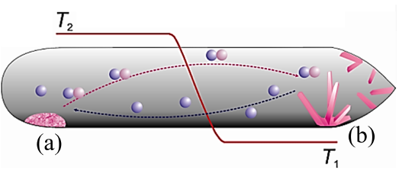
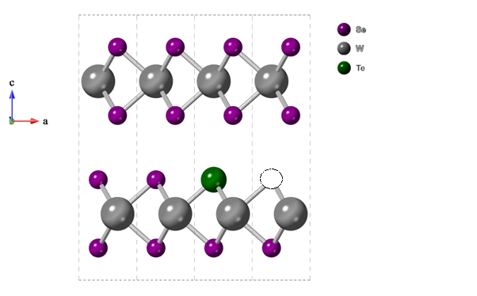
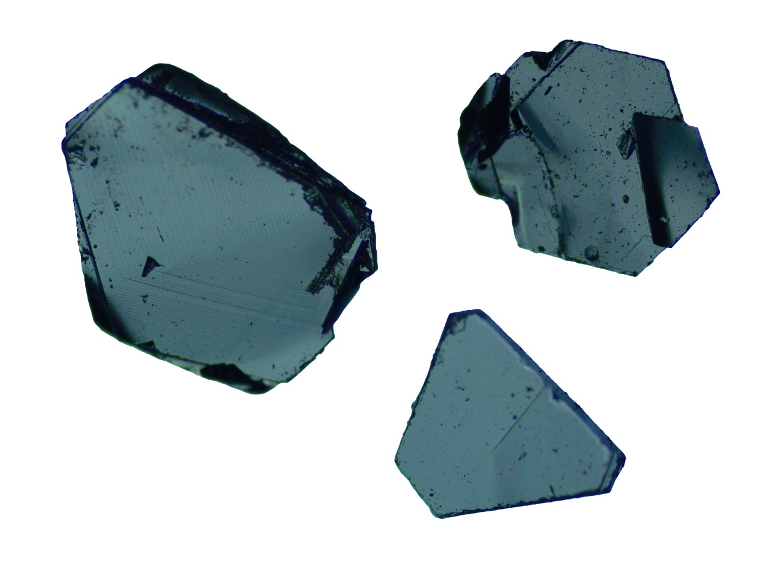
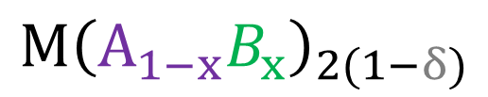
Single crystal growth
$${M\text{A}}_{2}$$
$${M\left(A_{1−x}B_{x}\right)}_{2}$$
$$M{\text{B}}_{2}$$
(ferro)magnetic semiconductor
Solid solution
Ferroelectric
semimetal
XRF
$$M{\left(A_{1−x}B_{x}\right)}_{2(1−δ)}$$
Solid solution single crystals
Synthesis by chemical vapor transport
Chalcogen interstitial (δ<0)
Chalcogen vacancies (δ>0)
Lowest formation energy
1 mm
G. Cardenas-Chirivi, PGG et al., npj 2D Mat. and Appl. 7 (2023) 54
H. Rojas, PGG et al., arXiv:2603.08515 (2026)

Slide 11






Single crystal growth
$${M\text{A}}_{2}$$
$${M\left(A_{1−x}B_{x}\right)}_{2}$$
$$M{\text{B}}_{2}$$
Solid solution
(ferro)magnetic semiconductor
Ferroelectric
semimetal
$$M{\left(A_{1−x}B_{x}\right)}_{2(1−δ)}$$
$$W{\text{Se}}_{2}$$
$$W{\text{Te}}_{2}$$
$$W{\text{S}}_{2}$$
$$W{\text{Te}}_{2}$$
$$Mo{\text{Se}}_{2}$$
$$Mo{\text{Te}}_{2}$$
$$Mo{\text{S}}_{2}$$
$$Mo{\text{Te}}_{2}$$
H. Rojas, PGG et al., arXiv:2603.08515 (2026)
G. Cardenas-Chirivi, PGG et al., npj 2D Mat. and Appl. 7 (2023) 54
Ramón Támara, PGG, et al., In preparation (2026)

Slide 12

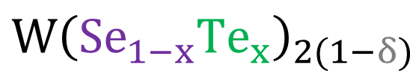
WSe₂→WTe₂ Phase Diagram
$$W{\left(Se_{1−x}Te_{x}\right)}_{2(1−δ)}$$
$\frac{n_{Se}}{n_{W}}+$ $\frac{n_{Te}}{n_{W}}=2$
G. Cardenas-Chirivi, PGG et al., npj 2D Mat. and Appl. 7 (2023) 54
H. Rojas, PGG et al., arXiv:2603.08515 (2026)

Slide 13
WSe₂→WTe₂ Phase Diagram
$$W{\left(Se_{1−x}Te_{x}\right)}_{2(1−δ)}$$
x
$\frac{n_{Se}}{n_{W}}+$ $\frac{n_{Te}}{n_{W}}=2$
G. Cardenas-Chirivi, PGG et al., npj 2D Mat. and Appl. 7 (2023) 54
H. Rojas, PGG et al., arXiv:2603.08515 (2026)

Slide 14
WSe₂→WTe₂ Phase Diagram
$$W{\left(Se_{1−x}Te_{x}\right)}_{2(1−δ)}$$
δ
G. Cardenas-Chirivi, PGG et al., npj 2D Mat. and Appl. 7 (2023) 54
H. Rojas, PGG et al., arXiv:2603.08515 (2026)

Slide 15
WSe₂→WTe₂ Phase Diagram
$$W{\left(Se_{1−x}Te_{x}\right)}_{2(1−δ)}$$
δ<0
(Se,Te) interstitials
δ>0
(Se,Te) vacancies
G. Cardenas-Chirivi, PGG et al., npj 2D Mat. and Appl. 7 (2023) 54
H. Rojas, PGG et al., arXiv:2603.08515 (2026)

Slide 16
WSe₂→WTe₂ Phase Diagram
$$W{\left(Se_{1−x}Te_{x}\right)}_{2(1−δ)}$$
Interstitials
vacancies
G. Cardenas-Chirivi, PGG et al., npj 2D Mat. and Appl. 7 (2023) 54
H. Rojas, PGG et al., arXiv:2603.08515 (2026)

Slide 17
WSe₂→WTe₂ Phase Diagram
$$W{\left(Se_{1−x}Te_{x}\right)}_{2(1−δ)}$$
Interstitials
vacancies
G. Cardenas-Chirivi, PGG et al., npj 2D Mat. and Appl. 7 (2023) 54
H. Rojas, PGG et al., arXiv:2603.08515 (2026)

Slide 18
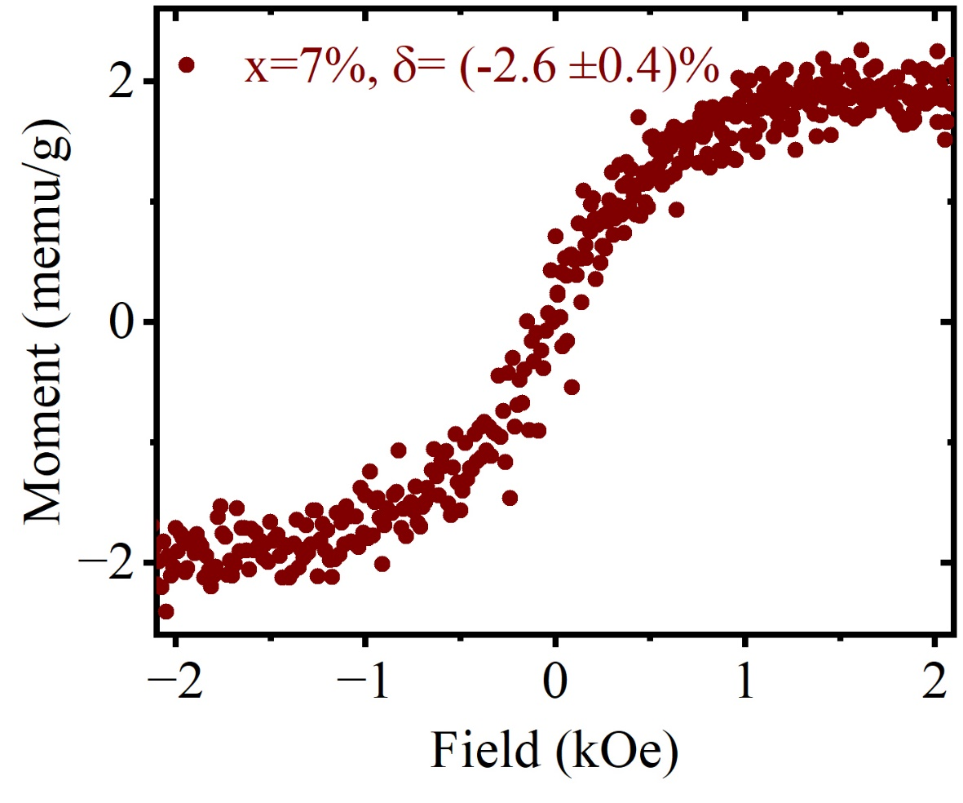
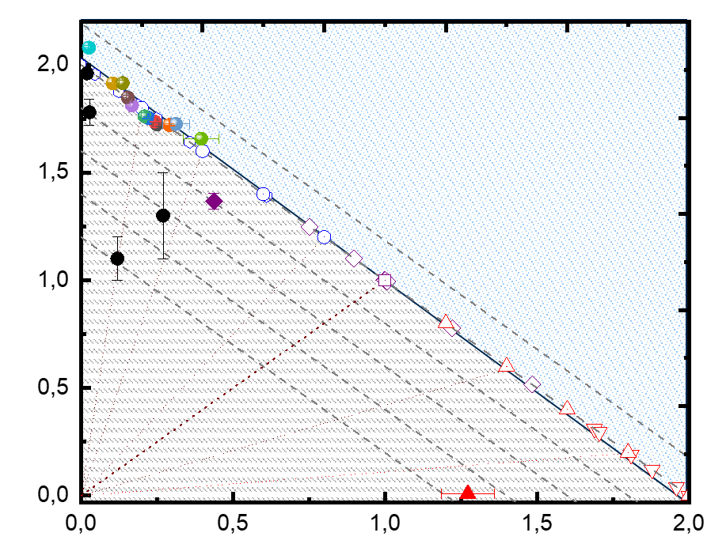
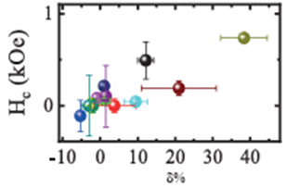
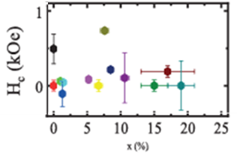
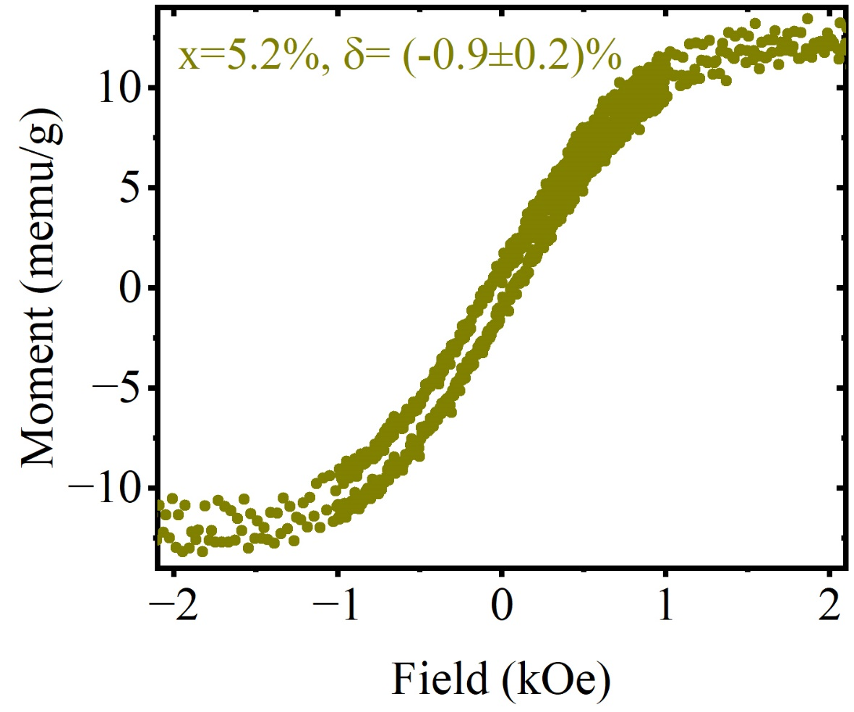
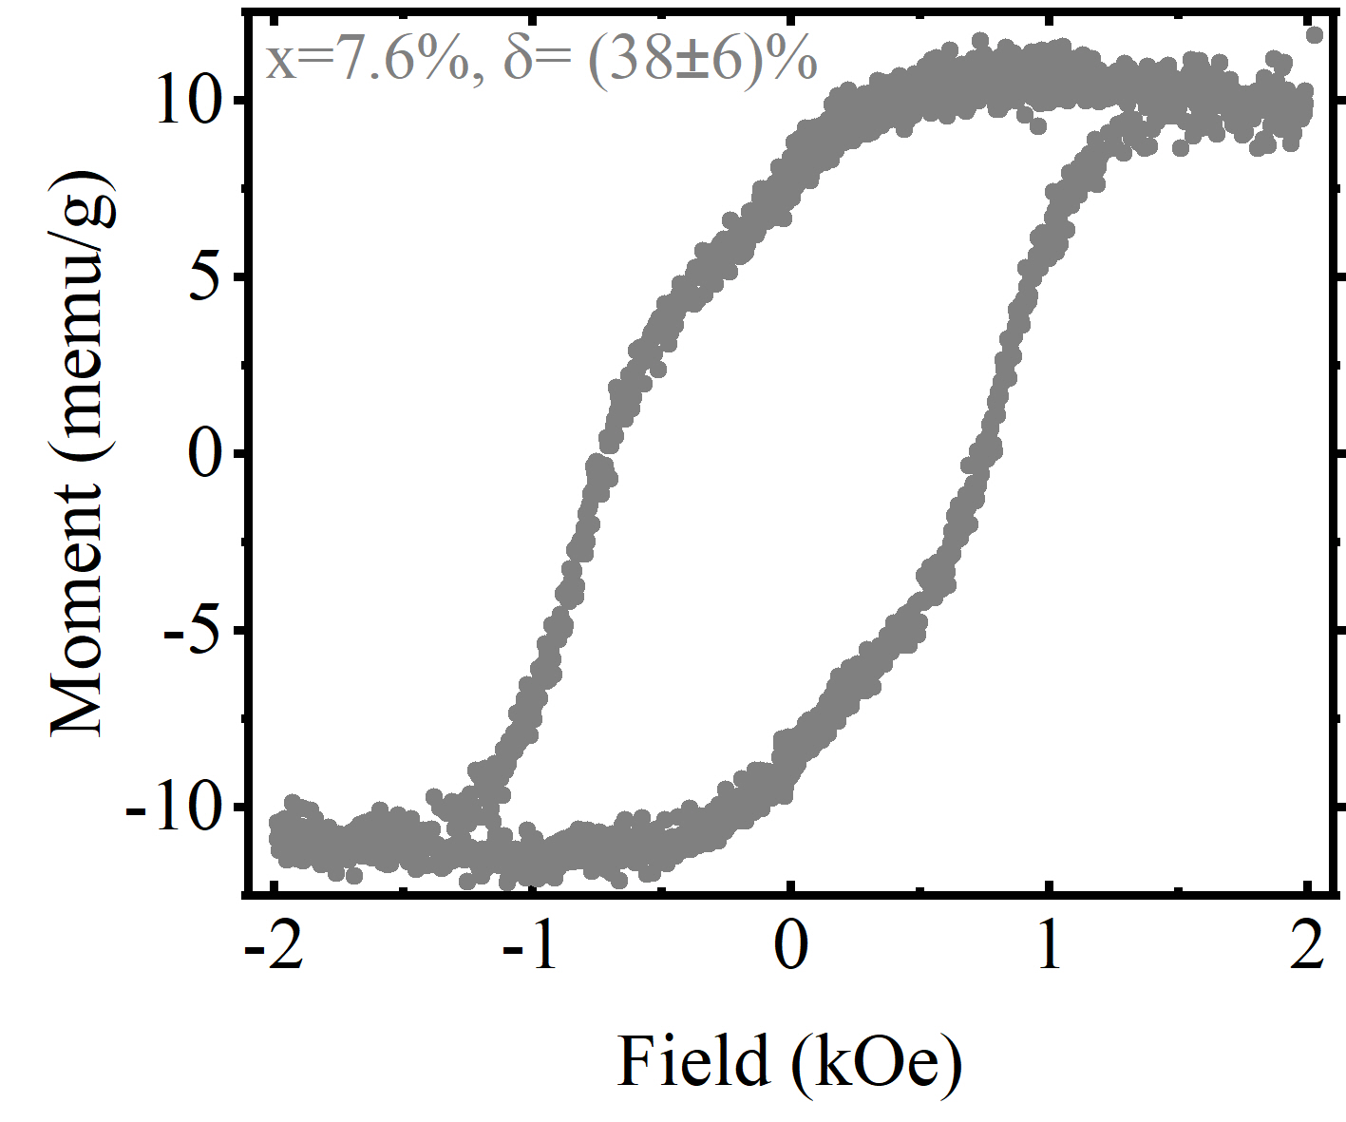
WSe₂→WTe₂ : Magnetism
Coercive Field
Vacancies strenghten Ferromagnetism
G. Cardenas-Chirivi, PGG et al., npj 2D Mat. and Appl. 7 (2023) 54
H. Rojas, PGG et al., arXiv:2603.08515 (2026)

Slide 19
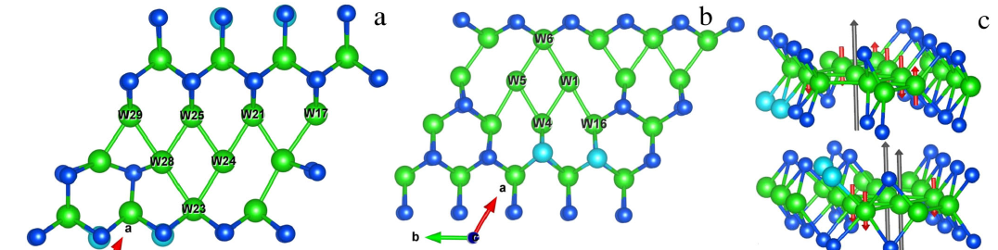
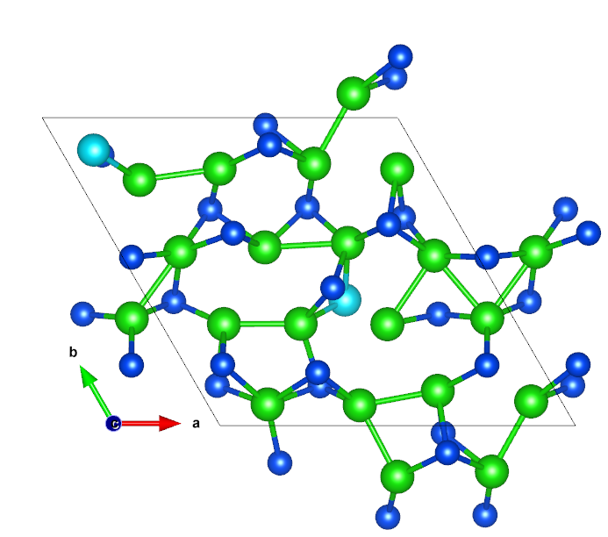
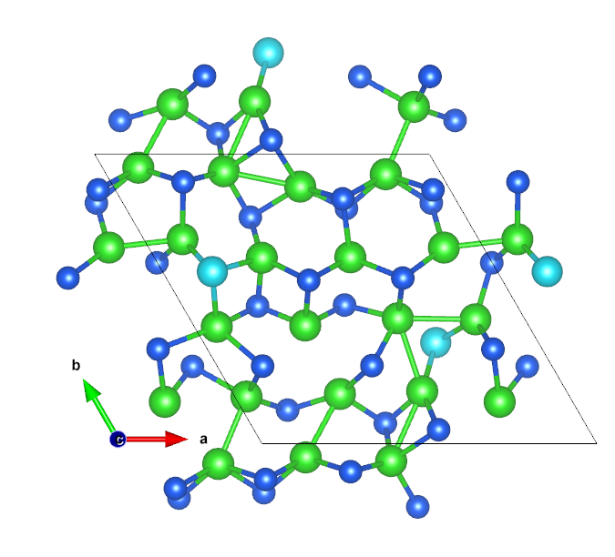
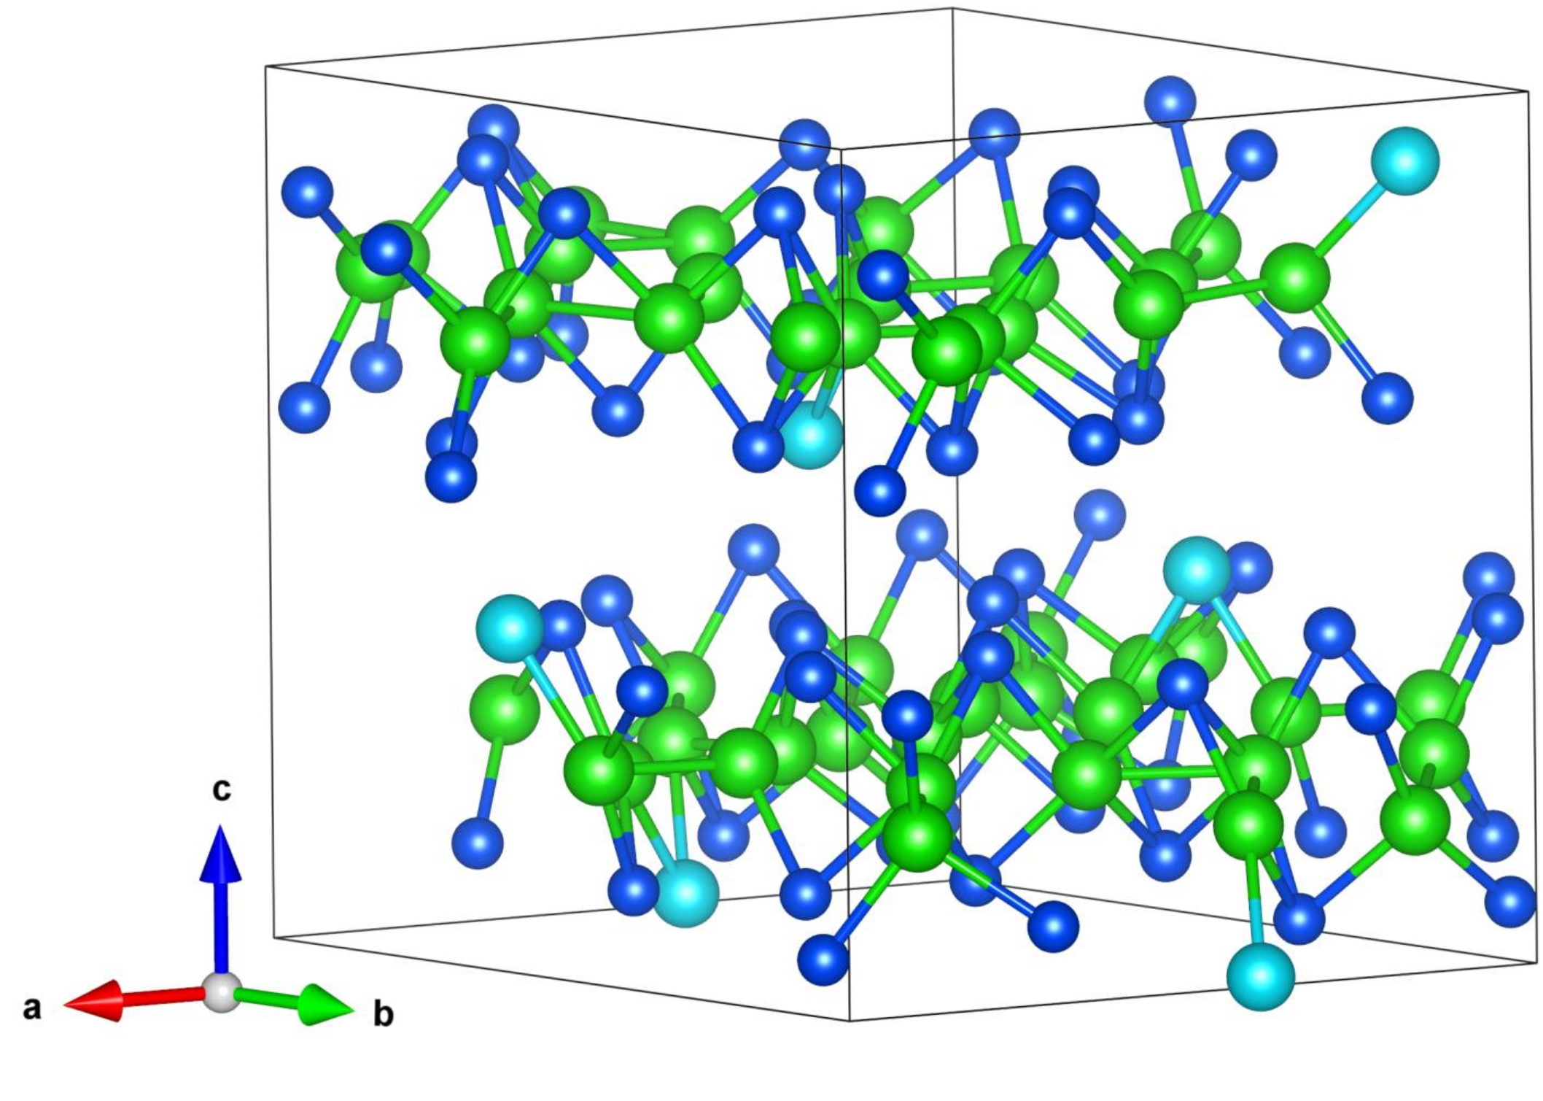
Ferromagnetism in W(Se_{1-x}Te_{x})_{2(1-δ)}: Possible mechanism
DFT calculations in systems which closely resemble (x,δ) values for experimental samples
x=10%, δ=39%
Realization 1:
Ferromagnetic
Realization 2:
Non-magnetic
G. Cardenas-Chirivi, PGG et al., npj 2D Mat. and Appl. 7 (2023) 54
Notes:
Simulations in 4x4x1 supercell (96 atoms)
Magnetic momento of order 0.1 uB/unit cell

Slide 20
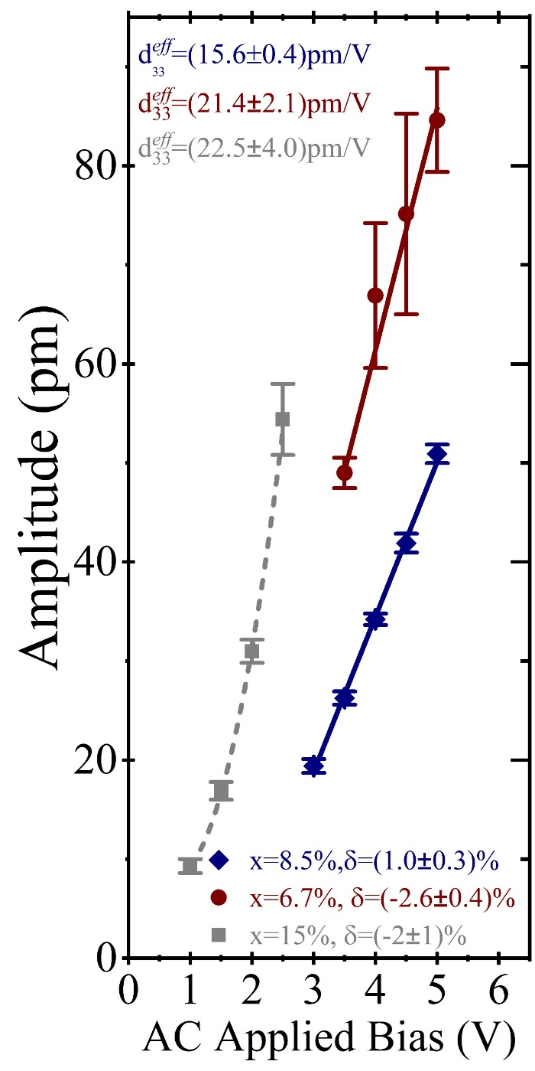
WSe₂→WTe₂ : Ferroelectricity
Para/piezoelectric
WSe₂ (monolayer)
Nano Energy 52 (2018) 117
G. Cardenas-Chirivi, PGG et al., npj 2D Mat. and Appl. 7 (2023) 54
H. Rojas, PGG et al., arXiv:2603.08515 (2026)

Slide 21
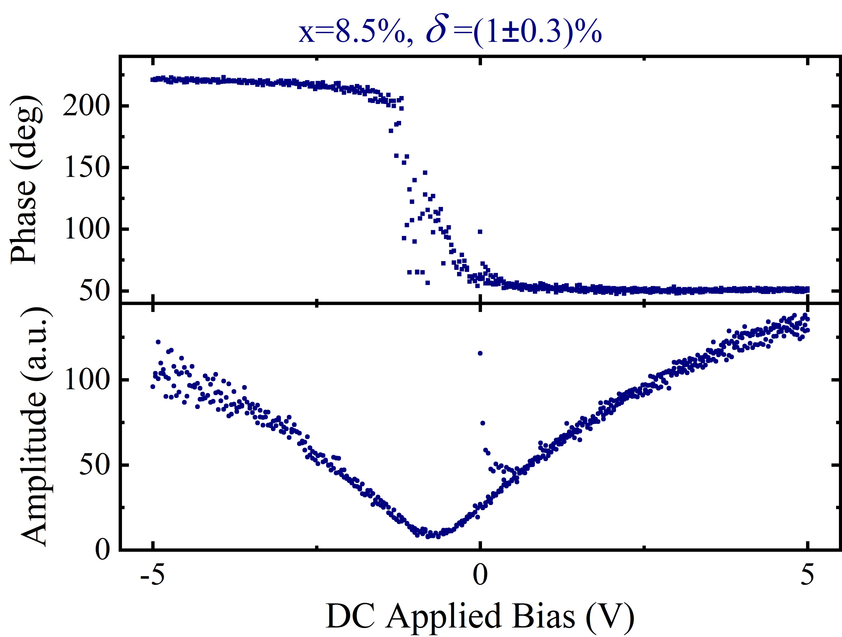
WSe₂→WTe₂ : Ferroelectricity
x=15%, δ=21%
Para/piezoelectric
x=7.6%, δ=38%
G. Cardenas-Chirivi, PGG et al., npj 2D Mat. and Appl. 7 (2023) 54
H. Rojas, PGG et al., arXiv:2603.08515 (2026)

Slide 22
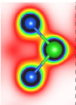
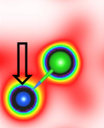
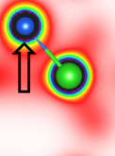

Ferroelectricity in W(Se_{1-x}Te_{x})_{2(1-δ)}: Possible mechanisms
Mechanisms contemplated in literature:
Non-centrosymetric crystal structure X
Sliding ferroelectricity ?
Vacancy induced ?
Our DFT simulations:
Pristine 2H-WSe₂ case: non-polar (c-axis)
Effect of vacancies: breaks local centrosymmetry → c-electric dipole
Hirshfeld charge analisis for local dipole formation
Se
+q
Se
Se
+q
W
-2q
W
-2q
W
-2q
Unit cell electric polarization through Berry-phase
Se
+q
Se
+q
Se
Electric dipole moment for Te-W dipoles: 20 times bigger!
G. Cardenas-Chirivi, PGG et al., npj 2D Mat. and Appl. 7 (2023) 54
H. Rojas, PGG et al., arXiv:2603.08515 (2026)
Notes:
D33-PPLN=19 pm/V

Slide 23
WSe₂→WTe₂ : Ferroic Phase diagram
G. Cardenas-Chirivi, PGG et al., npj 2D Mat. and Appl. 7 (2023) 54
H. Rojas, PGG et al., arXiv:2603.08515 (2026)

Slide 24
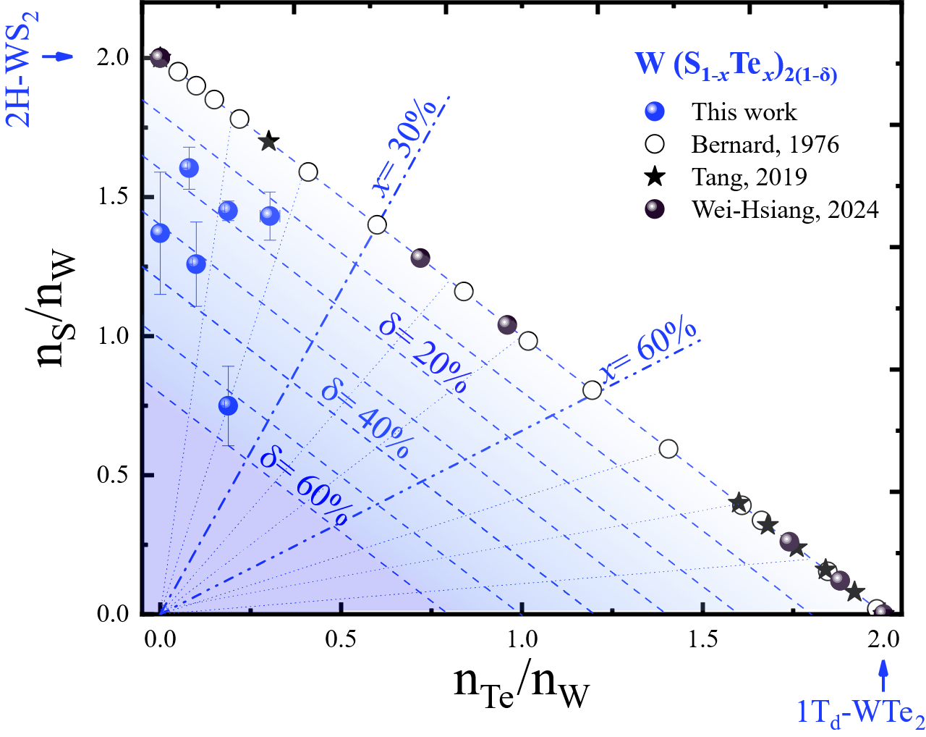
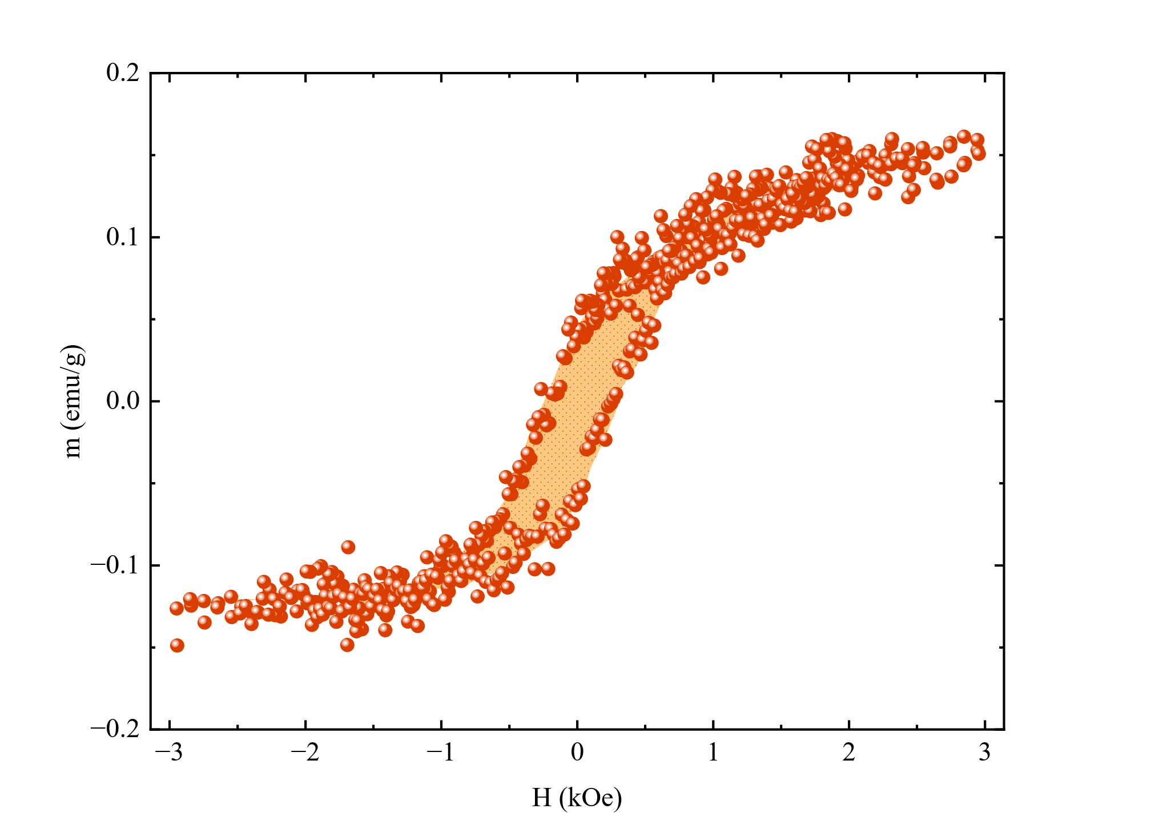
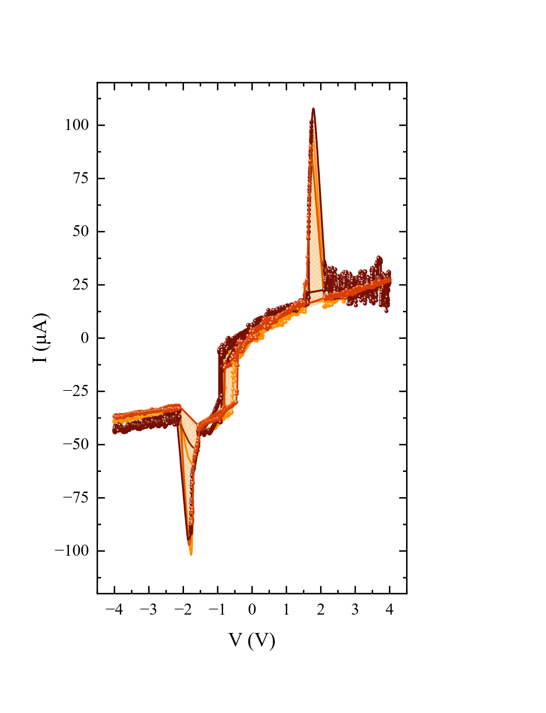









Ferroic properties
in other solid solutions
$$M{\left(A_{1−x}B_{x}\right)}_{2(1−δ)}$$
(ferro)magnetic semiconductor
Ferroelectric
semimetal
$$W{\text{Se}}_{2}$$
$$W{\text{Te}}_{2}$$
$$W{\text{S}}_{2}$$
$$W{\text{Te}}_{2}$$
BULK
Ferromagnetic
$$Mo{\text{Se}}_{2}$$
$$Mo{\text{Te}}_{2}$$
$$Mo{\text{S}}_{2}$$
$$Mo{\text{Te}}_{2}$$
Ferroelectric
Ramón Támara, PGG, et al., In preparation (2026)

Slide 25
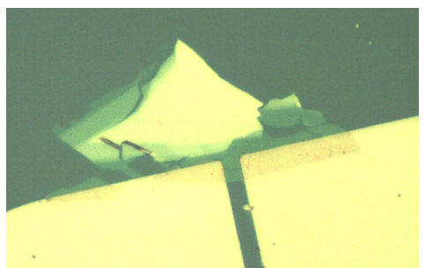
Ferroic properties
in other solid solutions
$$M{\left(A_{1−x}B_{x}\right)}_{2(1−δ)}$$
Monolayer!
NANOSTRUCTURES
(ferro)magnetic semiconductor
Ferroelectric
semimetal
$$W{\text{Se}}_{2}$$
$$W{\text{Te}}_{2}$$
electrode (-)
electrode (+)
$$W{\text{S}}_{2}$$
$$W{\text{Te}}_{2}$$
2um
BULK
Ferromagnetic
$$Mo{\text{Se}}_{2}$$
$$Mo{\text{Te}}_{2}$$
$$Mo{\text{S}}_{2}$$
$$Mo{\text{Te}}_{2}$$
Ferroelectric
Valentina Posada, PGG, et al., In preparation (2026)
Ramón Támara, PGG, et al., In preparation (2026)

Slide 26




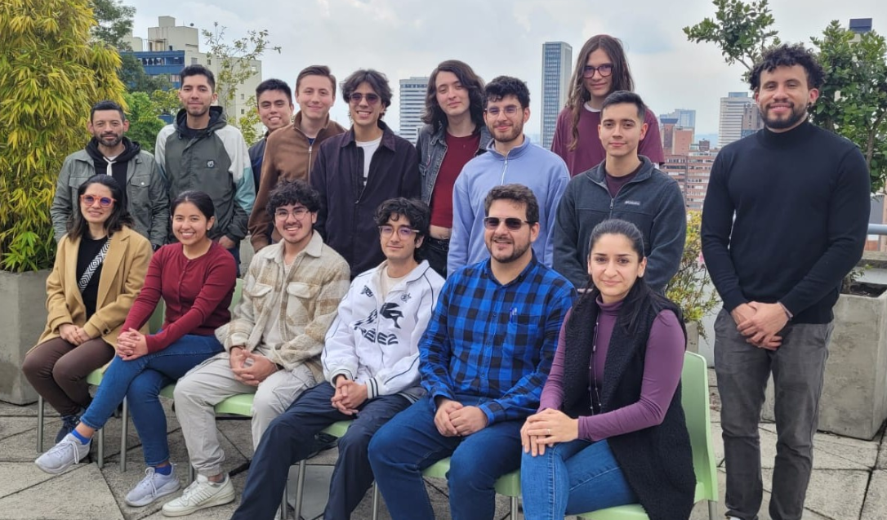





Acknowledgements
U. Rosario, U. Central, COL (Microscopy)
Prof. Jose A. Galvis
Prof. Alejandro Castañeda
Prof. Oscar Herrera
U. Norte, COL – (DFT - calculations)
Prof. Camilo Espejo
Prof. William López
Edwin Ramos
Camila Riveros
J. D. Santacruz
Brayan Walteros
Lina Rodríguez
David Santa
Juan A. Puyo
Noah Lodoño
Harold Rojas (PhD)
Ramón Támara (master)
Valentina Posada (und.)

Slide 27
Defect-induced ferroic states in solid solutions of layered van der Waals materials
$$M{\text{A}}_{2}$$
$$M{\left(A_{1−x}B_{x}\right)}_{2(1−δ)}$$
$$M{\text{B}}_{2}$$
Ferromagnetic semiconductor
Multiferroic semiconductor
Ferroelectric
semimetal
$$W{\text{Se}}_{2}$$
$$W{\text{Te}}_{2}$$
$$W{\text{S}}_{2}$$
$$W{\text{Te}}_{2}$$
H. Rojas, PGG et al., arXiv:2603.08515 (2026)
G. Cardenas-Chirivi, PGG et al., npj 2D Mat. and Appl. 7 (2023) 54
Paula Giraldo-Gallo
Universidad de Los Andes
Bogotá, Colombia
5th Workshop on Statistical Physics- April of 2026
Notes:
All at room temperature

Slide 28
Transition metal dichalcogenides - TMDs
Quasi-2D compounds
MX₂
In plane: T. Metal-chalcogen covalent bonds (strong)
Between planes: Chalcogen-chalcogen van-der Waals interaction (weak)
Low dimensional character
Exfoliation down to monolayers
Semiconducting
MoS₂, MoSe₂ (2H)
WS₂, WSe₂
Phenomena:
Indirect to direct gap in the monolayer limit
Applications:
Optoelectronics, spintronics, thermoelectrics, electronic devices
Metallic
NbS₂, NbSe₂ , NbTe₂, TaS₂, TaSe₂, WTe₂, MoTe₂ (1T’)
Plenomena:
Charge density wave, superconductivity, topological
Applications:
Energy, spintronics, switches, quantum computing
S. Manzeli et at., Nat. Rev. 2 (2017) 17033

Slide 29

Transition metal dichalcogenides - TMDs
Quasi-2D compounds
MX₂
Structural Polytypes
C.M.O. Bastos et al., PRM 3 (2019) 044002;

Slide 30
Ferroic orders and multiferroicity
Ferroelectricity
Typically show empty d orbitals
Typically insulators
Seem incompatible → Scarce in nature
Typically metals
Requires partially filled d/f orbitals
Ferroelasticity
Ferromagnetism
Magnetoelectric multiferroics
Electric-field controlled magnetic data storage
Examples (3D crystal structures):
Magnetically modulated piezoelectrics
Boracites: Ni₃B₇O₁₃I
Perovskites: Pb₂(CoW)O₆, BiFeO₃, BiMnO₃, TbMnO₃, others.
LuFe₂O₄
Multifunctional devices: single device, multiple tasks.
Spaldin N. & Fiebig M., Science 309 (2005) 391-392.

Slide 31

2D ferroics/multiferroics
Miniaturization of devices
3D ferroics/multiferroics → depolarization at nanoscale
2D ferroics/multiferroics
more robust to quantum confinement effects
intrinsic 2D crystal structure: bulk & nanolayer
Less susceptible to interfacial defects/chemical discontinuities when integrated into semiconductor industry devices
Fundamental understanding of long-range order in low-dimensional systems
2D-Multiferroics
G. Cardenas-Chirivi, PGG et al. Room temperature multiferroicity in a transition metal dichalcogenide, npj 2D Mat. and Appl. 7 (2023) 54
C. Wang et al., Nat. Materials 22 (2023) 542.

Slide 32




Ferroic orders in TMDs: Ferromagnetism
MoS₂ (bulk)
MoS₂ (nanosheets)
Fe-doped MoS₂ (monolayer)
V-doped WSe₂ (monolayer)
Appl. Phys. Lett. 101, 123105 (2012).
Adv. Mater. 34 (2022) 2106551
Grain boundary zig-zag edges
Nat. Comm.
11 (2020) 2034
J. Am. Chem. Soc. 2015, 137, 2622−2627
WSe₂ (nanosheets)
1T-VSe₂ (monolayer)
@RT, proton irr.
Nanoscale 9 (2017) 4898
Nat. Nanotech.
13 (2018) 289
PRL 110, 247201 (2013)
M-dangling bonds
Notes:
Sig-zag Edges and terminations → different spin densities depending on termination, moments localized around Se-p orbitals
Proton irradiation → spin density localized around Mo atoms next to MoS2 vacancies
1T incorporation: S vacancies trigger transformation from trigonal prismatic 2H to octahedral 1T phase locally, introducing Mo 4d states within the gap. Ferro through Exchange between vacancy and Mo 4d states.

Slide 33



Ferroic orders in TMDs: Ferroelectricity
1Td-WTe₂ (bulk)
1Td-WTe₂ (bi-trilayer)
Piezoelectricity
Nature 560 (2018) 336
Khanbareh,, TU Delft (2016).
MoS₂ (monolayer)
WSe₂ (monolayer)
Science adv. 5 (2019) eaax5080
1T-MoTe₂ (monolayer)
Nat. comm. 10 (2019) 1775
Nature 514 (2014) 470
Nano Energy 52 (2018) 117
Notes:
Ss-pmf → switching spectroscopy PFM

Slide 34



Ferroic orders in TMDs: Ferroelectricity
1Td-WTe₂ (bulk)
1Td-WTe₂ (bi-trilayer)
Piezoelectricity
Science adv. 5 (2019) eaax5080
Nature 560 (2018) 336
Khanbareh,, TU Delft (2016).
MoS₂ (monolayer)
WSe₂ (monolayer)
Broken centrosymmetry in 2H - odd # of layers
1T-MoTe₂ (monolayer)
Nat. comm. 10 (2019) 1775
Light: Science & Appl. (2016) 5, e16131
Nature 514 (2014) 470
Nano Energy 52 (2018) 117
Notes:
Ss-pmf → switching spectroscopy PFM

Slide 35





Multiferroicity in TMDs:
strategy imported from 3D
Spaldin N. & Fiebig M., Science 309 (2005) 391.
Fiebig M., J. Phys. D: Appl. Phys. 38 (2005) R123.
Ferroelectric → PbZr_{1–x}Ti_{x}O₃ (PZT)
Composites, heterostructures
Ferromagnet →Tb_{1–x}Dy_{x}Fe₂ (Terfenol-D)
In the TMDs’ world
$${M\text{A}}_{2}$$
$${M\left(A_{1−x}B_{x}\right)}_{2}$$
$$M{\text{B}}_{2}$$
(ferro)magnetic semiconductor
Solid solution
Ferroelectric
semimetal
Single crystals

Slide 36



Single crystal growth
XRF
$$W{\left(Se_{1−x}Te_{x}\right)}_{2(1−δ)}$$
Te-doped $WSe_{2}$ single crystals
Synthesis by chemical vapor transport
Chalcogen vacancies
1 mm
(Also molten flux technique, in Te or Sb fluxes)
G. Cardenas-Chirivi et al. Room temperature multiferroicity in a transition metal dichalcogenide, npj 2D Mat. and Appl. 7 (2023) 54

Slide 37
WSe₂→WTe₂ Phase Diagram
$$W{\left(Se_{1−x}Te_{x}\right)}_{2(1−δ)}$$
Crystal structure
Interstitials
x < 30% → 2H
x > 80% → 1Td
30% < x < 80%
2H + 1Td
vacancies
G. Cardenas-Chirivi, PGG et al., npj 2D Mat. and Appl. 7 (2023) 54
H. Rojas, PGG et al., arXiv:2603.08515 (2026)

Slide 38


structural properties
$$W{\left(Se_{1−x}Te_{x}\right)}_{2(1−δ)}$$

Slide 39
WSe₂→WTe₂ structural properties
XRF
$$W{\left(Se_{1−x}Te_{x}\right)}_{2(1−δ)}$$
Te-doped $WSe_{2}$ single crystals
X-ray diffraction
Chalcogen vacancies
2H crystal structure for all dopings studied (x<15%)
(XRD – powder and single crystal)
Increase in lattice parameters → ($\frac{∆c}{c}\sim 2.5\%; \frac{∆a}{a}\sim 1.6\%$)
No signatures of 1Td structure
H. Rojas-Paez, PGG, et al., In preparation (2024)
G. Cardenas-Chirivi et al., npj 2D Mat. and Appl. 7 (2023) 54

Slide 40

WSe₂→WTe₂ structural properties
XRF
$$W{\left(Se_{1−x}Te_{x}\right)}_{2(1−δ)}$$
Te-doped $WSe_{2}$ single crystals
Raman spectroscopy
1Td ($A_{1}^{5}$, $A_{1}^{2}$)
2H
Te-doping
WSe₂
Chalcogen vacancies
2H crystal structure for all dopings studied (x<15%)
(XRD – powder and single crystal)
Increase in lattice parameters → ($\frac{∆c}{c}\sim 2.5\%; \frac{∆a}{a}\sim 1.6\%$)
No signatures of 1Td structure
H. Rojas-Paez, PGG, et al., In preparation (2024)
G. Cardenas-Chirivi et al., npj 2D Mat. and Appl. 7 (2023) 54
Notes:
Agregar líneas de raman para fase WTe2

Slide 41



Ferromagnetism in W(Se_{1-x}Te_{x})_{2(1-δ)}: Possible mechanism
DFT calculations in systems which closely resemble (x,δ) values for experimental samples
x=10%, δ=39%
Realization 1:
DOS for spin-up and spin-down electrons
Projected DOS onto atomic orbitals
Ferromagnetic
Suggests that magnetism comes from
transition metal ion
d-electrons
At Fermi level: net magnetization→ more spin-up than spin-down
At Fermi level: major contribution from W d-orbitals
H. Rojas-Paez, PGG, et al., In preparation (2024)
G. Cardenas-Chirivi et al., npj 2D Mat. and Appl. 7 (2023) 54
Notes:
Simulations in 4x4x1 supercell (96 atoms)

Slide 42
Magnetic properties of W(Se_{1-x}Te_{x})_{2(1-δ)}
VSM - magnetization measurements
@ Room temperature
Ferromagnetic
Diamagnetic
H. Rojas-Paez, PGG, et al., In preparation (2024)
G. Cardenas-Chirivi et al., npj 2D Mat. and Appl. 7 (2023) 54

Slide 43
Magnetic properties of W(Se_{1-x}Te_{x})_{2(1-δ)}
VSM - magnetization measurements
@ Room temperature
2 days
Ferromagnetic
Diamagnetic component is strongly dependent on oxidation/aging
Diamagnetic
Ferromagnetic component is more robust (H_{c})
15 days
H. Rojas-Paez, PGG, et al., In preparation (2024)
G. Cardenas-Chirivi et al., npj 2D Mat. and Appl. 7 (2023) 54

Slide 44
Magnetic properties of W(Se_{1-x}Te_{x})_{2(1-δ)}
Ferromagnetic component
@ Room temperature
Te doping promotes formation of vacancies
Chalcogen vacancies seem to drive ferromagnetism
H. Rojas-Paez, PGG, et al., In preparation (2024)
G. Cardenas-Chirivi et al., npj 2D Mat. and Appl. 7 (2023) 54
Notes:
Te promotes vacancies: Lower electronegativity difference for Te-M bond formation → weaker bond

Slide 45

Magnetic properties of W(Se_{1-x}Te_{x})_{2(1-δ)}
Ferromagnetic component: variation of Hc and Ms with storage time
G. Cardenas-Chirivi et al. Room temperature multiferroicity in a transition metal dichalcogenide, arXiv:2212.02490 (2023).
Notes:
Masa de las muestras?

Slide 46



Ferroelectricity in W(Se_{1-x}Te_{x})_{2(1-δ)}
SS-PFM – switching spectroscopy piezoforce microscopy measurements
@ Room temperature
Increasing Te concentration (x)
Enhanced ferroelectricity
x=1.4%, δ=9%
x=7.6%, δ=38%
x=15%, δ=21%
H. Rojas-Paez, PGG, et al., In preparation (2024)
G. Cardenas-Chirivi et al., npj 2D Mat. and Appl. 7 (2023) 54
Notes:
Ti covered silicon tips for PFM

Slide 47




Ferroelectricity in W(Se_{1-x}Te_{x})_{2(1-δ)}: Piezoelectric coefficient
DART - PFM – Dual AC tracking resonance piezoforce microscopy measurements, @ Room temperature
x=1.4%, δ=9%
x=7.6%, δ=38%
x=15%, δ=21%
$$d_{33}^{eff}=26±4 \text{pm}\text{/}\text{V}$$
PPLN
Piezoelectricity is strongest for the highest Te-doped sample
Highest reported piezoelectric coefficient value for TMDs
H. Rojas-Paez, PGG, et al., In preparation (2024)
G. Cardenas-Chirivi et al., npj 2D Mat. and Appl. 7 (2023) 54
Notes:
D33-PPLN=19 pm/V

Slide 48

Ferroelectricity in W(Se_{1-x}Te_{x})_{2(1-δ)}
SS-PFM – switching spectroscopy piezoforce microscopy measurements
@ Room temperature
G. Cardenas-Chirivi et al. Room temperature multiferroicity in a transition metal dichalcogenide, arXiv:2212.02490 (2023).

Slide 49

Ferroelectricity in W(Se_{1-x}Te_{x})_{2(1-δ)}
SS-PFM – switching spectroscopy piezoforce microscopy measurements
@ Room temperature
G. Cardenas-Chirivi et al. Room temperature multiferroicity in a transition metal dichalcogenide, arXiv:2212.02490 (2023).

Slide 50

Ferroelectricity in W(Se_{1-x}Te_{x})_{2(1-δ)}: Possible mechanisms
Mechanisms contemplated in literature:
Non-centrosymetric crystal structure
Sliding ferroelectricity
Vacancy induced ?
Our DFT simulations:
Pristine 2H-WSe₂ case: non-polar (c-axis)
Effect of vacancies: breaks local centrosymmetry → c-electric dipole
Hirshfeld charge analisis for local dipole formation
Se
+q
Se
Se
+q
W
-2q
W
-2q
W
-2q
Unit cell electric polarization through Berry-phase
Se
+q
Se
+q
Se
Electric dipole moment for Te-W dipoles: 20 times bigger!
Intralayer
Interlayer
Possible dipole switching mechanisms
G. Cardenas-Chirivi et al. Room temperature multiferroicity in a transition metal dichalcogenide, arXiv:2212.02490 (2023).
Notes:
D33-PPLN=19 pm/V

