Slide 1

Departamento
de Física
Interactions of photons with Matter
Carlos Avila
Physics Department
Universidad de Los Andes, Colombia

Slide 2

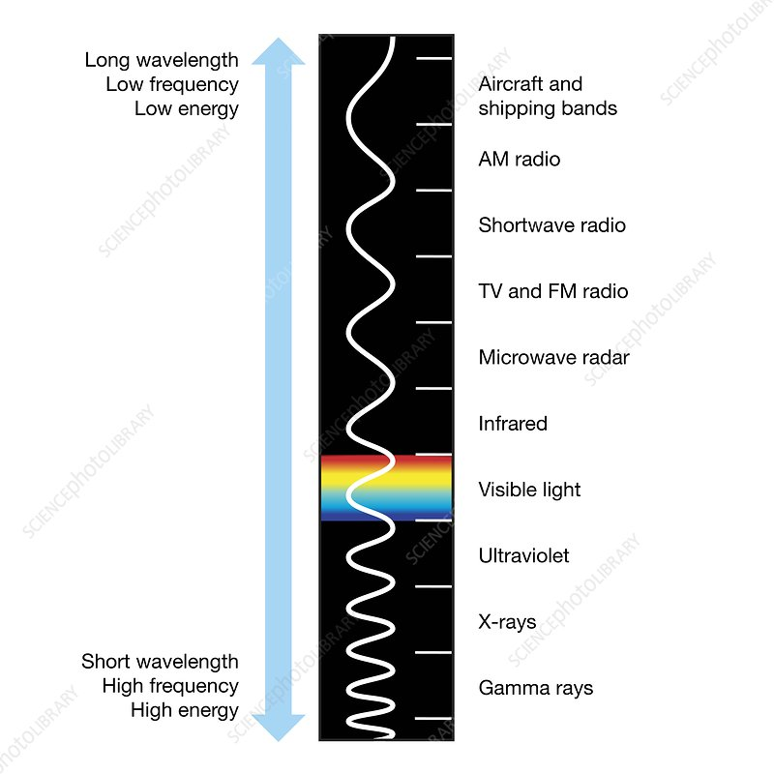
Radiation
Ionizing
Directly ionizing
Indirectly ionizing
Non-ionizing
EM WAVES
λ≥ 100nm
Electrons
Protons
Neutrons
α particles
EM WAVES
with λ< 100nm
UV
Visible
Infrared
Microwaves
Radio waves
X rays
(0.01 nm < λ < 10 nm )
γ rays
(λ < 0.01 nm )

Slide 3
Departamento
de Física
Talk Content
Photoelectric effec
Compton effect
Rayleigh Scattering
Pair Production
Inroduction to XPCI

Slide 4
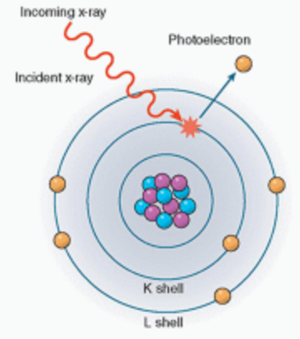




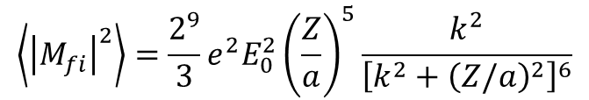

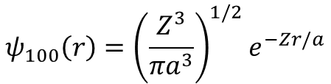
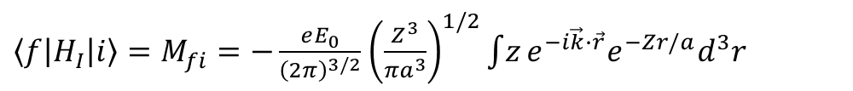

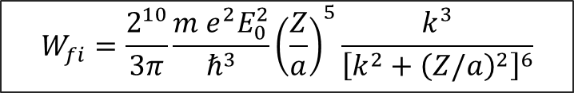

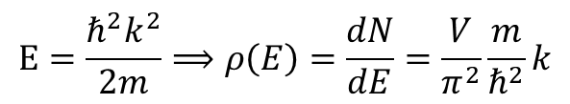
$$γ+A ⟶A^{+}+e^{−}$$
Photoelectric effect
$$ψ_{100}\left(r\right)={\left(\frac{Z^{3}}{{πa}^{3}}\right)}^{1/2}e^{−Zr/a}$$
For a hidrogen-like atom in the ground state:
The final sate is a free electron: $ψ_{f}\left(k\right)= \frac{1}{{\left(2π\right)}^{3/2}}e^{i\vec{k}∙\vec{r}}$
Assuming polarization along the z-axis:
$\left\langle f | H_{I} | i\right\rangle =M_{fi}=−\frac{eE_{0}}{{\left(2π\right)}^{3/2}}$ ${\left(\frac{Z^{3}}{{πa}^{3}}\right)}^{1/2}\int{z}e^{−i\vec{k}∙\vec{r}}e^{−Zr/a}d^{3}r$
Kinetic energy of the ejected electron:
Solving the integral and performing angular averaging:
$$ℏω−I_{Z}=\frac{ℏ^{2}k^{2}}{2m} ; I_{Z}=\frac{13.6 eV Z^{2}}{n^{2}}$$
$$\left\langle {\left|M_{fi}\right|}^{2}\right\rangle =\frac{2^{9}}{3}e^{2}E_{0}^{2}{\left(\frac{Z}{a}\right)}^{5}\frac{k^{2}}{{\left[k^{2}+{\left(Z/a\right)}^{2}\right]}^{6}}$$
Transition rate for photoelectric absorption:
$$W_{fi}=\frac{2π}{ℏ}{\left|\left\langle ψ_{f}(k) | −\frac{e}{m}\vec{A}∙\vec{p} | ψ_{nlm}\right\rangle \right|}^{2}ρ(E_{f})$$
The number of states in a shell of radius k and thickness dk
$$E=\frac{ℏ^{2}k^{2}}{2m}⟹ρ\left(E\right)=\frac{dN}{dE}=\frac{V}{π^{2}}\frac{m}{ℏ^{2}}k$$
$dN=2\frac{V}{{\left(2π\right)}^{3}}4k^{2}dk=\frac{V}{π^{2}}k^{2}dk;$ with
For atomic dimensions: $ka≪1 ⇒ e^{i\vec{k}∙\vec{r}}≈1$
$⟹\vec{A}≈{\hat{ε}A}_{0}e^{−iωt}$ dipole approximation
$$W_{fi}=\frac{2^{10}}{3π}\frac{{m e}^{2}E_{0}^{2}}{ℏ^{3}}{\left(\frac{Z}{a}\right)}^{5}\frac{k^{3}}{{\left[k^{2}+{\left(Z/a\right)}^{2}\right]}^{6}}$$
$$W_{fi}=\frac{2π}{ℏ}{\left|\left\langle ψ_{f}(k) | −e\vec{E}∙\vec{r} | ψ_{nlm}\right\rangle \right|}^{2}ρ(E_{f})$$
This is the plane wave aproximation

Slide 5
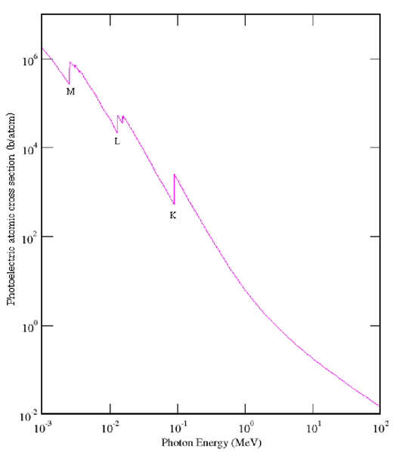
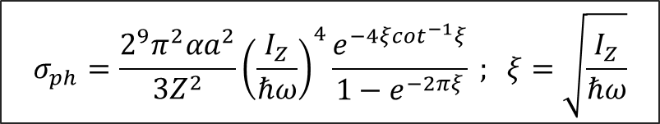

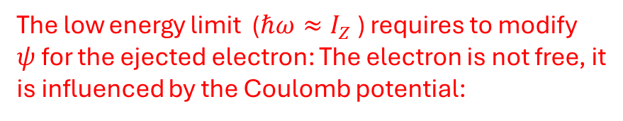
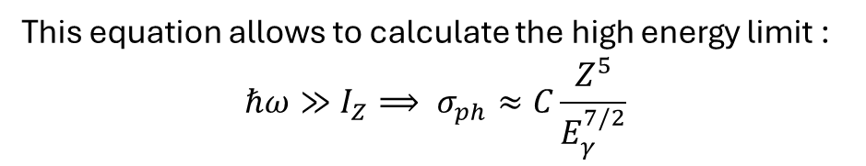

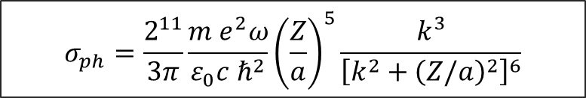

Photoelectric absortion cross section
$$σ_{ph}=\frac{Transition rate}{Flux}= \frac{W_{fi}}{Φ_{γ}}$$
$$σ_{ph}^{Pb}$$
where $Φ_{γ}=\frac{I}{ℏω}=\frac{ε_{0}{cE}_{0}^{2}}{2ℏω}$
$$σ_{ph}=\frac{2^{11}}{3π}\frac{{m e}^{2}ω}{{ε_{0}c ℏ}^{2}}{\left(\frac{Z}{a}\right)}^{5}\frac{k^{3}}{{\left[k^{2}+{\left(Z/a\right)}^{2}\right]}^{6}}$$
This equation allows to calculate the high energy limit :
$$ℏω≫I_{Z}⟹ σ_{ph}≈C\frac{Z^{5}}{E_{γ}^{7/2}}$$
The low energy limit ($ℏω≈I_{Z}$ ) requires to modify $ψ$ for the ejected electron: The electron is not free, it is influenced by the Coulomb potential:
$$σ_{ph}=\frac{2^{9}π^{2}αa^{2}}{3Z^{2}}{\left(\frac{I_{Z}}{ℏω}\right)}^{4}\frac{e^{−4ξ\cot^{−1}ξ}}{1−e^{−2πξ}} ; ξ=\sqrt{\frac{I_{Z}}{ℏω}}$$
Stobbe formula
Quantun Mechanics, special chapters, W. Greiner, Springer 1998
Quantum Electrodynamics, W. Greiner, J. Reinhart, Springer, 2009
Relativistic Quantum mechics and field, theory, F. Gross, J. Wiley&sons, 1993
In the limit $ℏω≈I_{Z}: σ_{ph}≈6.3×{10}^{−22}Z^{−2}$

Slide 6
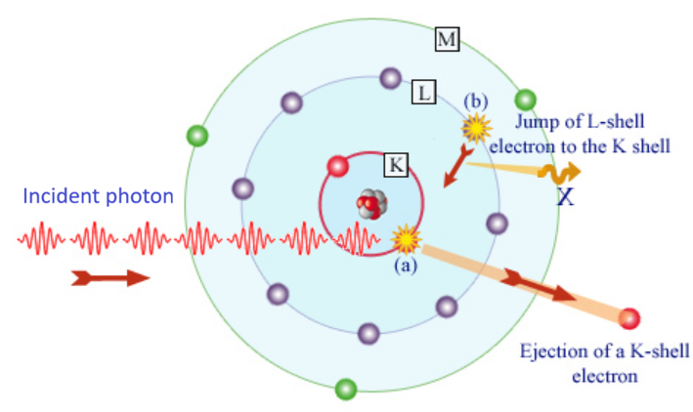
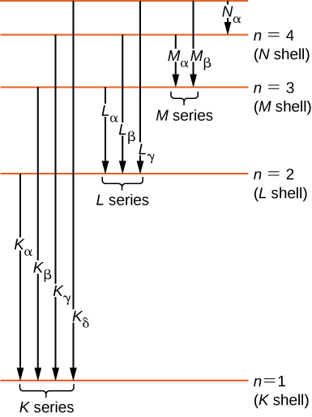
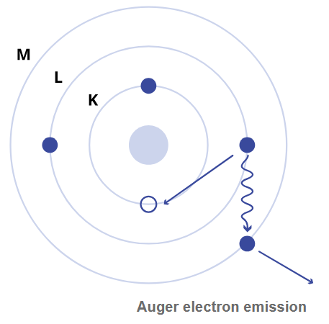
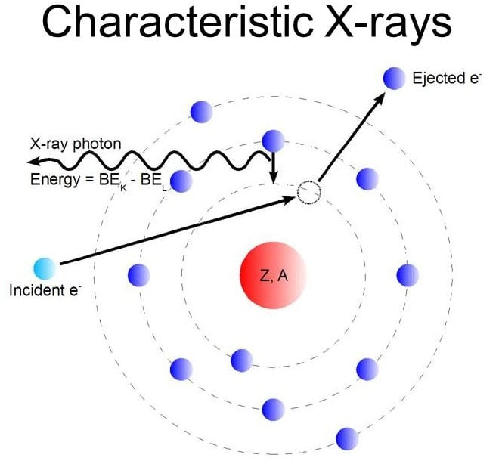
Characteristic X-ray emission
Auger electrons
An X-ray photon is emitted when a higher shell electron ocupies a vacancy from an ejected electron due to ionization
Secondary electrons can be emitted from an atom during relaxation
https://radioactivity.eu.com/articles/phenomenon/photoelectric_effect
https://www.ossila.com/pages/auger-electrons
https://www.careers360.com/physics/characteristic-x-rays-topic-pge
https://oncologymedicalphysics.com/kilovoltage-x-ray-generation/

Slide 7
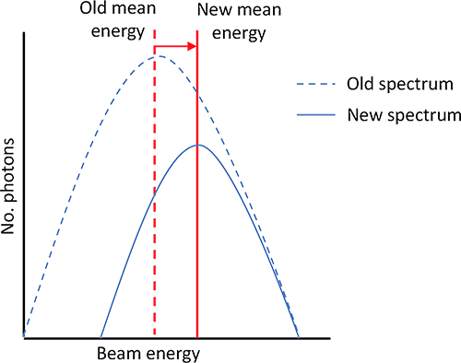


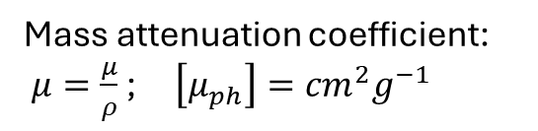





Linear attenuation coefficient
$dI=−μIdx⟹I=I_{0}e^{−μx}$ (Beer-Lambert law)
$$μ=nσ ; \left[μ\right]={cm}^{−1}$$
$$I_{0}$$
Mass attenuation coefficient:
$μ=\frac{μ}{ρ}$ ; $\left[μ_{ph}\right]={cm}^{2}g^{−1}$
$$I$$
$μ=μ_{ph}+μ_{C}+μ_{pair}+μ_{R}$
$$dx$$
Some data bases for attenutaion coefficients:
NIST-XCOM: https://physics.nist.gov/PhysRefData/Xcom/html/xcom1.html
HENKE: https://henke.lbl.gov/optical_constants/
Beam hardening
Half value layer
A polychromatic X-ray beam becomes more energetic ( "harder") as it passes through an object
Thickness needed to reduce incident beam intensity by half:
$$I=\frac{I_{0}}{2}=I_{0}e^{−μx_{1/2}}⟹x_{1/2}=\frac{ln⁡(2)}{μ}$$

Slide 8
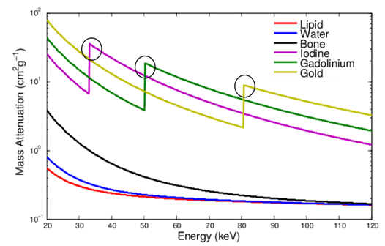



K-edge subtraction imaging
The abrupt increase in the photoelectric x-section at the K-shell is useful for X-ray imaging
Take 2 images at energies below and a bove a K-edge:
$$E_{1}<E_{K }; E_{2}> E_{K}$$
For normal tissue: $μ\left(E_{2}\right)≈μ(E_{1})$
For a contrast agent: $μ\left(E_{2}\right)≫μ(E_{1})$
Image 1: $I_{1}=I_{0}exp\left(−μ_{B}{\left(E_{1}\right)x}_{B}−μ_{C}( E_{1})x_{C}\right)$
Image 2: $I_{2}=I_{0}exp\left(−μ_{B}{\left(E_{2}\right)x}_{B}−μ_{C}( E_{2})x_{C}\right)$
Take logarithms and subtract:
https://www.spectralphotoncountingct.com/en/page/contrast-agents-k-edge-imaging
$$ln\left(I_{0}/I_{1}\right)=μ_{B}{\left(E_{1}\right)x}_{B}+μ_{C}( E_{1})x_{C}$$
A common technique in Angiography, Cancer imaging, contrast-enhanced mammography, material id, etc.
$$− ln\left(I_{0}/I_{2}\right)=μ_{B}{\left(E_{2}\right)x}_{B}+μ_{C}( E_{2})x_{C}$$
$$x_{C}≈\frac{ln\left(I_{0}/I_{1}\right)−ln\left(I_{0}/I_{2}\right)}{μ_{C}\left( E_{1}\right)−μ_{C}( E_{2})}$$
Photon counting detectors with polychromatic sources:
Take only one image and divide in energy bins.

Slide 9
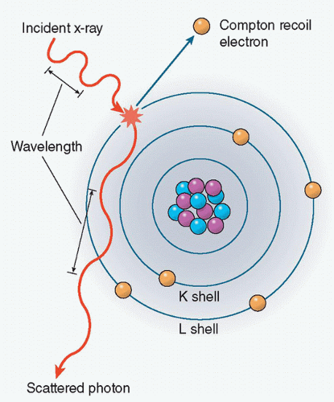
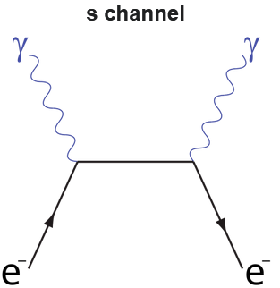
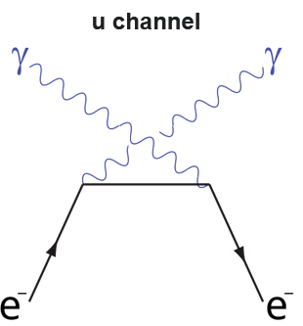
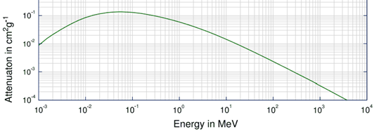

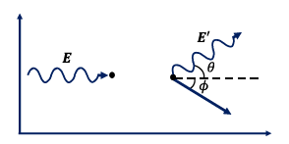
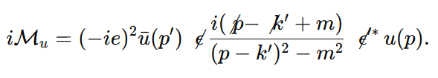

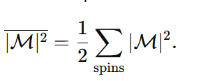

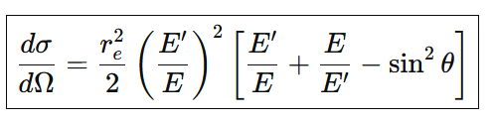


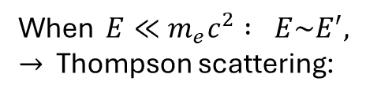




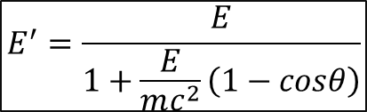
Compton scattering
$$γ+e^{−} ⟶γ^{′}+e^{−}$$
We can get the Compton cross section from Feynman rules (QED):
https://radiologykey.com/x-ray-imaging-fundamentals/
When $E≪m_{e}c^{2} : E\sim E^{′}, →$ Thompson scattering:
$$p_{i}^{μ}=\left(\frac{E}{c}+mc,p,0,0\right); p_{ e}^{μ}=\left(\frac{E_{e}}{c},{\vec{p}}_{e}\right)$$
$$p_{f, γ}^{μ}=\left(\frac{E^{′}}{c},pcosθ,psenθ,0\right)$$
When $E≫m_{e}c^{2} :$
$p_{ e}^{μ}=$ $p_{i}^{μ}−p_{f, γ}^{μ} ;{ p}_{e}^{μ}p_{e,μ}=m^{2}c^{2}$
$$E^{′}=\frac{E}{1+\frac{E}{mc^{2}}\left(1−cosθ\right)}$$
Klein-Nishina Formula

Slide 10
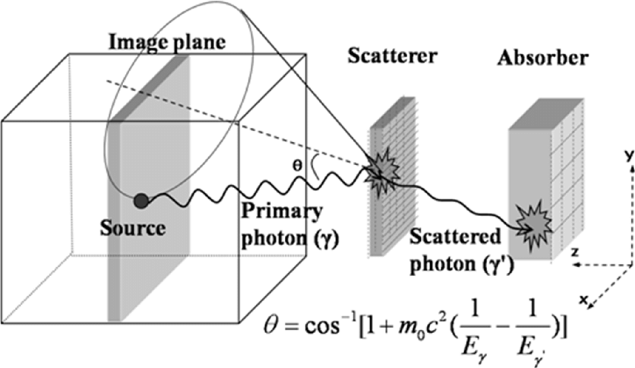
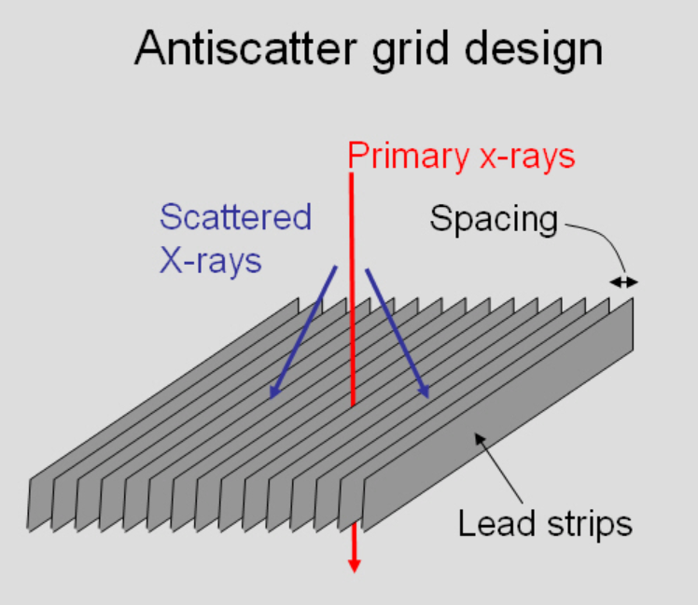
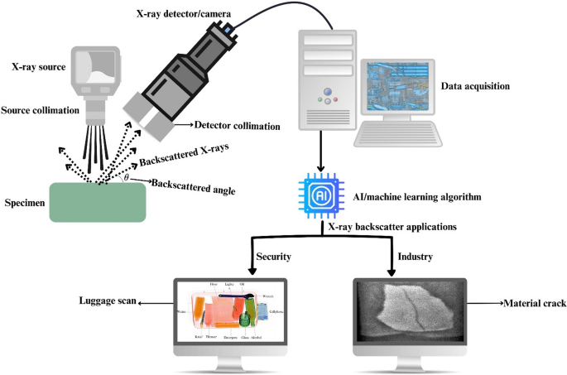
Compton scattering: effect on imaging
Compton Camera
In conventional X-ray imaging: Compton scattering is a source of image degradation. Solution:
Reconstruct direction of gamma rays in the energy range where Compton scattering is the dominant effect
https://www.researchgate.net/figure/Principle-of-a-Compton-camera-The-Compton-scattering-angle-is-the-opening-angle-of-the_fig1_224353796
Compton back-scattering imaging
https://www.upstate.edu/radiology/education/rsna/radiography/scattergrid.php

Slide 11
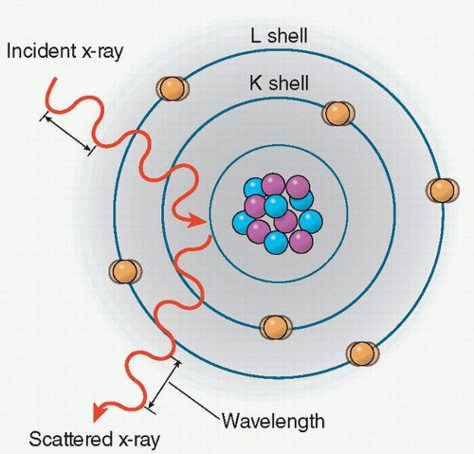


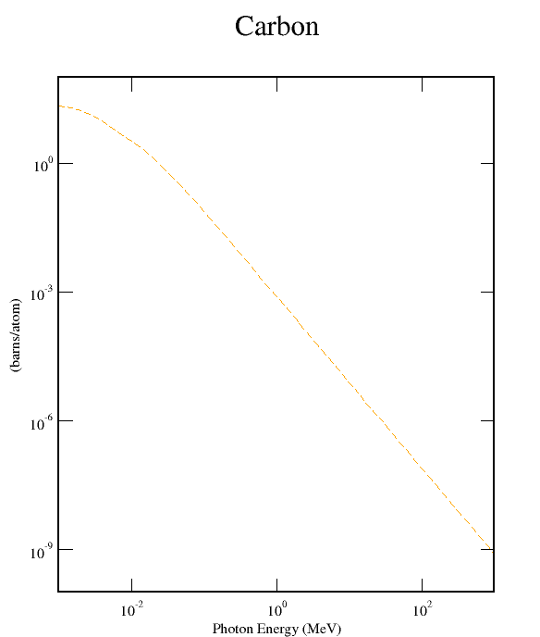



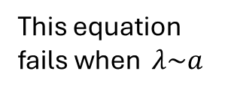
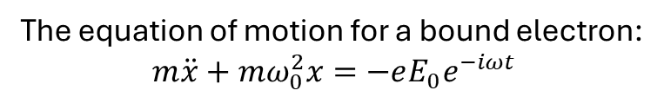
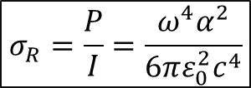

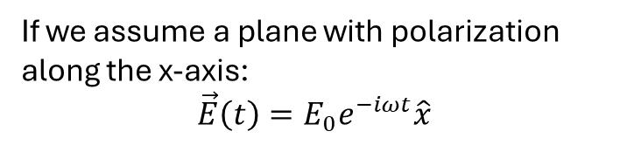

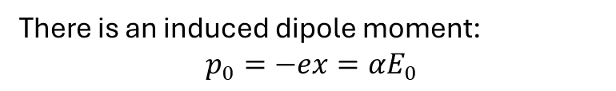
Rayleigh scattering
For a hidrogen-like charge distribution:
$$γ+A ⟶γ+A$$
There is an induced dipole moment:
$$p_{0}=−ex=αE_{0}$$
The power radiated from an oscillating dipole is:
$$\frac{dσ_{R}}{dΩ}\sim q^{−8}$$
At large energies:
The inciden EM wave intensity:
https://radiologykey.com/x-ray-imaging-fundamentals/
Elastic scattering of photons by particles with sizes smaller than the the photon wavelenght.
Then, the Rayleigh cross section can be found as:
If we assume a plane with polarization along the x-axis:
$$\vec{E}\left(t\right)=E_{0}e^{−iωt}\hat{x}$$
$$σ_{R}=\frac{P}{I}=\frac{ω^{4}α^{2}}{6πε_{0}^{2}c^{4}}$$
This equation fails when $λ\sim a$
The equation of motion for a bound electron:
$$m\ddot{x}+mω_{0}^{2}x=−eE_{0}e^{−iωt}$$
We need to introduce atomic form factor:
Rayleigh scattering plays an important role in Dark field imaging.
$$⟹x=\frac{−eE_{0}}{m\left(ω_{0}^{2}−ω^{2}\right)}e^{−iωt}$$

Slide 12
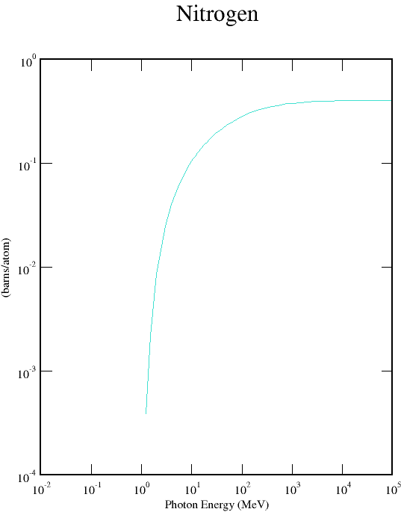
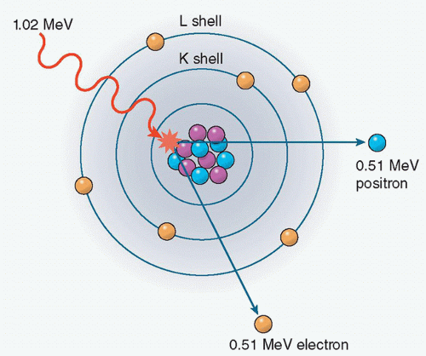
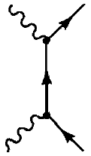
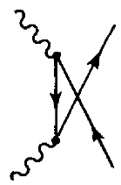
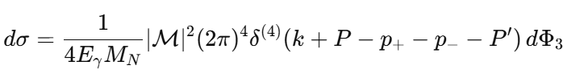

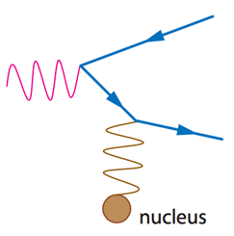




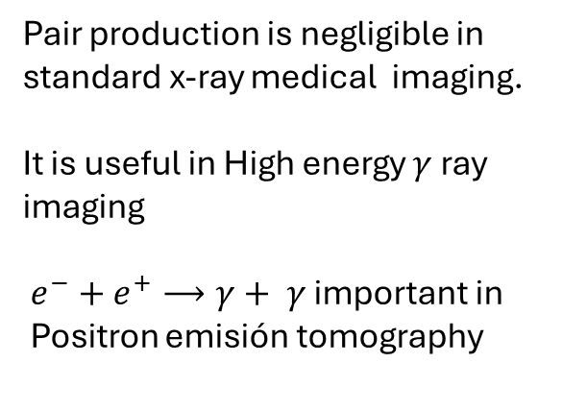
$$γ+Z ⟶Z+ e^{−}+e^{+}$$
Pair production
A pesence of a nucleus is needed to absorb mometum.
Threshold energy: $E_{γ}=2mc^{2}$
In the limit $E_{γ}≫m_{e}c^{2}$ $:$
Pair production is negligible in standard x-ray medical imaging.
It is useful in High energy $γ$ ray imaging
$e^{−}+e^{+}⟶γ+ γ$ important in
Positron emisión tomography

Slide 13
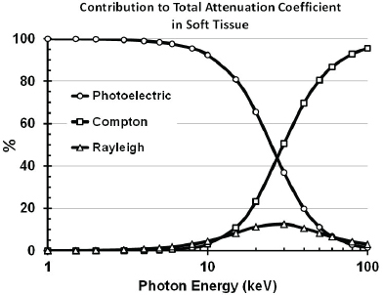
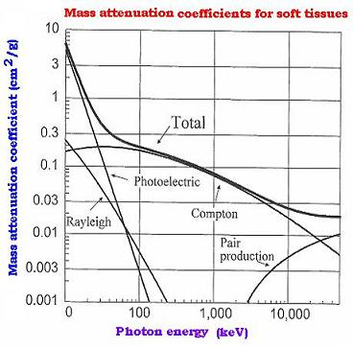
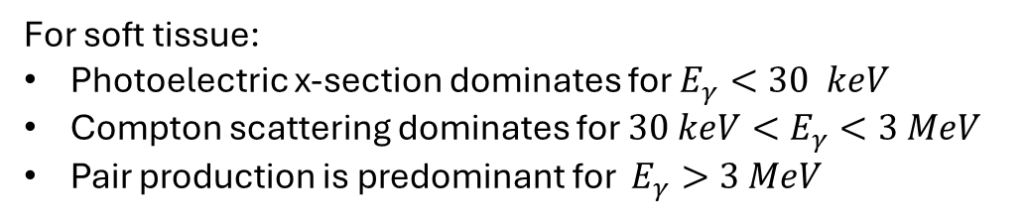
For soft tissue:
Photoelectric x-section dominates for $E_{γ}<30 keV$
Compton scattering dominates for $30 keV<E_{γ}<3 MeV$
Pair production is predominant for $E_{γ}>3 MeV$

Slide 14
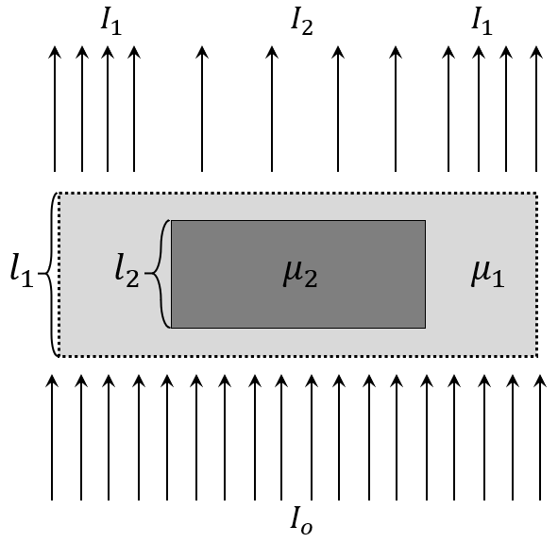





X-RAY ATTENUATION IMAGING BASIC PRINCIPLE
Starting from Beer-Lambert law:
Detector
$$I\left(E,z\right)=I_{o}Exp\left[− μ\left(E,z\right)z\right]$$
$$μ=μ_{photo}+μ_{incoh−sc}+μ_{coh−sc}$$
For an object 2 embedded in another object 1:
$$I_{2}=I_{1}Exp\left[−μ_{1}\left(l_{1}−l_{2}\right)\right]⋅Exp\left[−μ_{2}l_{2}\right]$$
Contrast can be defined as:
$$C= \frac{I_{1}−I_{2}}{I_{1}}=1−Exp(−l_{2}\left(|Δμ|\right))$$
Source
For polychromatic sources:
Attenuation imaging produces poor contrast of Object 2 in cases where $μ_{2}≪ μ_{1}$ (hollow area of bones) or $μ_{2}≈μ_{1 }$(blood within a blood vessel).

Slide 15






Departamento
de Física
X ray phase contrast imaging (XPCI)
Many biological and human tissues are soft: they have low X- ray absorption → they are difficult to visualize with conventional X ray techniques:
Breast Tissue
Blood Vessels ( withouth a contrast agent)
2 specific cases:
The EM wave propagating through the sample is $ψ=ψ_{0}exp\left(i\frac{nω}{c}z\right)$
In the x ray energy range the index of refraction can be written as : $n=1− δ+iβ$
→ $ψ=ψ_{0}e^{−βk_{0}z}e^{ikz\left(1−δ\right)}$
Phase effects are produced by $δ$ : $ΔΦ=−k\int_{0}^{Z_{0}}{δ dz}$
Attenuation effects are caused by $β$ : $I={\left|ψ_{0}\right|}^{2}e^{−2k\int_{0}^{Z_{0}}{β dz}}$
For many soft tissues $δ$ is ~ 3 orders of magnitude greater than $β$→ phase effects could enhance Image constrast

Slide 16







Transport of intensity equation and XPCI
Maxwell equations in vacuum:
$$∇^{2}ψ−\frac{1}{c^{2}}\frac{∂^{2}ψ}{∂t^{2}}=0$$
T.I.E. : The phase gradient influences the wave intensity!
A finite differences solution of T.I.E.:
For a monochormatic wave propagating in the z direction:
$$I(x,y,z+δz)≈I\left(x,y,z\right)−\frac{δz}{k}\left\{{\vec{∇}}_{⊥}I\left(x,y,z\right)∙{\vec{∇}}_{⊥}Φ\left(x,y\right)+I(x,y,z) ∇_{⊥}^{2}Φ(x,y)\right\}$$
$$ψ\left(\vec{r},t\right)=U(\vec{r})e^{−iωt}$$
$$⟹∇^{2}U+k^{2}U=0$$
The wave intensity depends on the gradiente and laplacian of the phase
W$ith U=A(x,y,z)e^{ikz}$ and applying the paraxial approximation (: the wave propagates with very small angles with respect to the propation axis):
$$\left|\frac{∂^{2}A}{∂z^{2}}\right|≪\left|2k\frac{∂A}{∂z}\right|{⟹∇}_{⊥}^{2}A+2ik\frac{∂A}{∂z}=0$$
Phase-contrast techniques are designed to measure the gradient or the Laplacian of the phase
To account for small angle scattering form sample microstructure a difusión term is added to the T.I.E.:
$$\frac{∂I}{∂z}=−\frac{1}{k}∇_{⊥}∙\left(I∇_{⊥}Φ\right)+∇_{⊥}∙\left(D∇_{⊥}I\right)$$
The intensity of the wave is:
${I=ψ}^{∗}ψ=A^{2} ⟹A=\sqrt{I}e^{iΦ}$
Fokker-Planck equation: allows Dark field imaging
$$\frac{∂I}{∂z}+\frac{1}{k}∇_{⊥}∙\left(I∇_{⊥}Φ\right)$$
T.I.E.

Slide 17








PHASE RETRIEVAL
One often cited technique in the literature: Paganin´s method, which assumes:
The sample is uniform
The sample is made of a single material
The ratio $γ=\frac{δ}{β}$ remains constant throug the sample
$$Φ=−k\int_{0}^{Z_{0}}{δ dz=−γk\int_{0}^{z_{0}}{βdz}}$$
$$I(z_{0})=I_{0}e^{−2k\int_{0}^{Z_{0}}{β dz}}$$
since
Replacing $I\left(z_{0}\right)=I_{0}e^{−2k\int_{0}^{Z_{0}}{β dz}}$and $Φ$ into the T.I.E.:
$$\frac{1}{δz}\left(I\left(z_{0}+δz\right)−I(z_{0})\right)=−\frac{1}{k}∇_{T}∙\left(I_{0}e^{−2k\int_{0}^{Z_{0}}{β dz}}∇_{T}\left(−γk\int_{0}^{z_{0}}{βdz}\right)\right)$$
$\frac{I}{I_{0}}=$ $e^{−2k\int_{0}^{Z_{0}}{β dz}}−\frac{γδz}{2k}∇_{T}^{2}\left(e^{−2k\int_{0}^{Z_{0}}{β dz}}\right)$
Taking the Fourier transform and simplifying:
$$ℱ\left(e^{−2k\int_{0}^{Z_{0}}{β dz}}\right)=\frac{ℱ\left(\frac{I}{I_{0}}\right)}{1+\frac{γδz}{2k}\left(k_{x}^{2}+k_{y}^{2}\right)}$$
$$Φ=\frac{γ}{2}ln\left\{ℱ^{−1}\left[\frac{ℱ\left(\frac{I}{I_{0}}\right)}{1+\frac{γδz}{2k}\left(k_{x}^{2}+k_{y}^{2}\right)}\right]\right\}$$
Since $Φ=\frac{γ}{2}ln\left(e^{−2k\int_{0}^{Z_{0}}{β dz}}\right)$
There are more methods to retrieve the pase which depend on the XPCI technique, including the training of NN.

Slide 18




XPCI methods at UNIANDES HEP _LAB
1) Inline - Free propagation
2) Single Mask Edge Illumination
3) Speckle based

Slide 19
CONCLUSIONS
A detailed understanding of photon–matter interaction cross sections as a function of energy enables the optimal use of different imaging techniques across distinct photon-energy regimes.
Databases of X-ray interactions with matter are built upon theoretical calculations from quantum electrodynamics (QED) and atomic physics, and are validated against experimental measurements.
The theoretical foundations of X-ray phase-contrast imaging (XPCI) are the Transport of Intensity Equation (TIE) and the Fokker–Planck equation.

