Slide 1
CATNIP: Comprehensive Analysis Toolkit for
Near-field Imaging and
Phase-retrieval
Manuel Fernando Sánchez Alarcón
Università degli Studi di Trieste

Slide 2
X-ray Imaging Setup

Slide 3
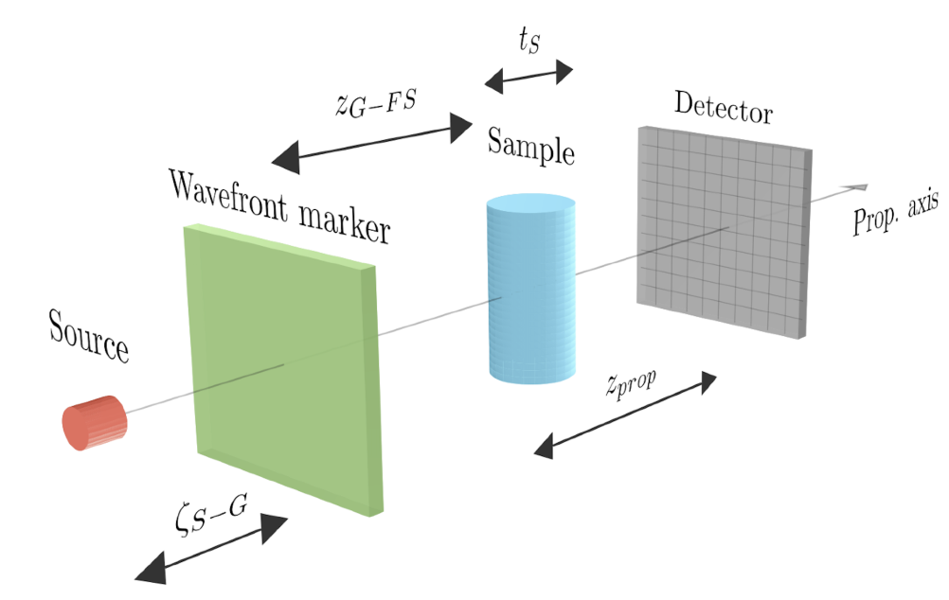
X-ray Imaging Setup

Slide 4
Source

Slide 5
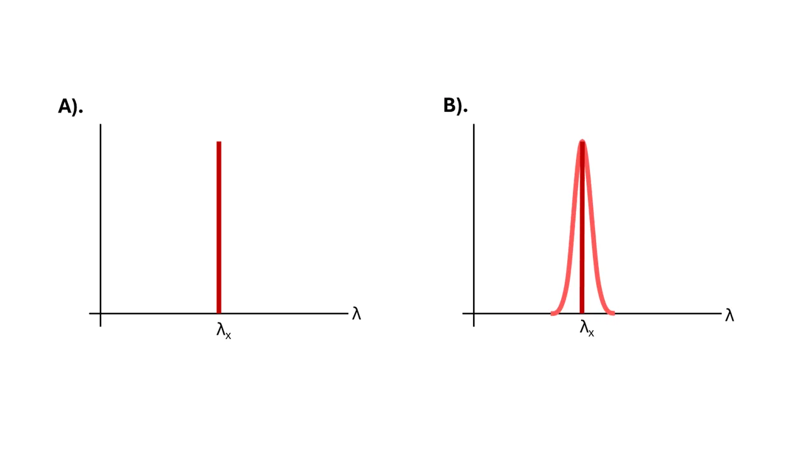
Source
Monochromatic
Polychromatic
Taken from: https://www.edinst.com/resource/understanding-bandpass-and-resolution-in-photoluminescence-spectroscopy/

Slide 6
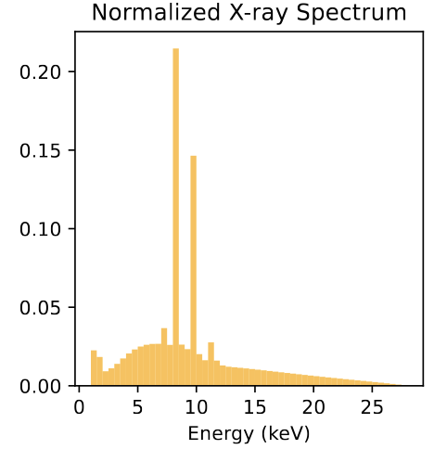
Source
Monochromatic
Polychromatic
Taken from: https://www.edinst.com/resource/understanding-bandpass-and-resolution-in-photoluminescence-spectroscopy/

Slide 7
Wavefront Marker

Slide 8
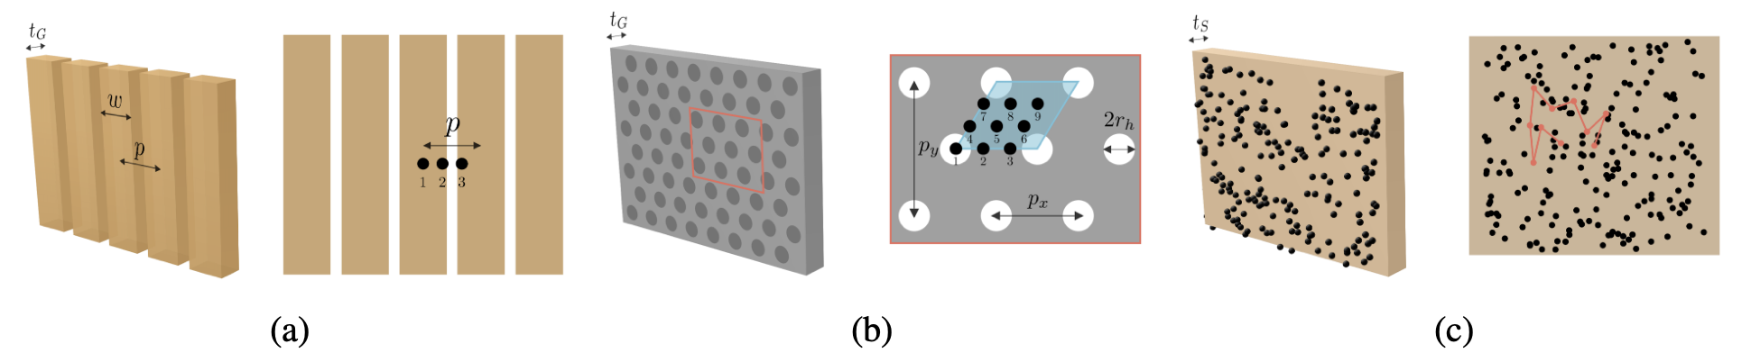
Wavefront Marker
Edge-Illumination (EI)
Single-Grating Based Imaging (SGBI)
Speckle Based Imaging (SBI)

Slide 9
Sample

Slide 10
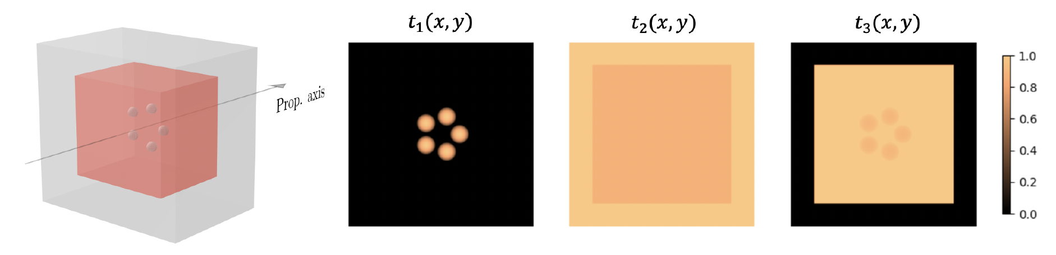
Sample: Mammo Phantom

Slide 11
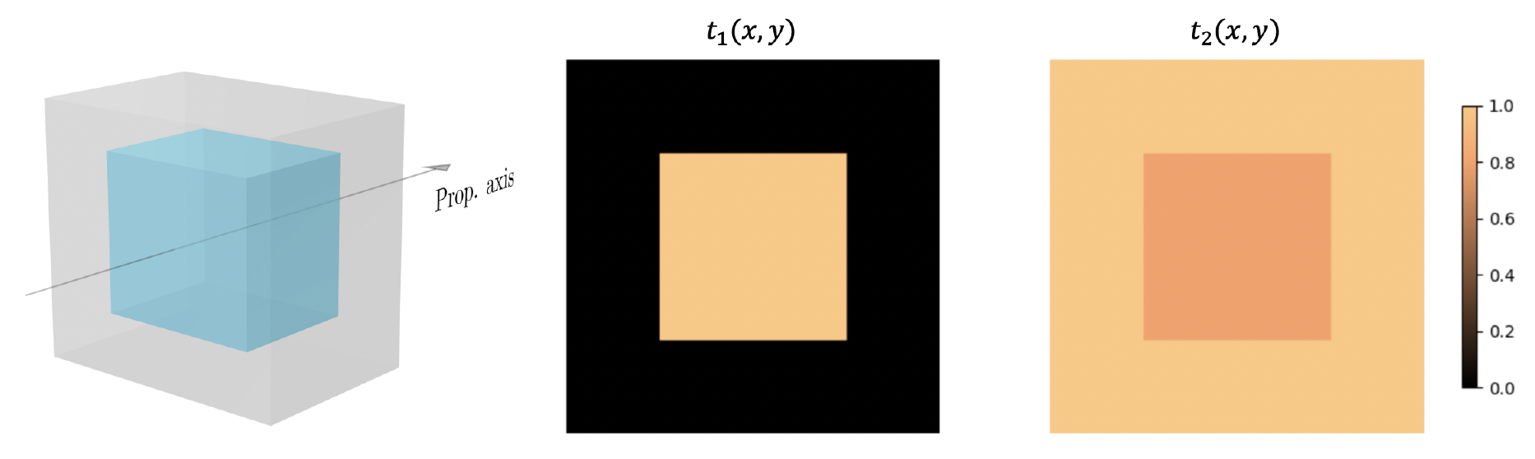
Sample: Block

Slide 12
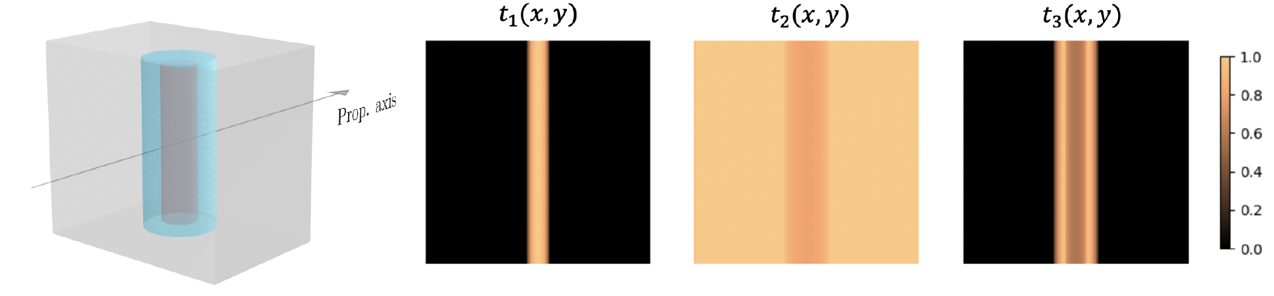
Sample: Angio tube

Slide 13
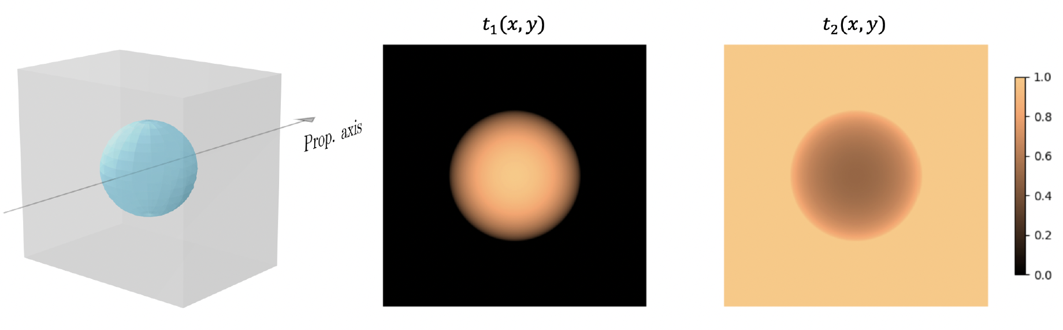
Sample: Sphere

Slide 14
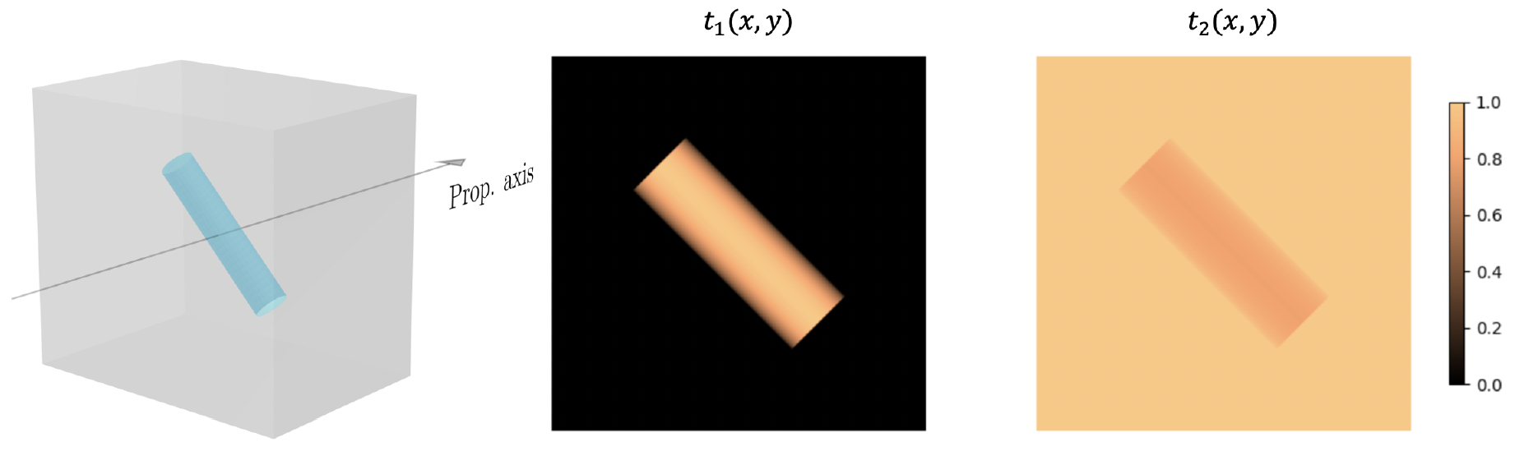
Sample: Fibre

Slide 15
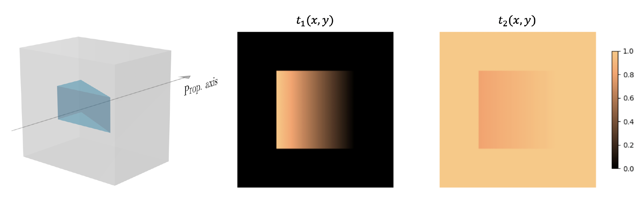
Sample: Wedge

Slide 16
Detector

Slide 17
Detector
PSF Total: Detector + Source
Binning Factor
Poisson Noise

Slide 18
Simulation Algorithm

Slide 19
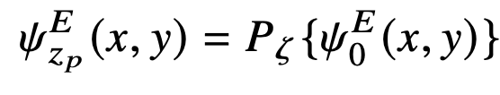
Simulations: Propagation + Interaction
1
1
1
1
1
1
1
1
1

Slide 20
Simulations: Propagation + Interaction

Slide 21

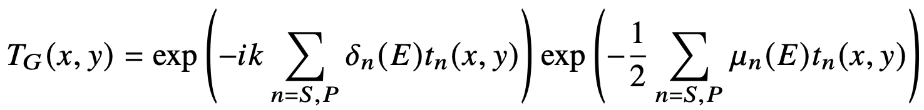
Simulations: Propagation + Interaction

Slide 22
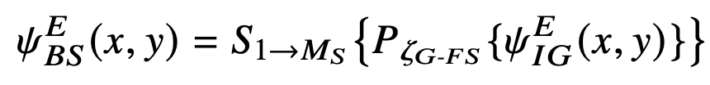
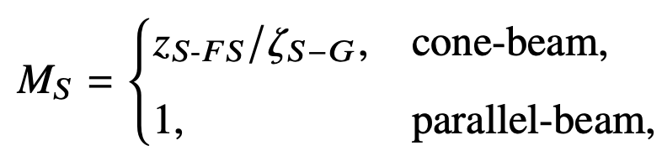
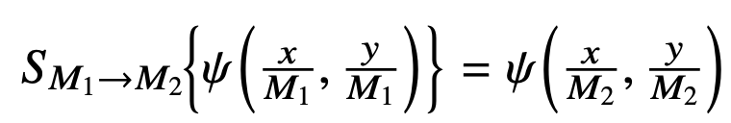
Simulations: Propagation + Interaction

Slide 23

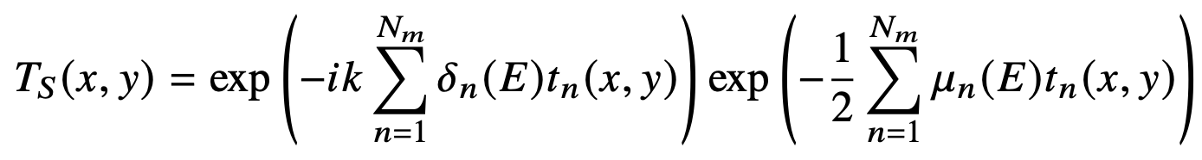
Simulations: Propagation + Interaction

Slide 24
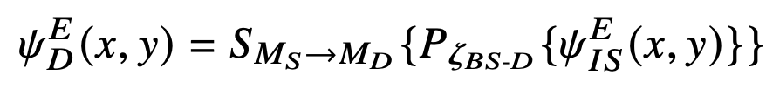
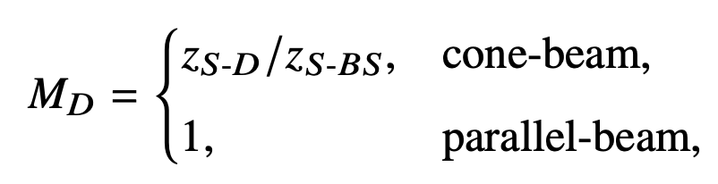
Simulations: Propagation + Interaction

Slide 25
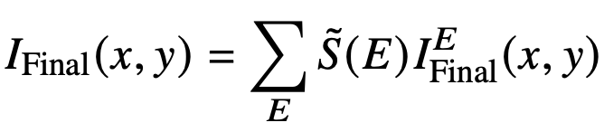
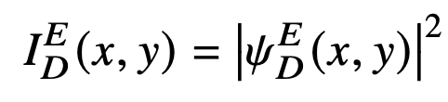
Image Formation
For polychromatic sources:
+ Poisson Noise + PSF Blurring

Slide 26



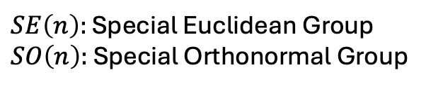

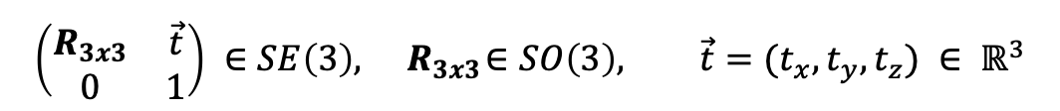

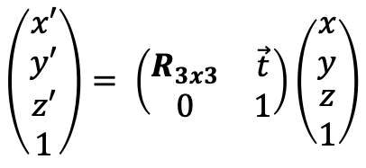


Computed Tomography
$$t_{y}$$
$$\left(\begin{matrix}x′ \\ y′ \\ \begin{aligned}z′ \\ 1\end{aligned}\end{matrix}\right)= \left(\begin{matrix}R_{3x3} & \vec{t} \\ 0 & 1\end{matrix}\right)\left(\begin{matrix}x \\ y \\ \begin{aligned}z \\ 1\end{aligned}\end{matrix}\right)$$
$$R_{y}$$
$$\left(\begin{matrix}R_{3x3} & \vec{t} \\ 0 & 1\end{matrix}\right) ∈SE\left(3\right), { R}_{3x3}∈SO\left(3\right), \vec{t}=(t_{x}, t_{y}, t_{z}) ∈ ℝ^{3}$$
$$R_{z}$$
$$t_{x}$$
$SE\left(n\right):$ Special Euclidean Group
$SO\left(n\right):$ Special Orthonormal Group
$$t_{z}$$
$$R_{x}$$

Slide 27
References
Pre-Print in Optica: https://preprints.opticaopen.org/articles/preprint/CATNIP_An_Open-Source_Wave-Optics_Simulation_Framework_for_Multimodal_X-ray_Imaging/30269386?file=58468411
CATNIP Manual: https://github.com/Spoksonat/CATNIP/blob/main/CATNIP_Manual.pdf

