Slide 1

Convolutional Neural Networks for Phase Retrieval in Speckle-based Imaging
Simón González López

Slide 2
Contents
Why do we need to use Deep Learning?
Deep Learning in a nutshell.
Convolutional Neural Networks.
Convolutions: A practical example.
UNet: Retrieving speckle displacements.
Training, Validation and Evaluation Dataset.
1

Slide 3
Why do we need to use Deep Learning?
MIST [1,2]:
Needs priori information about the sample.
Originally written for monochromatic energy.
Needs at least two [1] or four [2] sample images to retrieve multimodal information.
UMPA [3]:
Iterative minimization of a cost function.
It requires several images (20) to retrieve signals with high quality and spatial resolution.
Why Deep Learning?
Limitations on traditional phase retrieval algorithms: Absorbed dose and priori information is needed.
A model could learn a function to retrieve speckle pattern displacements from one sample image only.
2

Slide 4
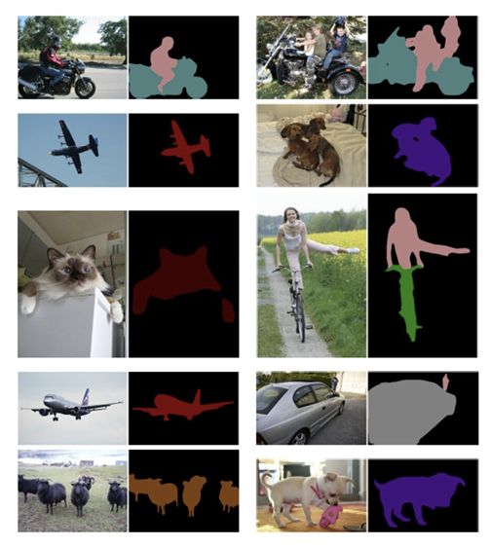
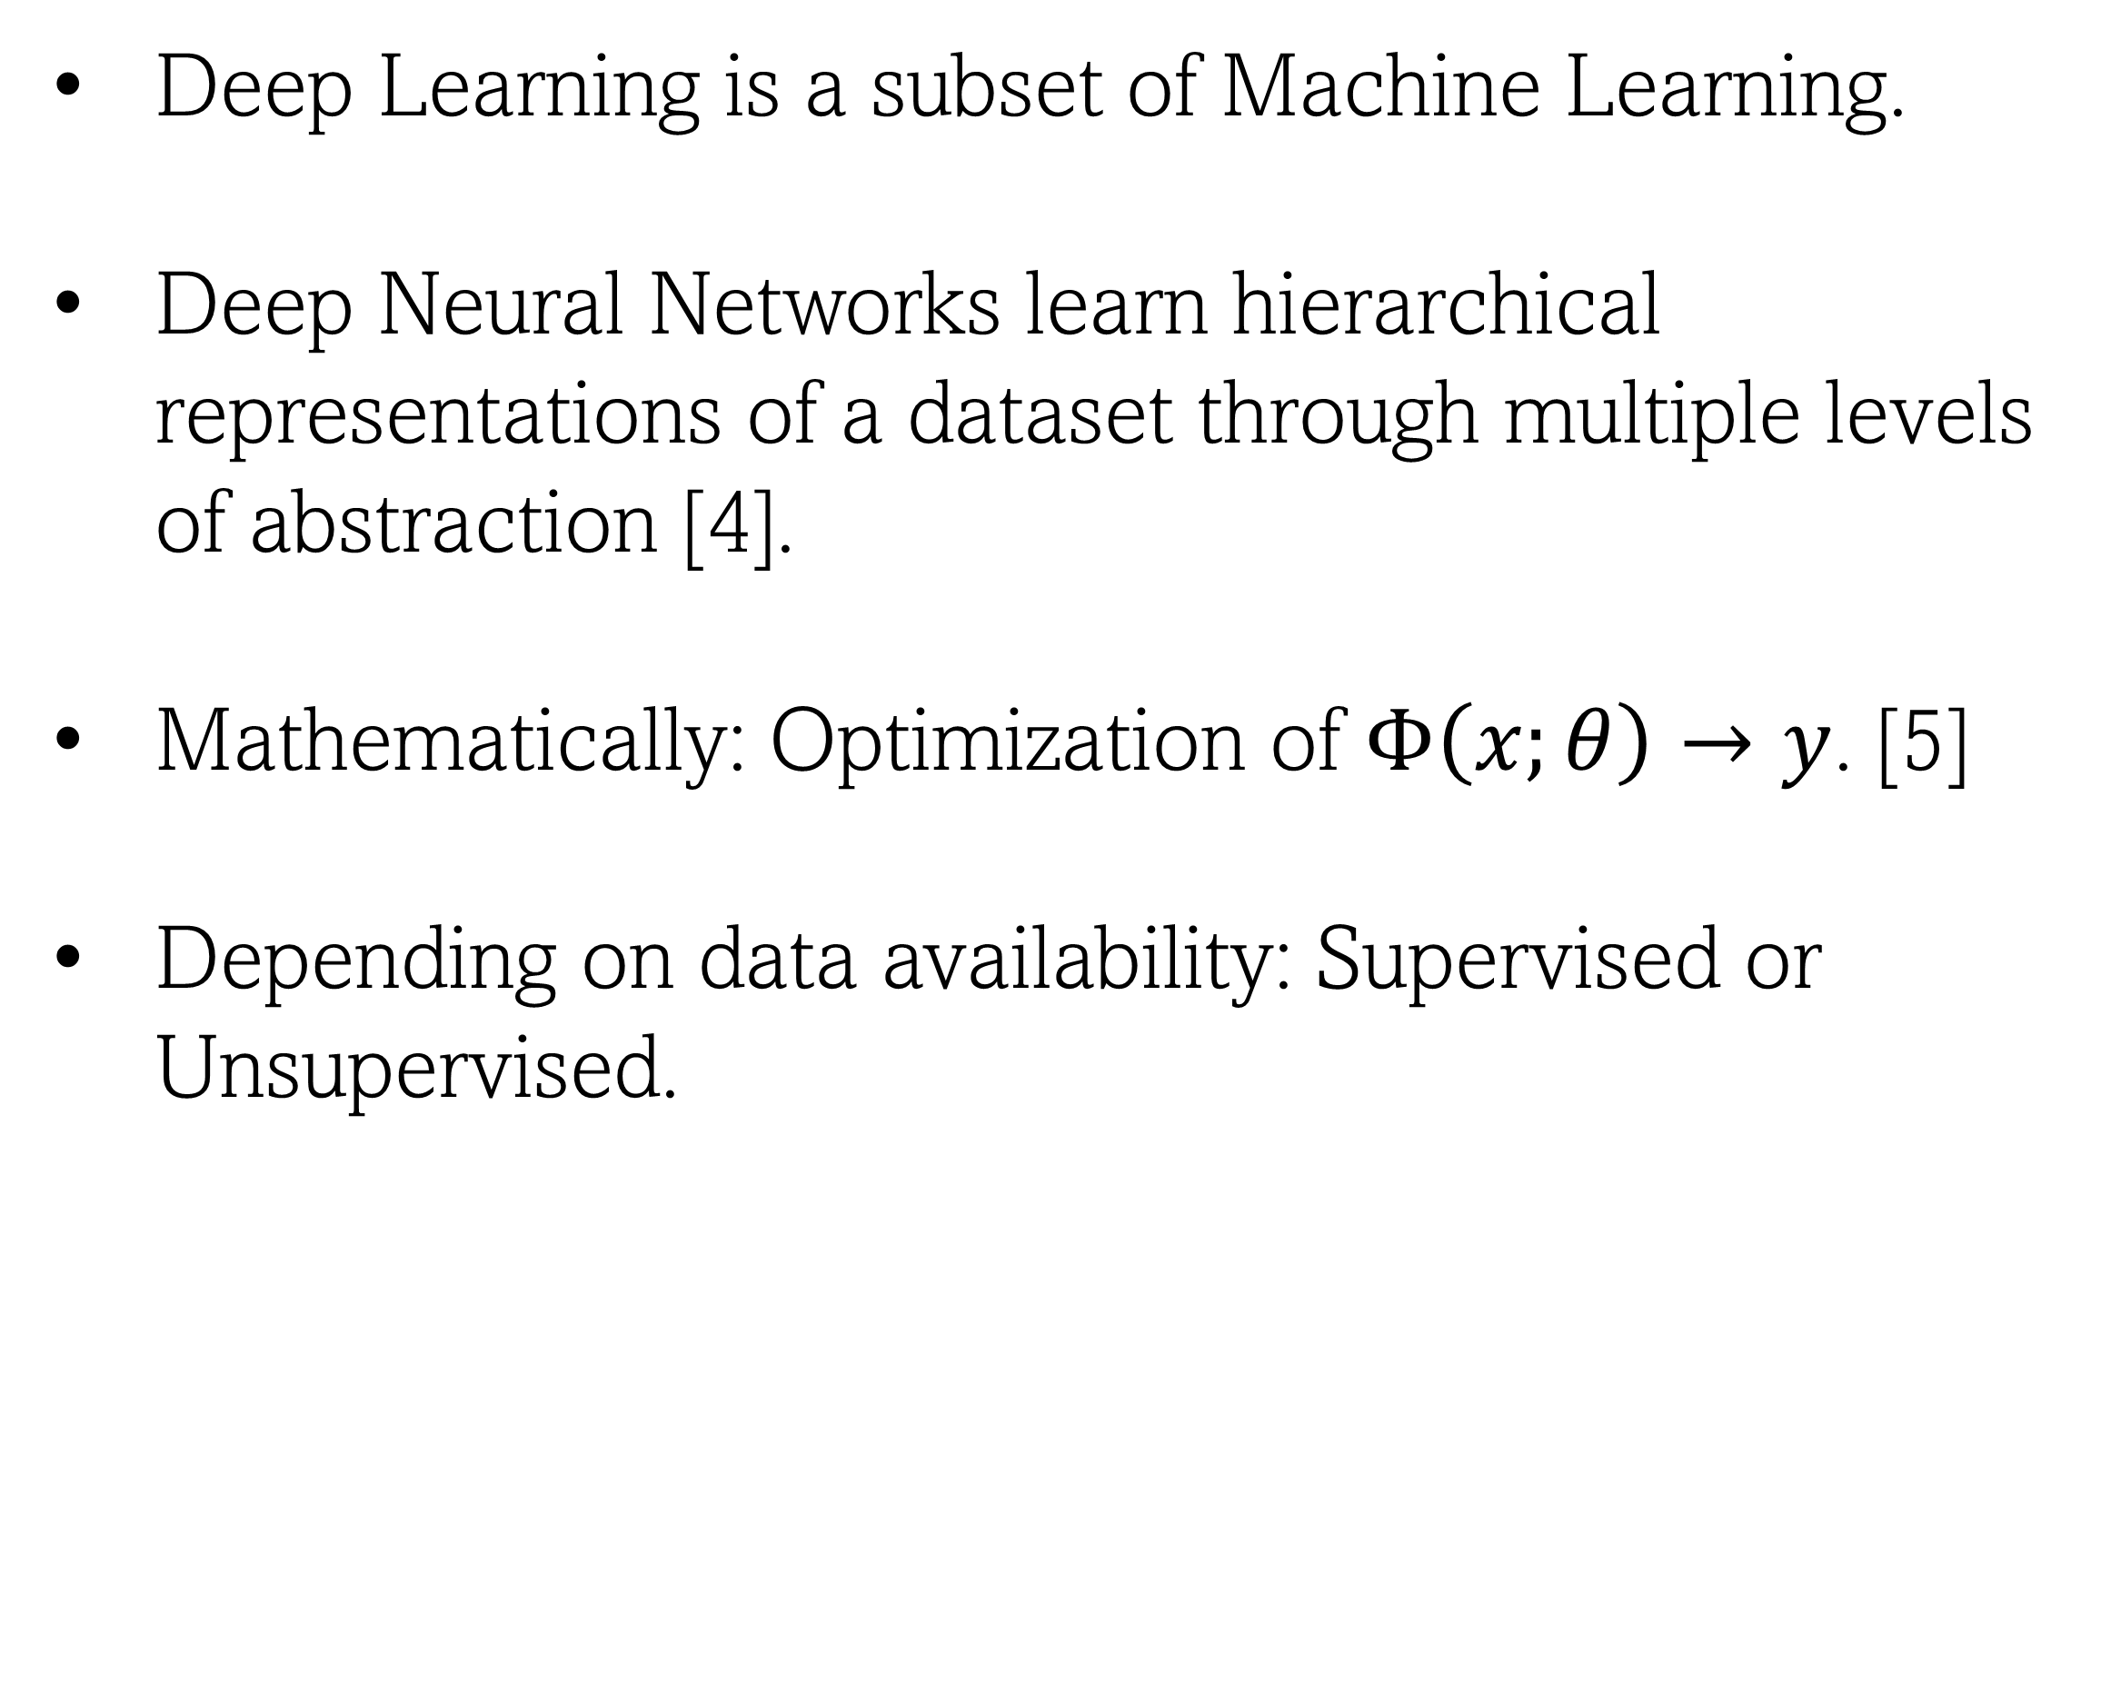
Deep Learning in a Nutshell
Deep Learning is a subset of Machine Learning.
Deep Neural Networks learn hierarchical representations of a dataset through multiple levels of abstraction [4].
Mathematically: Optimization of $Φ\left(x;θ\right)→y$. [5]
Depending on data availability: Supervised or Unsupervised.
Fig1: Segmentation task performed by Deep Learning models. Taken from [6].
3

Slide 5

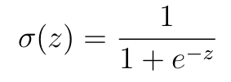

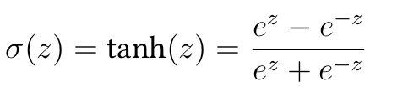

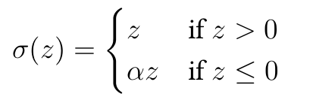




Deep Learning in a Nutshell
Optimal $Φ$
Target $y$
Loss Function
Backpropagation
Neural Network Layers
INPUT $x$
Output $\hat{y}$
Linear Transformations
Non Linear Activation
4

Slide 6

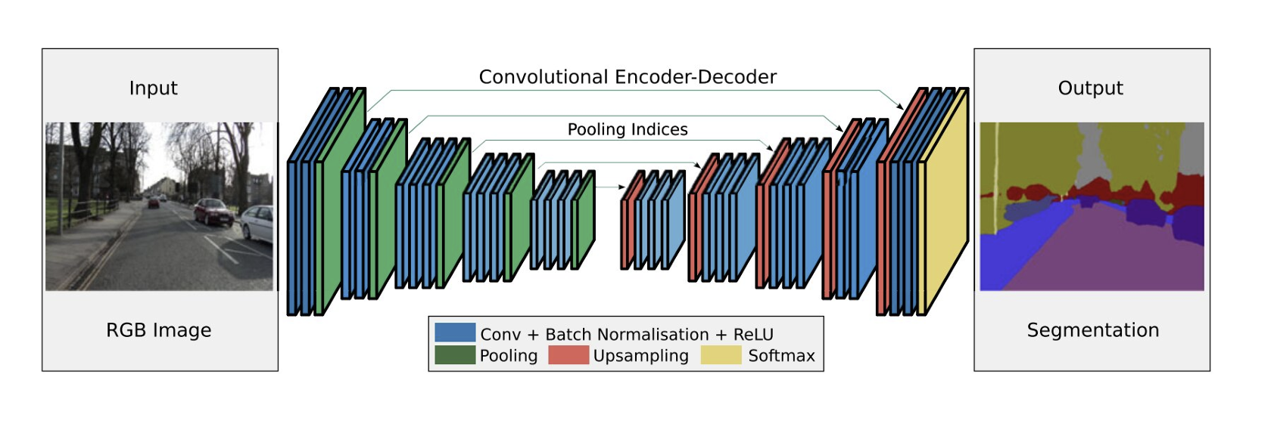
Convolutional Neural Networks
Image processing [5].
Operates on high-dimensional tensors (H x W x C).
Convolution for extracting hierarchical features [5]
Max Pooling to systematically reduce the dimensionality of input tensor [5].
Fig2: Convolutional Neural Network. Taken from [6].
5

Slide 7
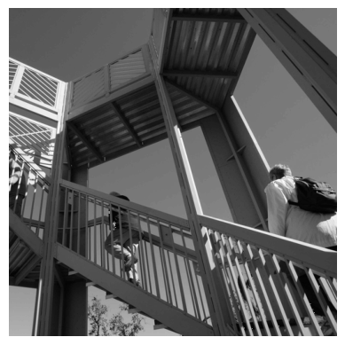
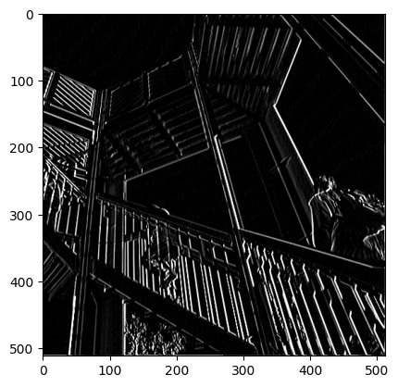
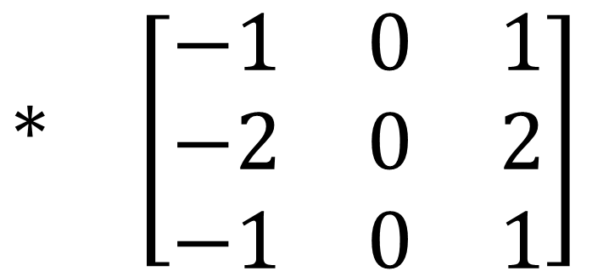
Convolutions: Practical Example
Input Image Highlight vertical borders
$$∗ \left[\begin{matrix}−1 & 0 & 1 \\ −2 & 0 & 2 \\ −1 & 0 & 1\end{matrix}\right]$$
6

Slide 8
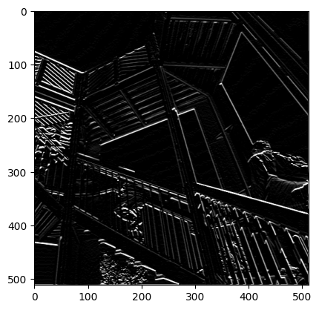
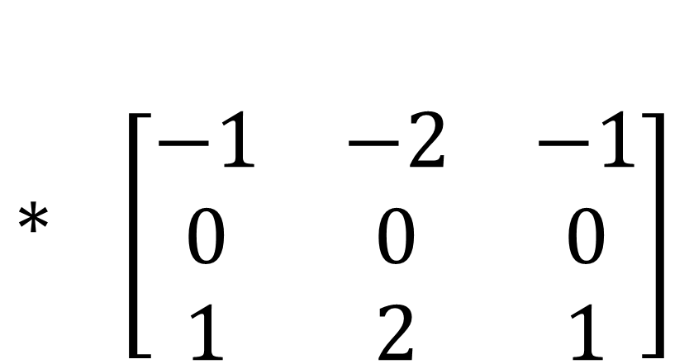
Convolutions: Practical Example
Input Image Highlight horizontal borders
$$∗ \left[\begin{matrix}−1 & −2 & −1 \\ 0 & 0 & 0 \\ 1 & 2 & 1\end{matrix}\right]$$
7

Slide 9
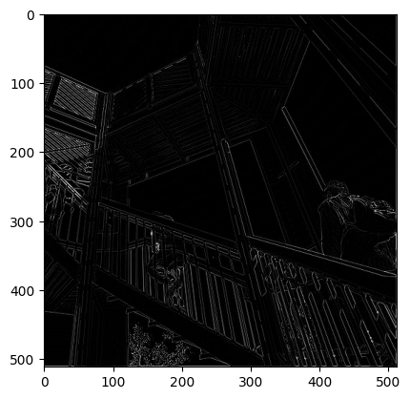
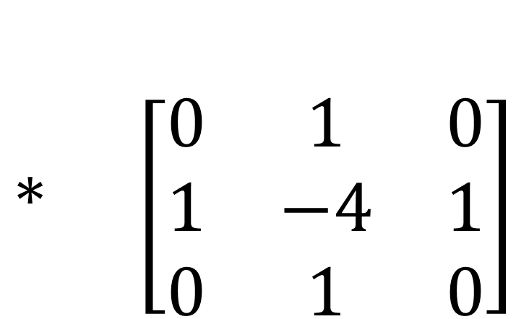
Convolutions: Practical Example
Input Image Highlight all borders
$$∗ \left[\begin{matrix}0 & 1 & 0 \\ 1 & −4 & 1 \\ 0 & 1 & 0\end{matrix}\right]$$
8

Slide 10
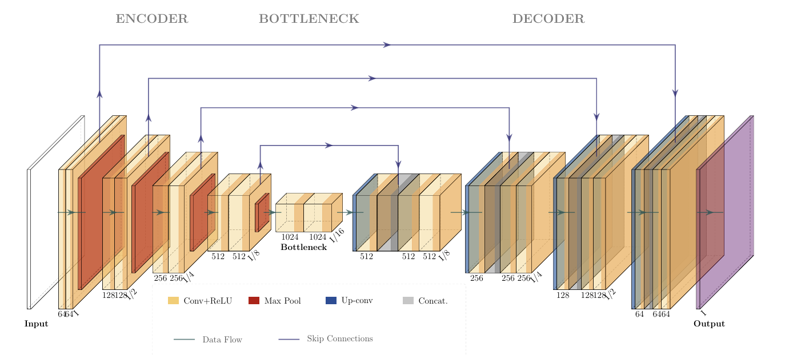
UNet: Retrieving Speckle Displacements
Fig3: UNet Architecture.
9

Slide 11
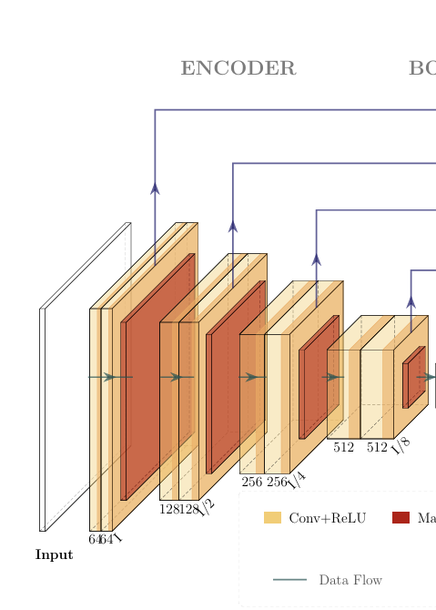
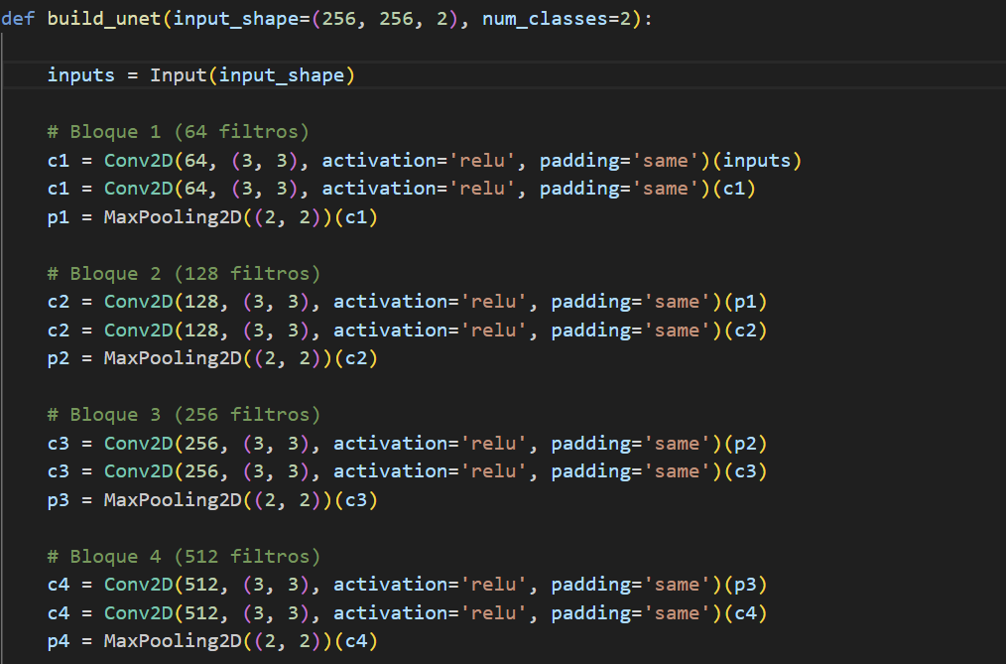
UNet: Retrieving Speckle Displacements
10

Slide 12
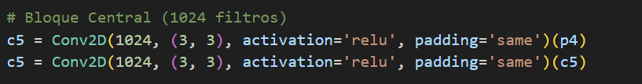
UNet: Retrieving Speckle Displacements
11

Slide 13
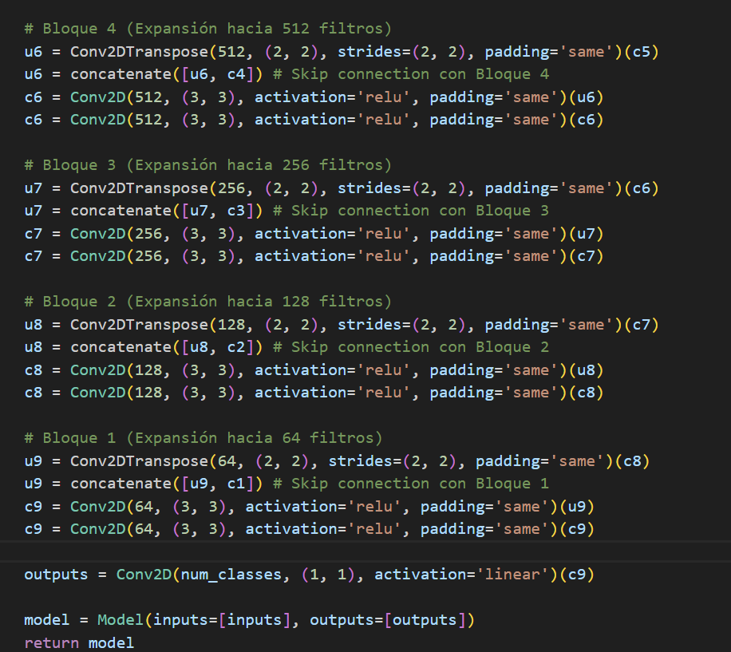
UNet: Retrieving Speckle Displacements
12

Slide 14
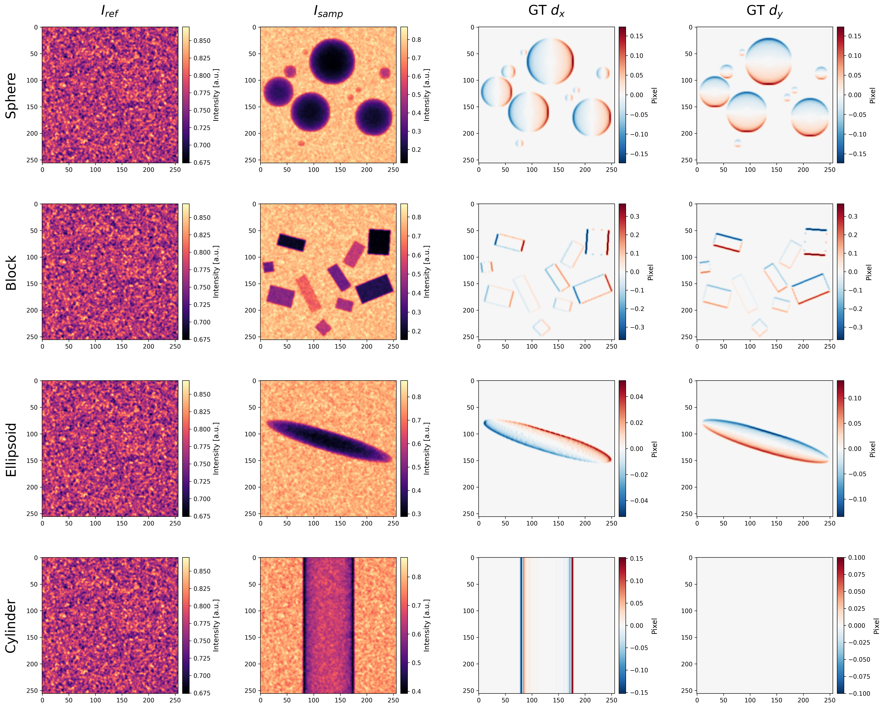

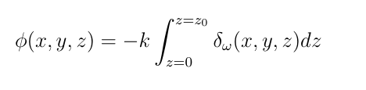

Training Dataset
600 images.
150 images per geometry.
Three materials: Al₂O₃, PMMA, Nylon.
28keV, 4 sandpapers SiC 125um, source-detector distance 2m.
Fig4: Training dataset.
13

Slide 15
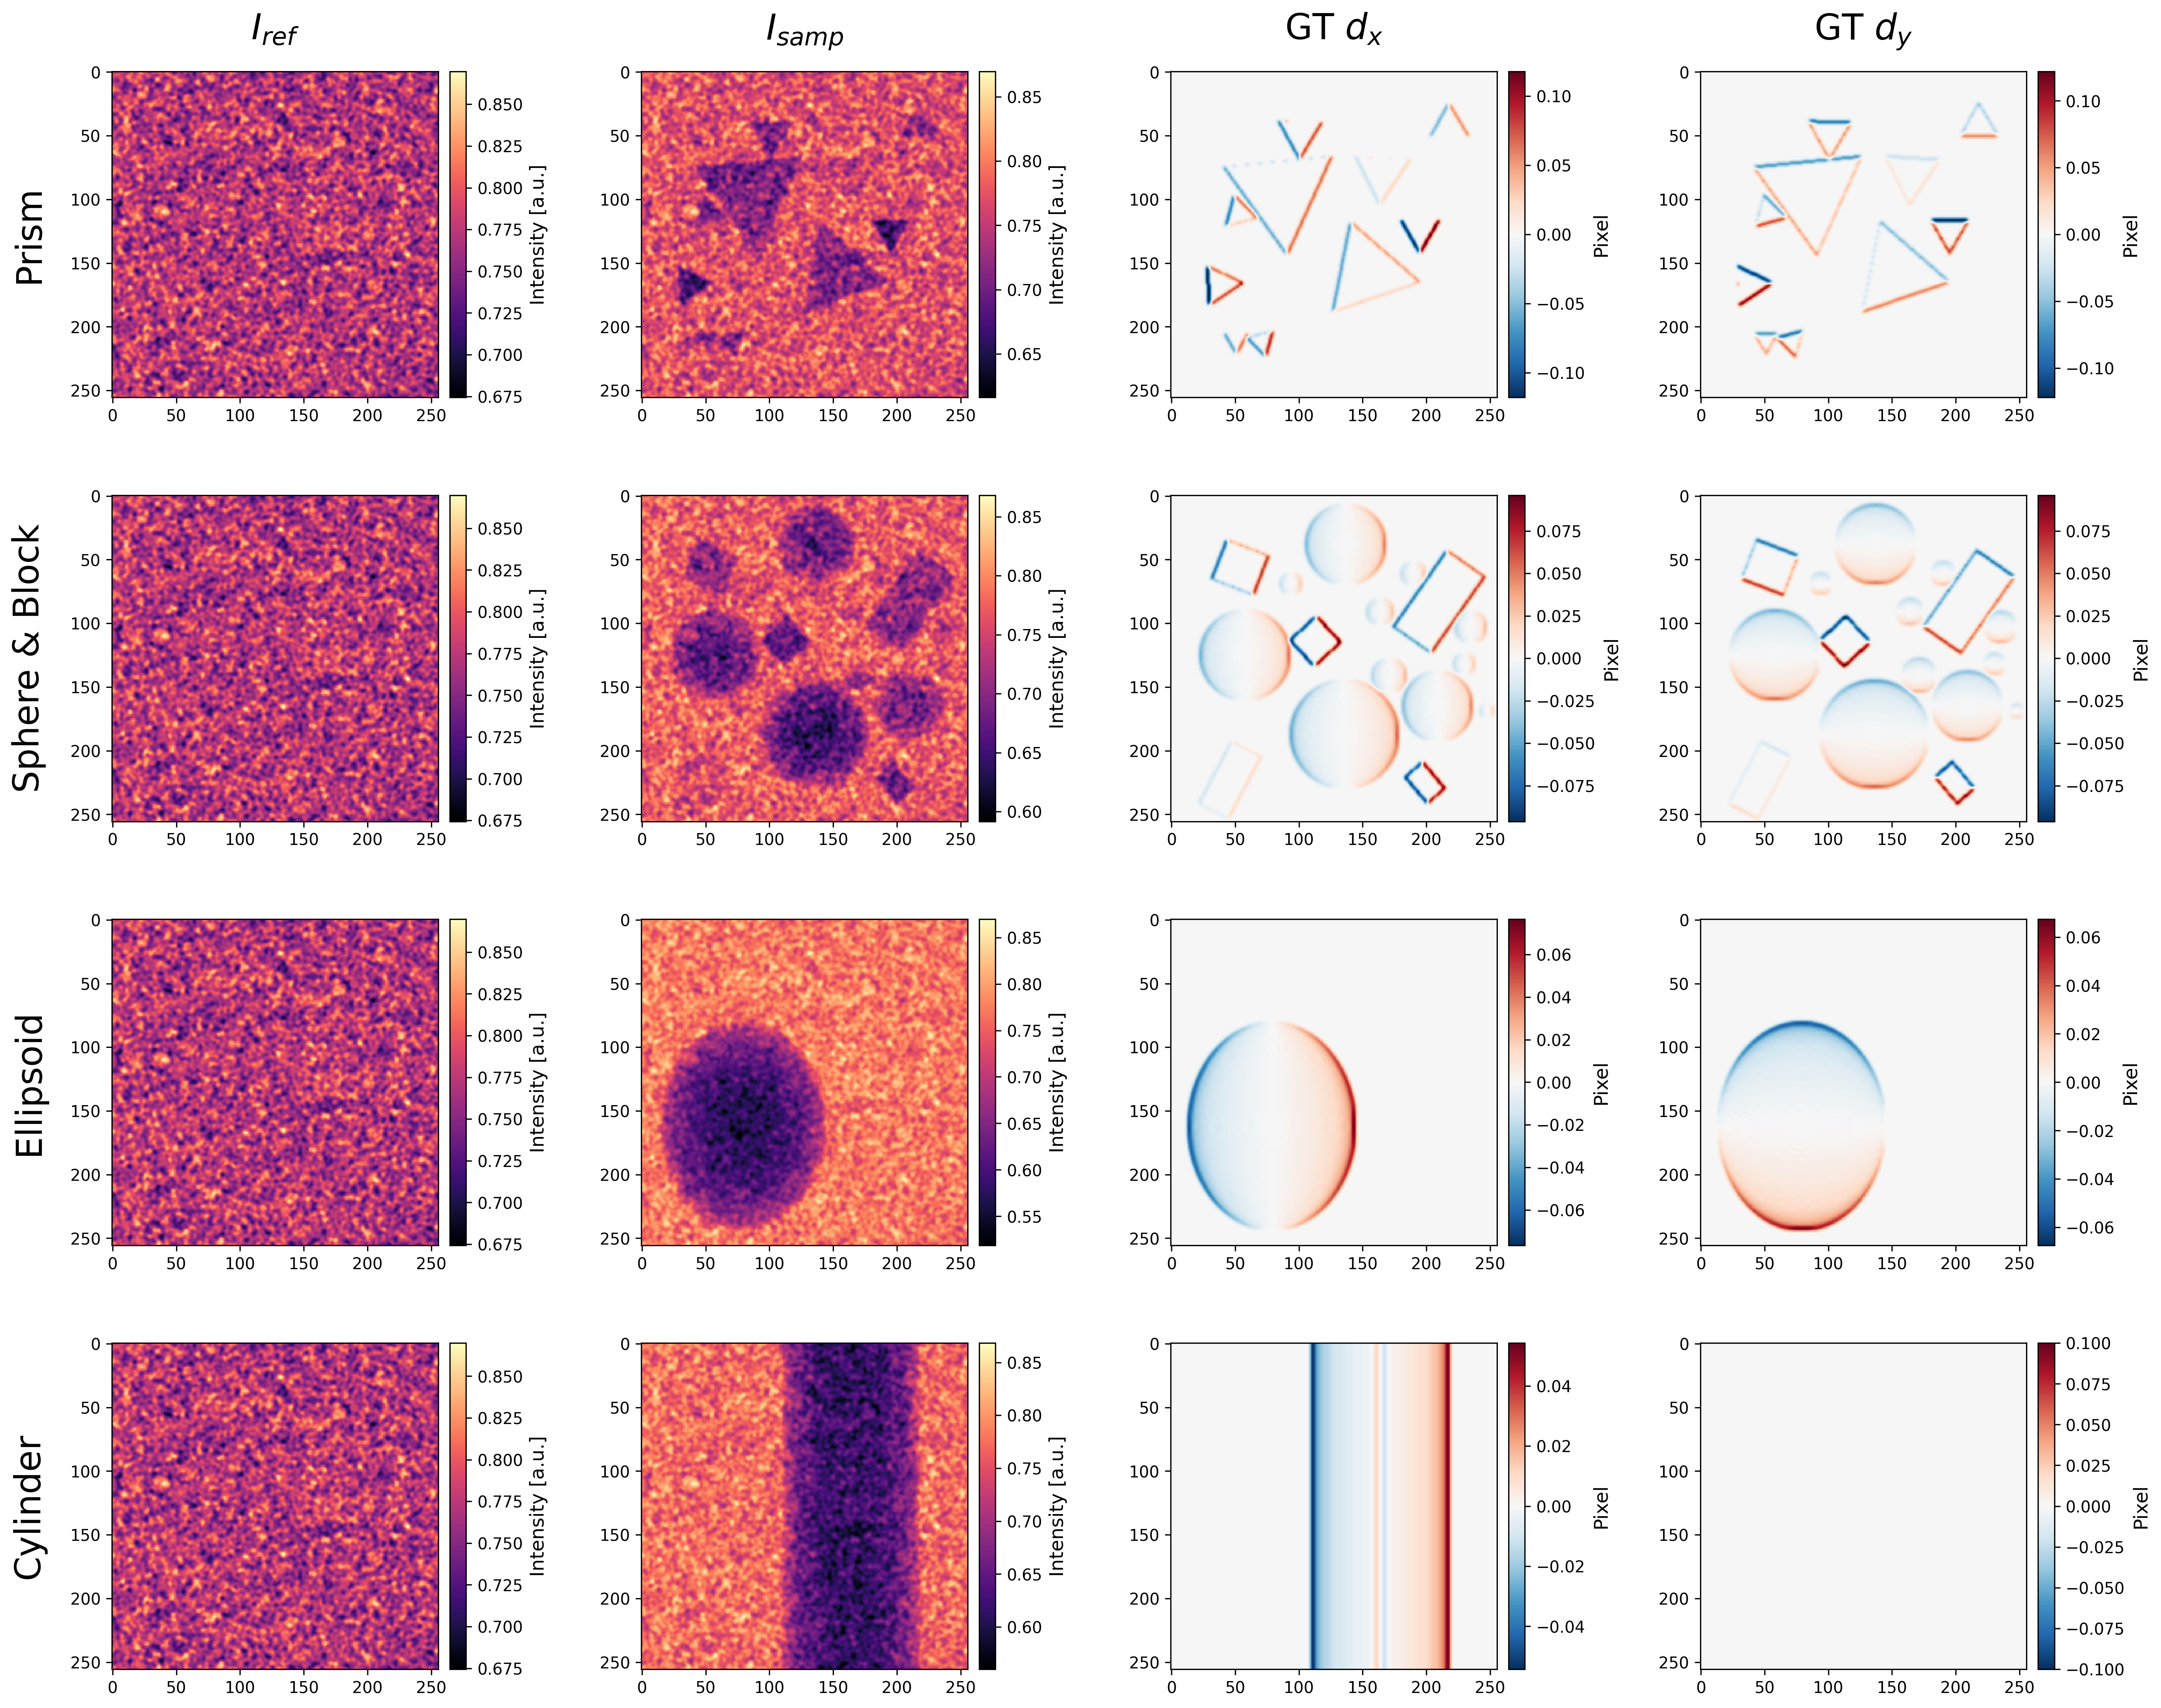
Validation Dataset
Fig5: Validation dataset.
14

Slide 16
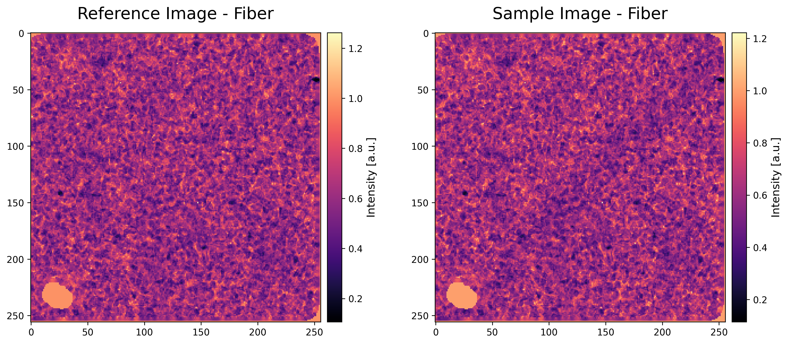
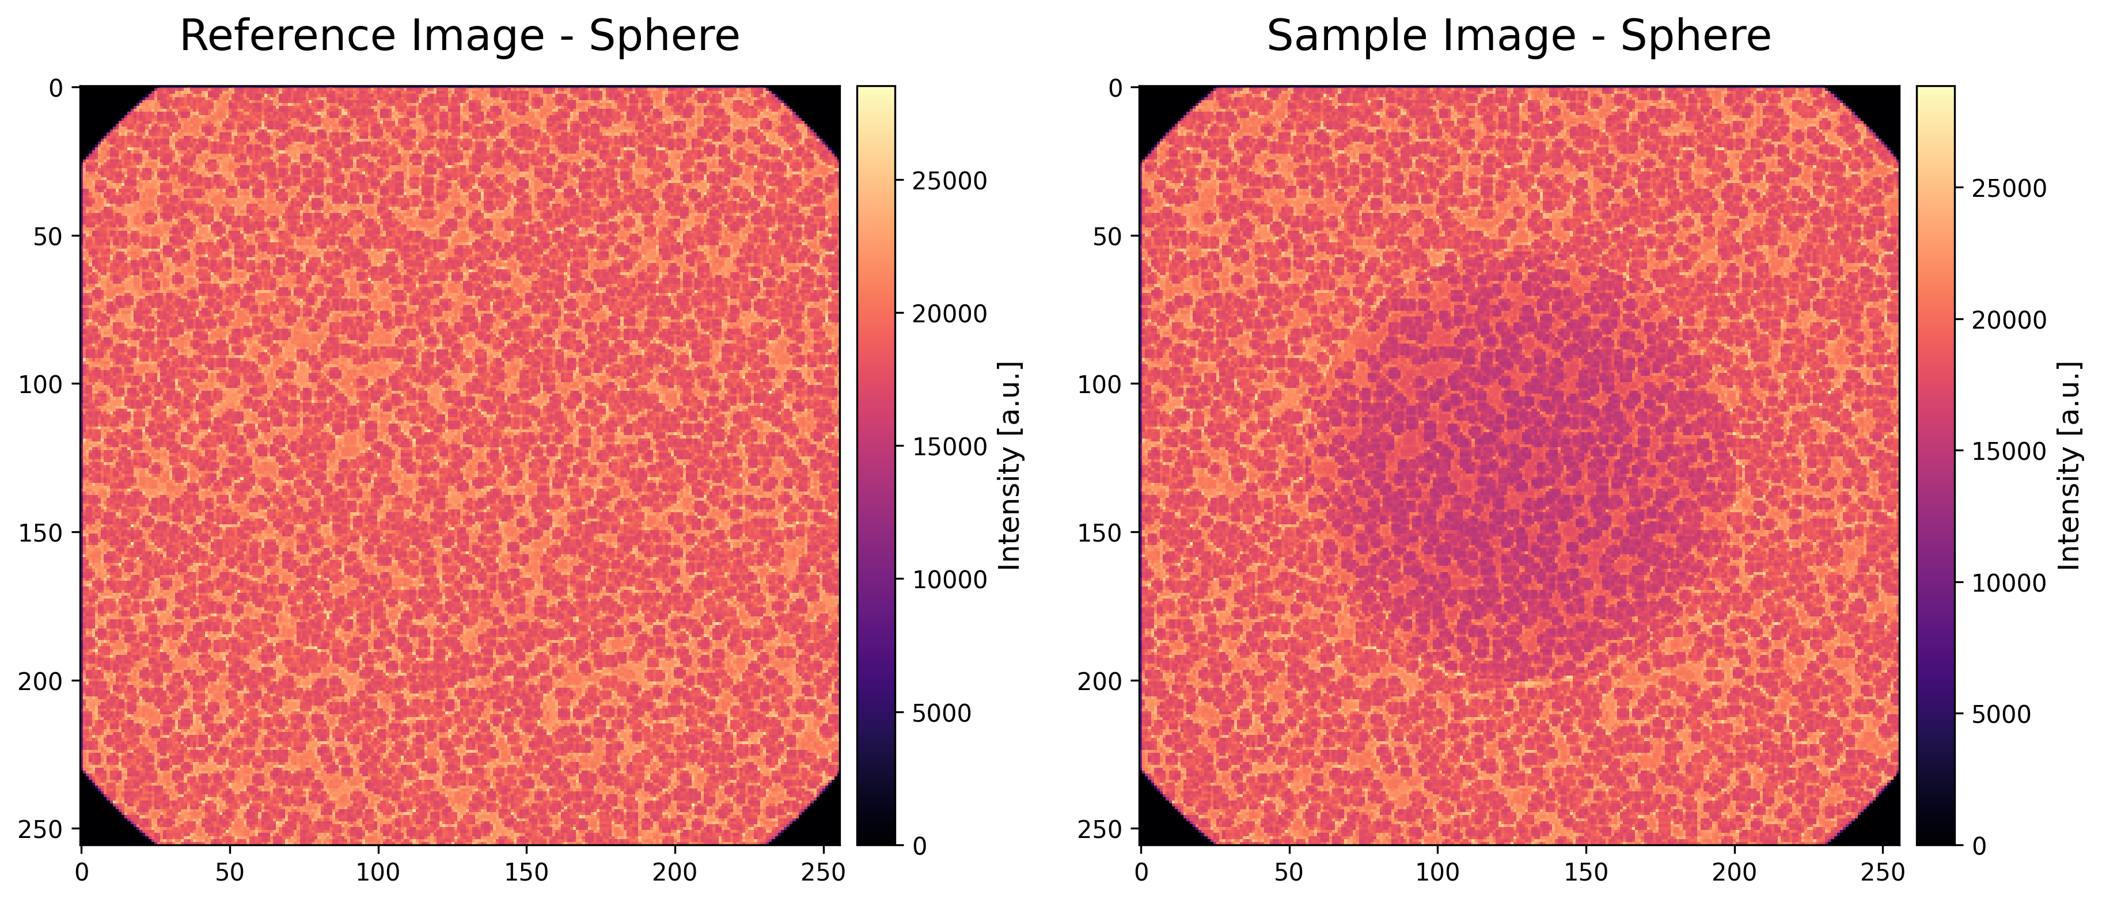
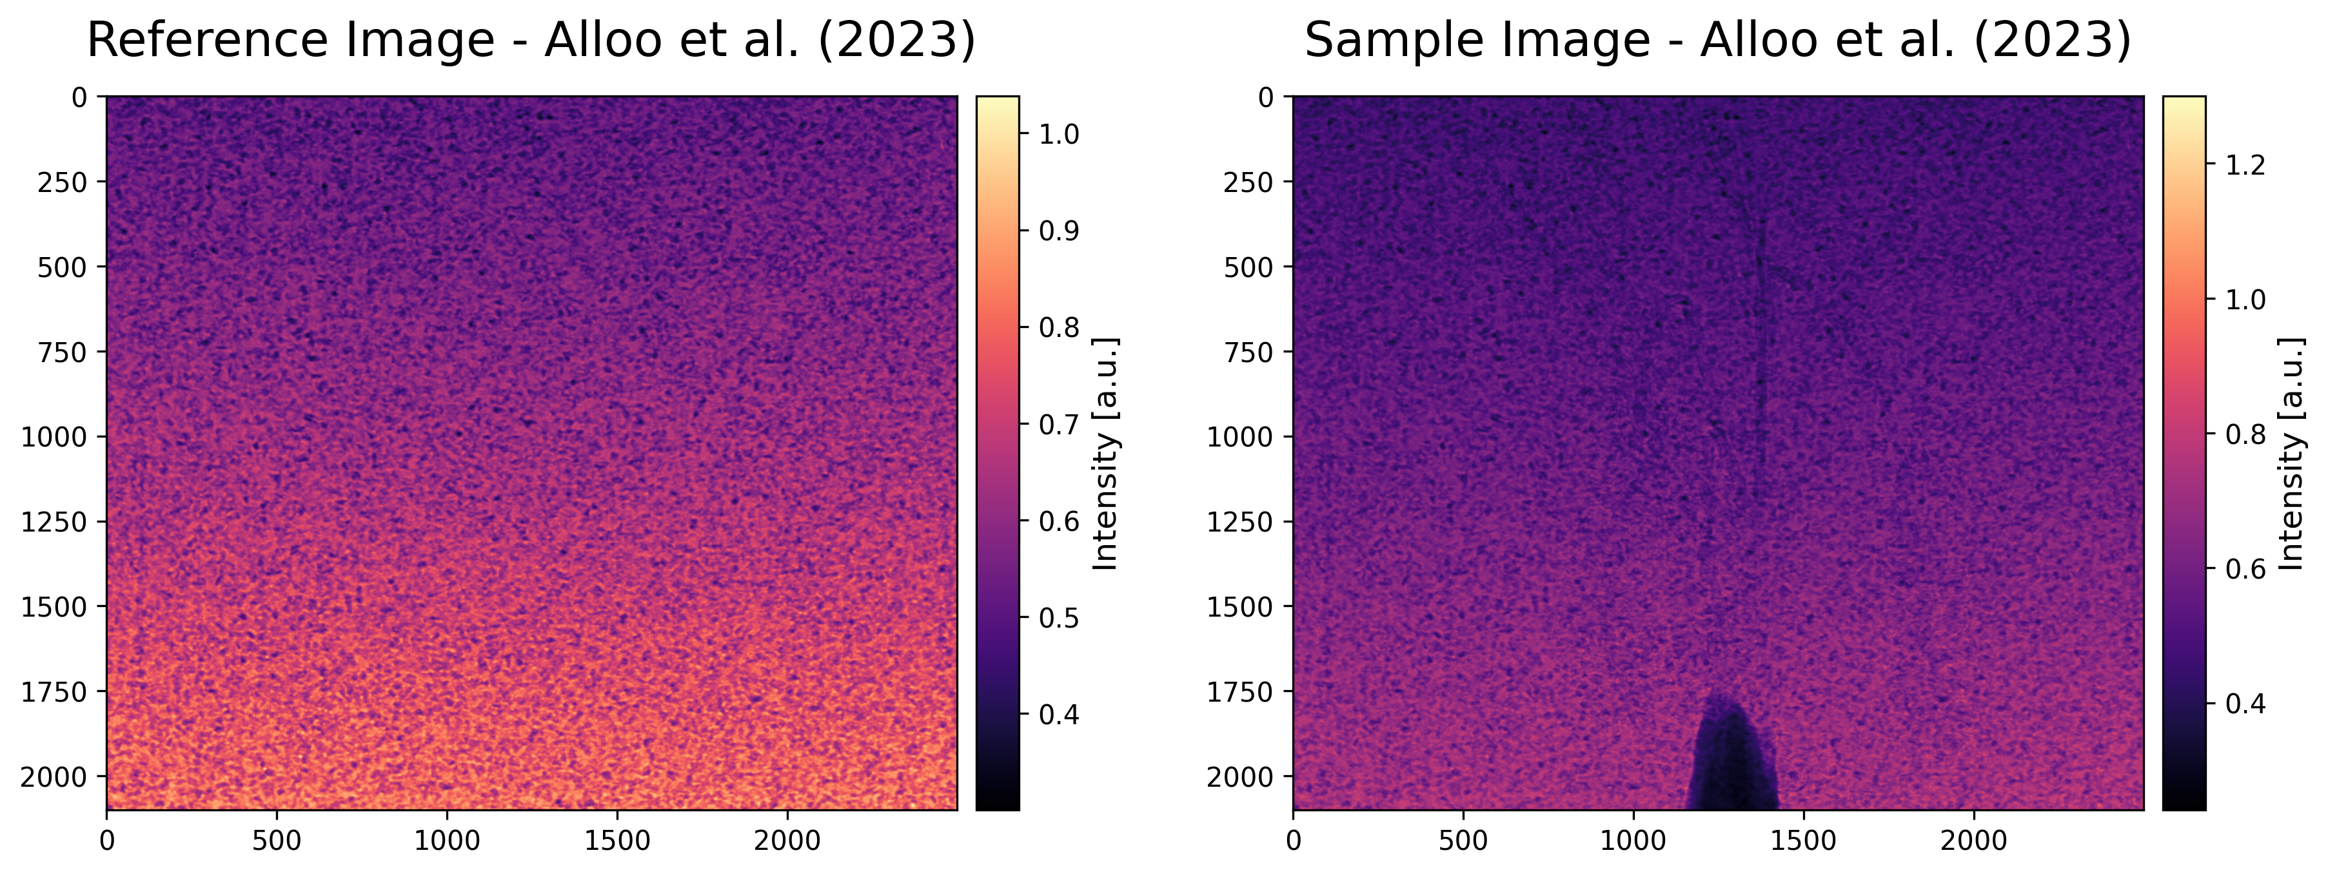
Evaluation Dataset
Fig6: Evaluation: Nylon fiber.
Fig7: Evaluation: Nylon sphere.
15
Fig8: Evaluation: Wattle flower [2].

Slide 17

Link to Google Drive
Link: https://drive.google.com/drive/folders/1TFuEhGH6aF2DhmRQAdSwJm6O6c6zZ8FN?usp=sharing
16

Slide 18
References
S. J. Alloo, D. M. Paganin, K. S. Morgan, M. J. Kitchen, A. W. Stevenson, S. C. Mayo, H. T. Li, B. M. Kennedy, A. Maksimenko, J. C. Bowden, et al., “Dark-field tomography of an attenuating object using intrinsic x-ray speckle tracking,” Journal of Medical Imaging, vol. 9, no. 3, pp. 031502–031502, 2022.
S. J. Alloo, K. S. Morgan, D. M. Paganin, and K. M. Pavlov, “Multimodal intrinsic speckle-tracking (mist) to extract images of rapidly-varying diffuse x-ray dark-field,” Scientific Reports, vol. 13, no. 1, p. 5424, 2023.
I. Zanette, T. Zhou, A. Burvall, U. Lundström, D. H. Larsson, M. Zdora, P. Thibault, F. Pfeiffer, and H. M. Hertz, “Speckle-based x-ray phase-contrast and dark-field imaging with a laboratory source,” Physical review letters, vol. 112, no. 25, p. 253903, 2014.
Y.LeCun, Y. Bengio, and G. Hinton, “Deep learning,” nature, vol. 521, no. 7553, pp. 436 444, 2015.
I. Goodfellow, Y. Bengio, A. Courville, and Y. Bengio, Deep learning, vol. 1. MIT press Cambridge, 2016
Minaee, S., Boykov, Y., Porikli, F., Plaza, A., Kehtarnavaz, N., & Terzopoulos, D. Image segmentation using deep learning: A survey. IEEE transactions on pattern analysis and machine intelligence, 44(7), 3523-3542. 2021.

