Slide 1


Slide 2

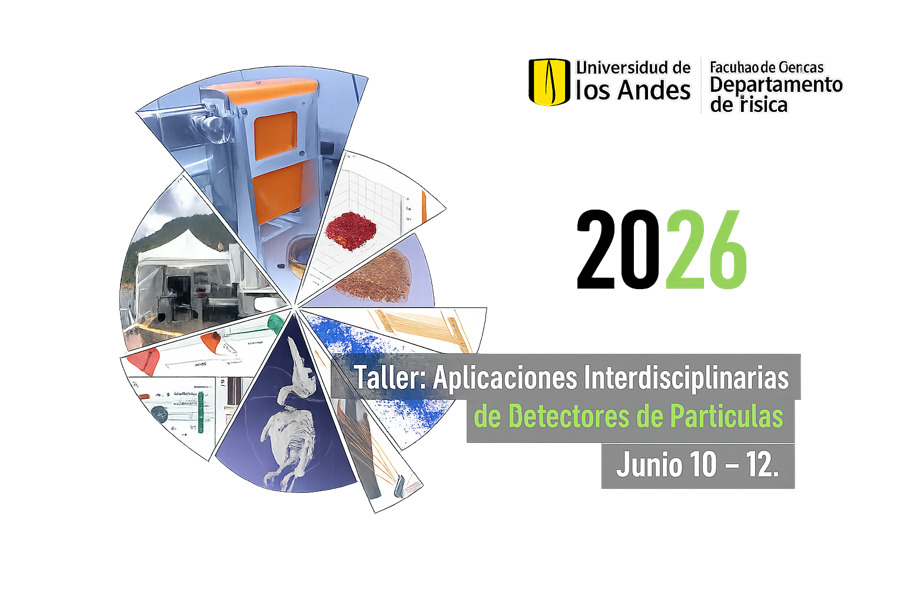
Detection of thermal neutrons and its applications
Luis Ricardo Beltran, Deywis Moreno
Bogotá, Colombia
2026

Slide 3
Introduction

Slide 4
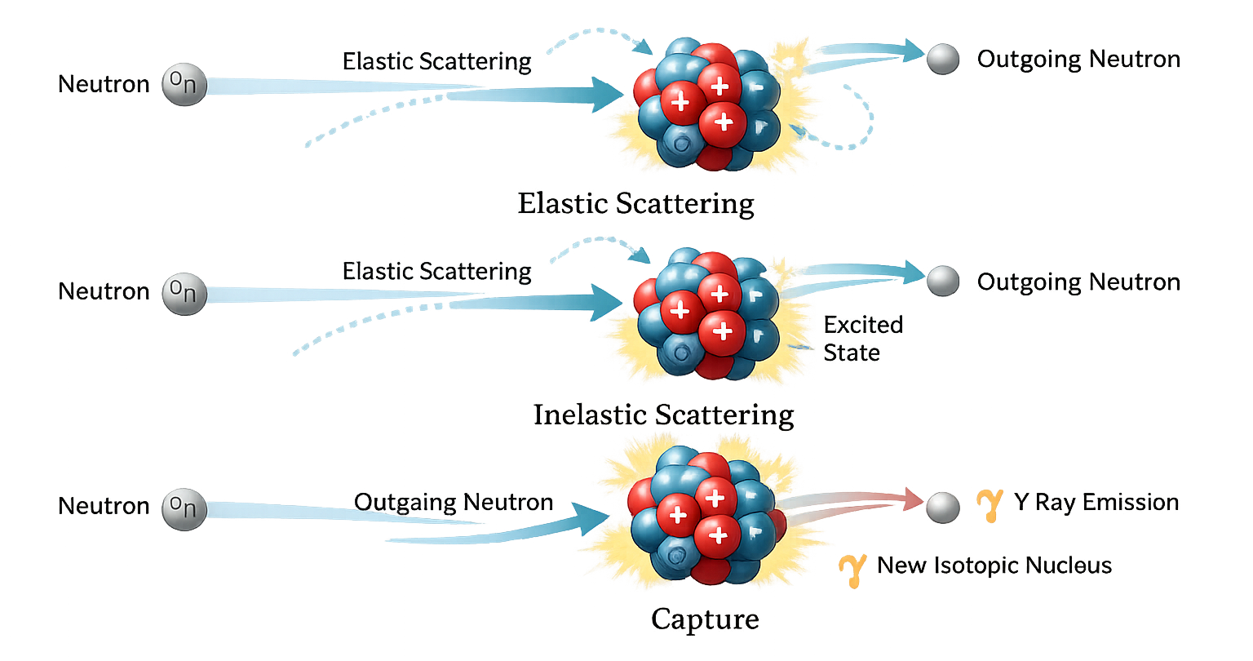
Neutron interaction
Main difficulties of detection:
Neutrons are electrically neutral.
They do not ionize matter directly.
Detection relies on interaction with a converter material to produce detectable charged particles

Slide 5
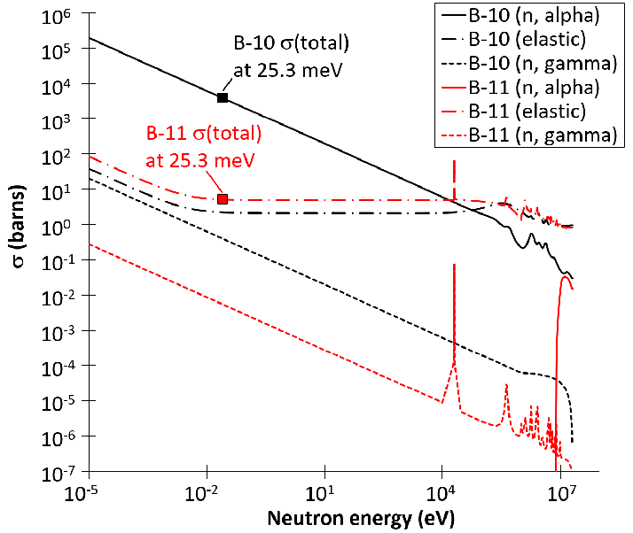
Neutron interaction
Neutron category by energy
Neutron category | Energy
Thermal Neutron | <0.025eV
Epithermal Neutron | >0.025eV <1eV
Fast Neutron | >1eV
Cross-section of the boron-10 and boron-11 as a function of neutron energy. Source: Reproduced
From: [1]

Slide 6
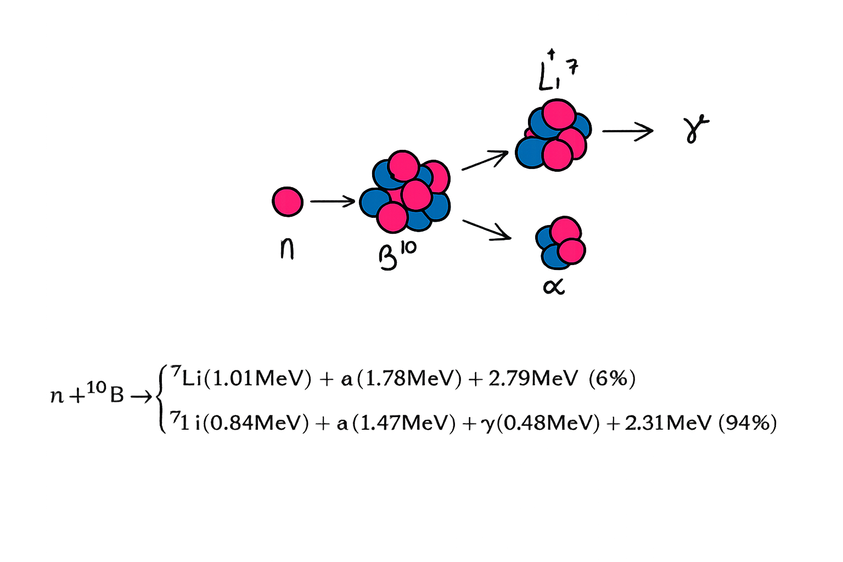

Theoretical framework
Capture of neutron for $B^{10}$

Slide 7
Applications

Slide 8
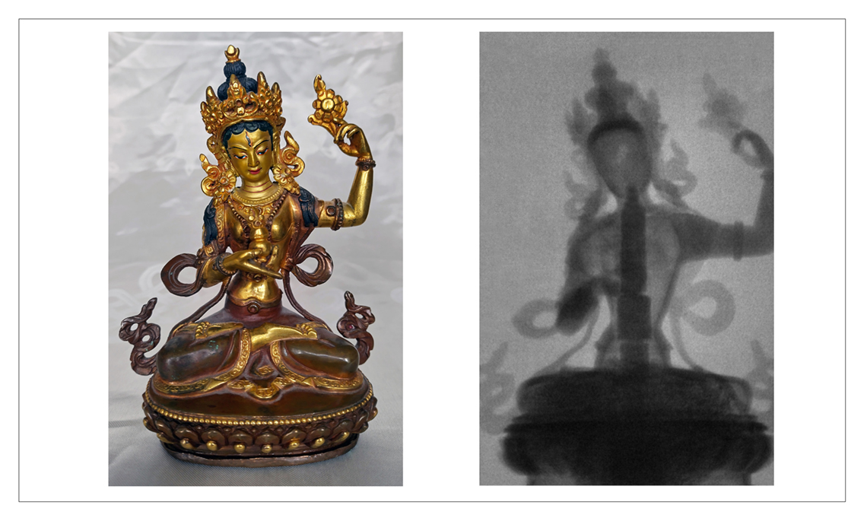
Applications – Neutron Imaging
The neutron imaging system at the Czech Technical University in Prague (CTU) revealed an axis mundi (a symbol of the connection between the physical and spiritual worlds) inside a Tibetan Bon statue of Chamma. (Photos: L. Sklenka/CTU)
Source: https://www.iaea.org/bulletin/advances-in-neutron-imaging-create-opportunities-for-low-power-research-reactors

Slide 9
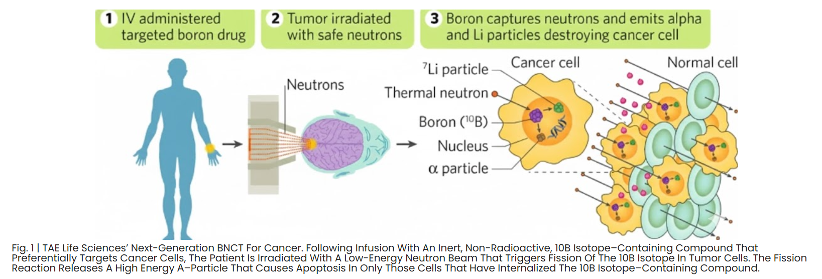
Applications - BNCT For Cancer
Source: https://taelifesciences.com/developing-targeted-drugs-for-boron-neutron-capture-therapy-to-treat-refractory-cancers/

Slide 10
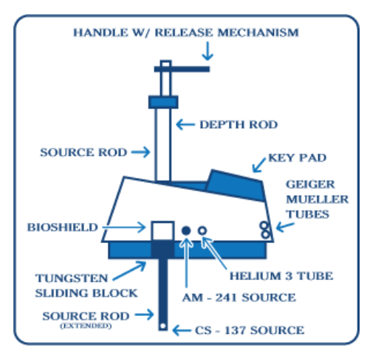
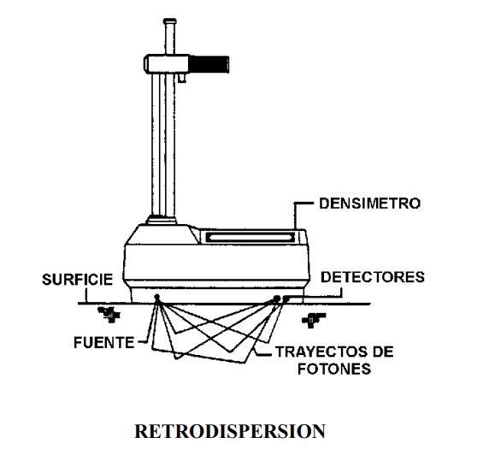
Applications - Engineering
Nuclear Densimeter
Source: https://www.apnga.com/gauge-basics/

Slide 11
Setup

Slide 12
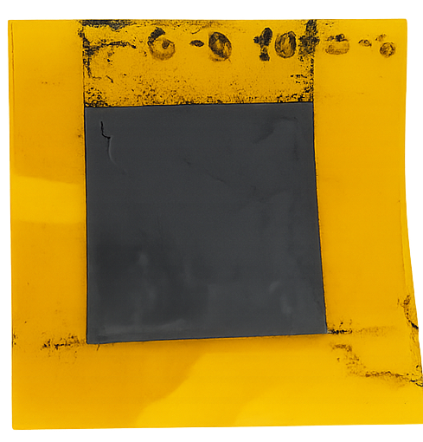
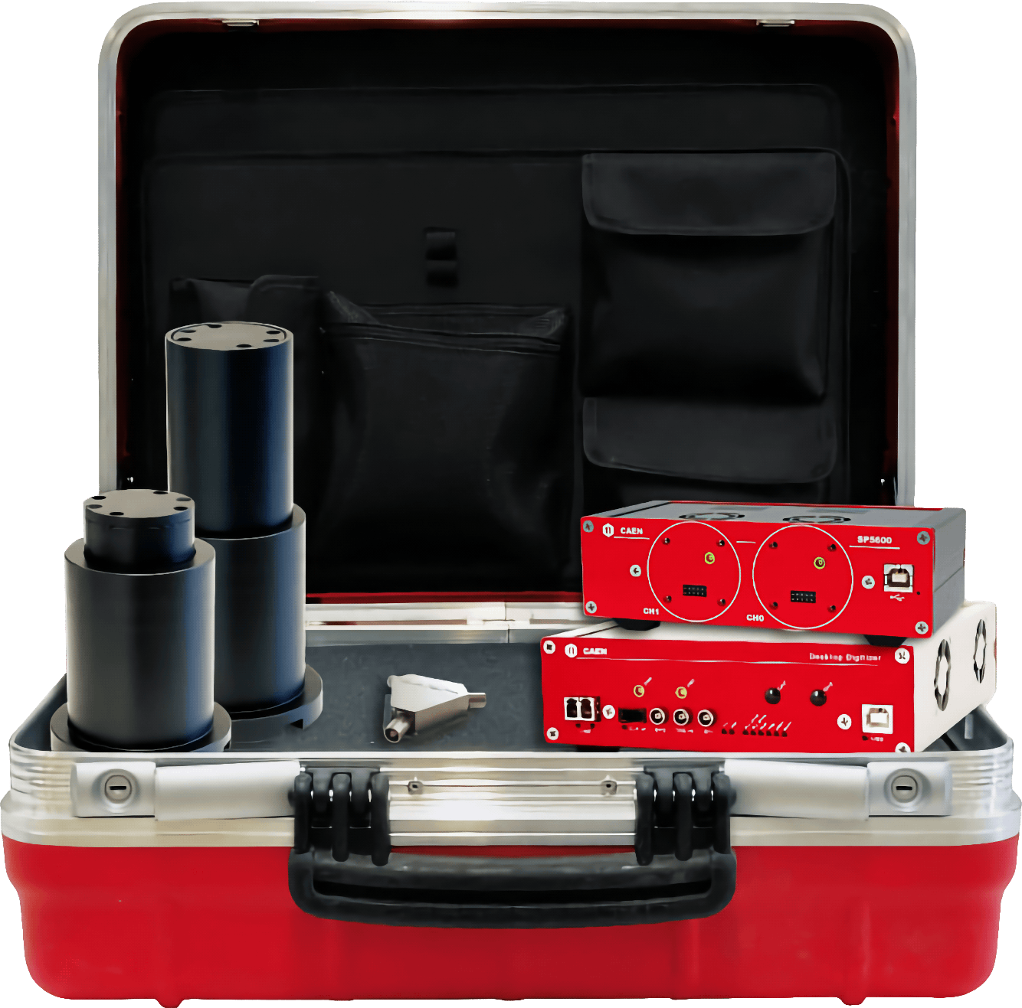


Setup
SP5600AN Educational Kit - Premium Version
Boron-doped graphene film
Lab Nanomateriales of UniAndes
Prof. Yenny Hernandez

Slide 13
Methodology

Slide 14
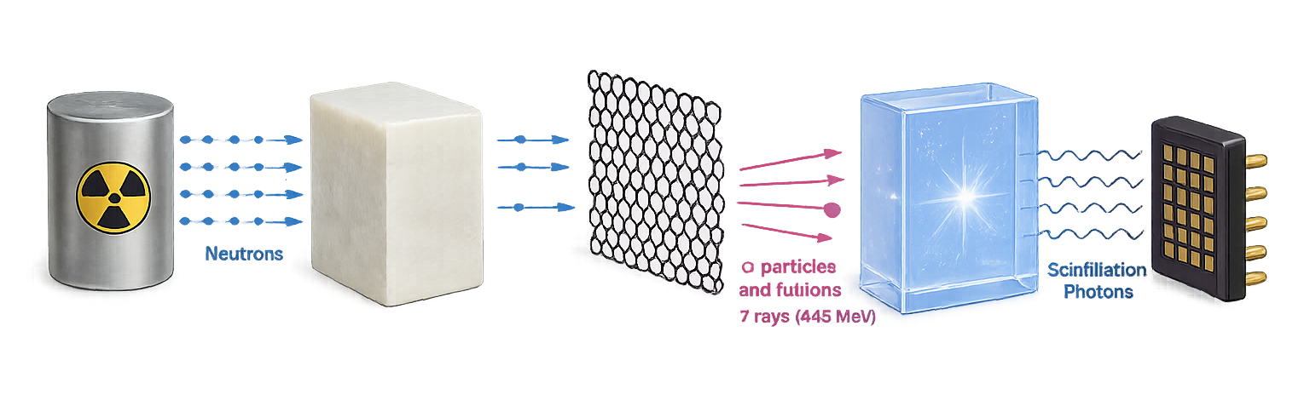

System Design
Fast Neutrons
Thermal Neutrons
$$α$$
$$γ$$
$${Li}^{7}$$
Optical
Photons
Am-Be Source
Generate Neutrons of mean energy of 4.5MeV and Gammas of 4.4MeV
Paraffine moderator
Thermalization of fast neutrons to 0.025ev
Boron-Graphene Film
Capture of thermal neutrons and generate alpha particles, Li7 ions and gammas (0,48MeV)
Scintillator Crystal
The gammas deposited their energy and generate optical photons
SiPM
Generate an electric signal for one optical photon

Slide 15
Simulation

Slide 16
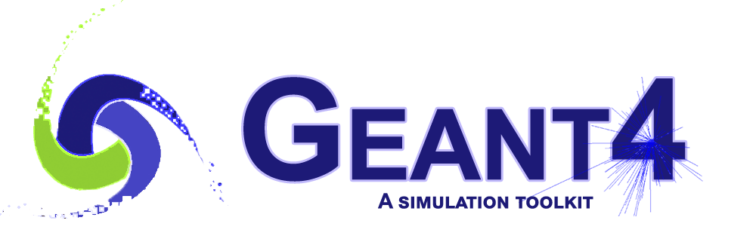


Geant4 Simulation
Geant4 (11.4.0): Monte Carlo simulation of neutron transport, geometry design and interactions.
ROOT (6.37.1): Analysis of energy spectra and particle distributions.
Uproot (5.6.6): Python library for automated extraction of ROOT data for batch processing.

Slide 17
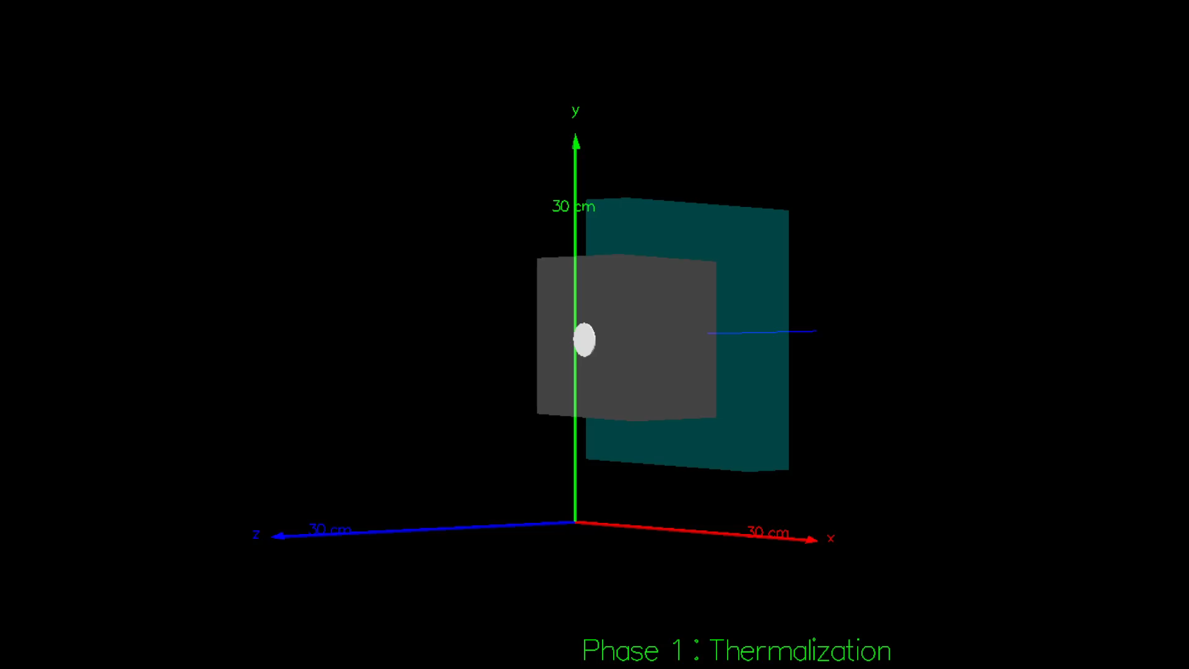
Thermalization
Geometry:
Lead (x=20cm, y=20cm z=4cm)
Paraffine (x,y,z variables)
Detector
Primary Generator Action:
Neutrons and gamma source:
AmBe ISO 8529-1
Physics:
QGSP_BERT_HP

Slide 18
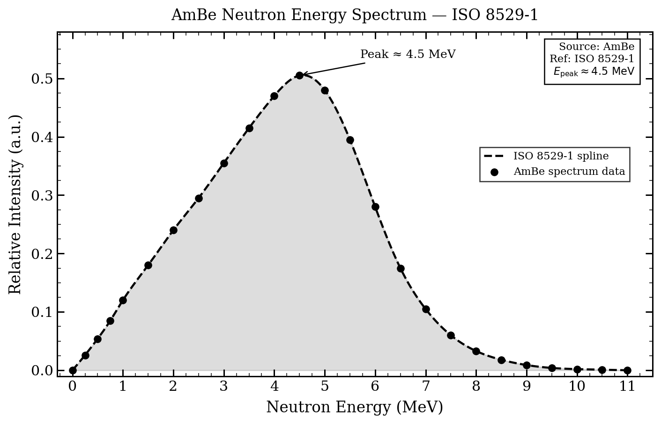
Thermalization – AmBe Source
  Isotropic
  range 0-11 MeV
  mean ~4.5 MeV
  60% of times generate one gamma of 4.4 Mev

Slide 19
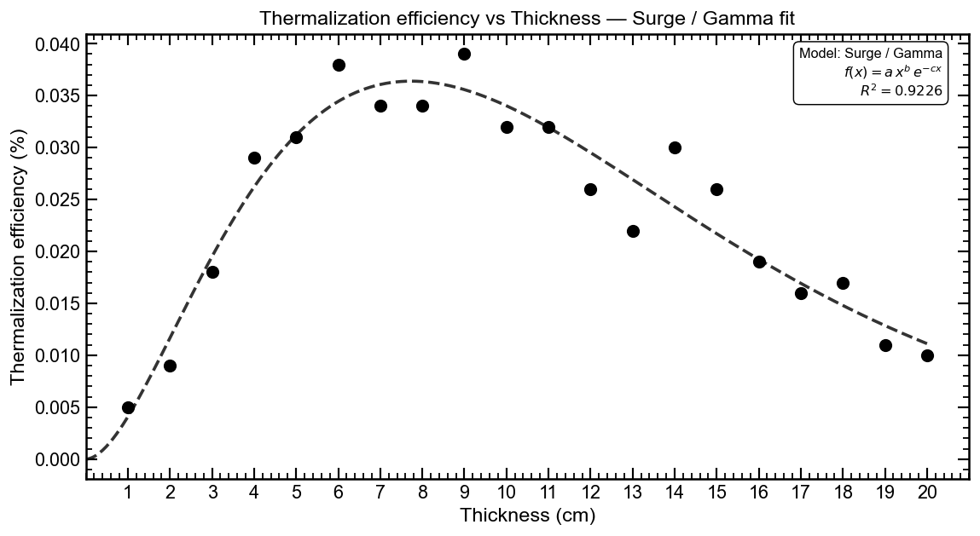
Thermalization – Thickness, Height and Width
Geometry Paraffin
0cm< x <20cm
0cm< y <20cm
0cm< z <20cm
Step = 1cm
Total simulations:
  8,000
Events for simulation:
100,000 events

Slide 20
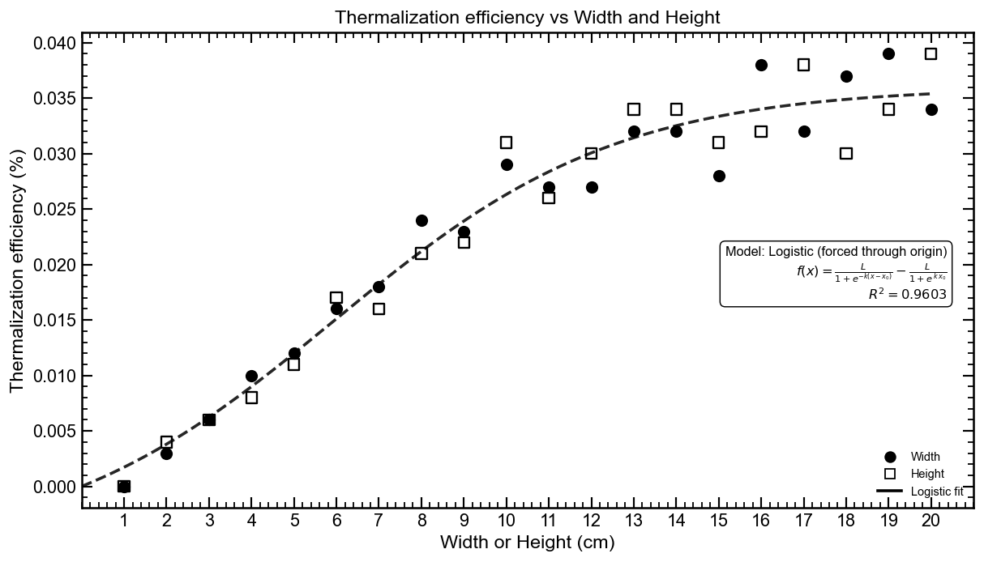
Thermalization – Thickness, Height and Width
Geometry Select:
  Height=12cm
  Width=12 cm
  Thickness= 8cm

Slide 21
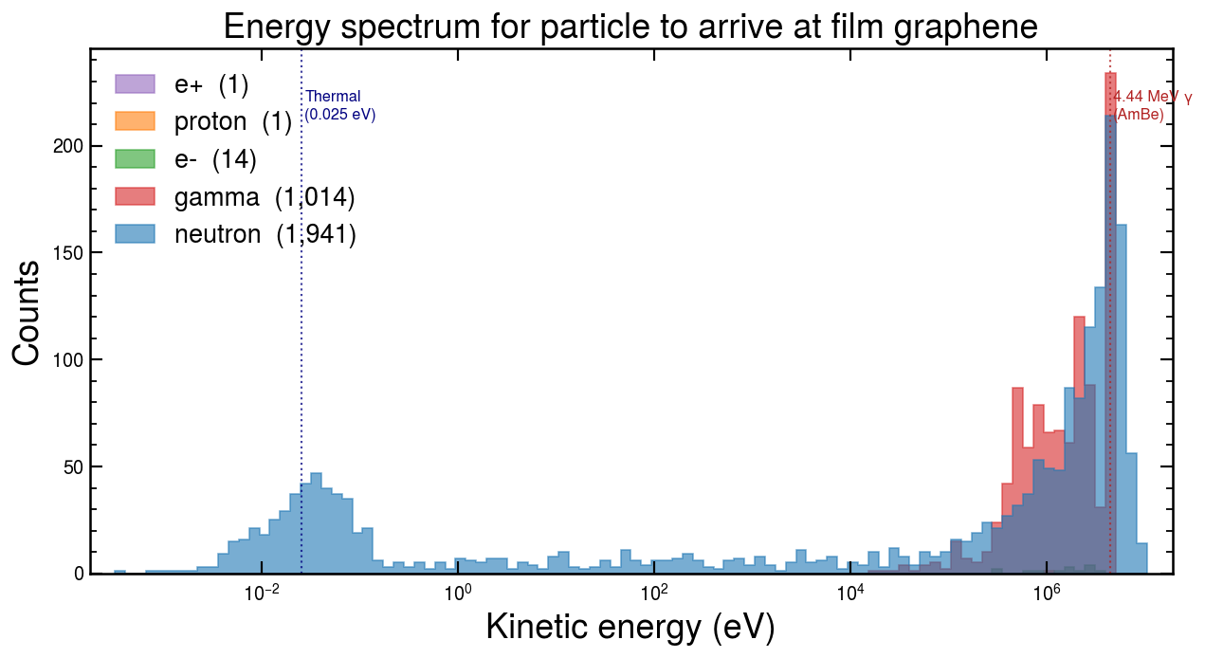
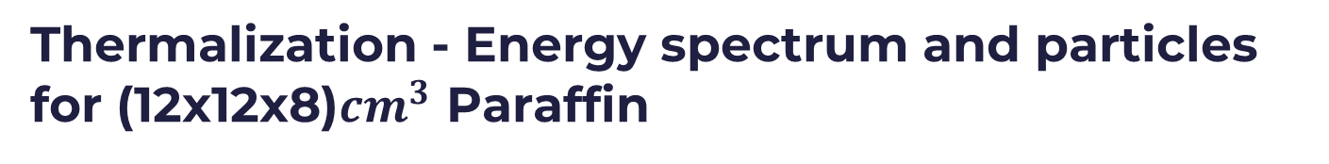
Thermalization - Energy spectrum and particles for (12x12x8)$cm^{3}$ Paraffin
Particles | Counts | % of 1,000,000 events
Fast Neutron | 1495 | 0.15%
Thermal Neutron | 446 | 0.04%
Gamma | 1014 | 0.10%
Electron | 14 | 0.001%
Positron | 1 | 0.0001%
Proton | 1 | 0.0001%
Total | 2971 | 0.29%

Slide 22
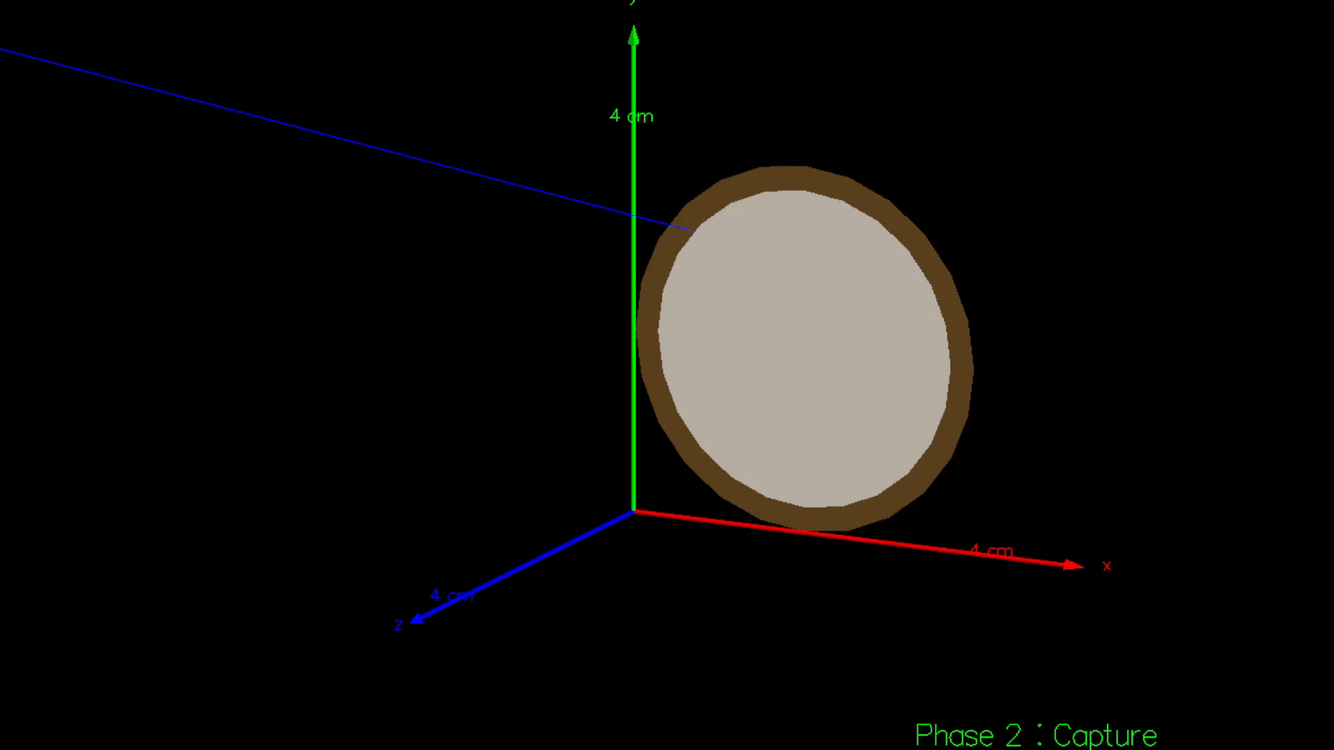
Neutron capture
Geometry:
Kapton (r=1.4cm, thickness=120um)
Film Graphene-B10 (r=1.3cm, thickness=Variable um)
% Of boron:
Variable
Primary Generator Action:
Particles in detector of Phase 1 after thermalization
Physics:
QGSP_BERT_HP

Slide 23
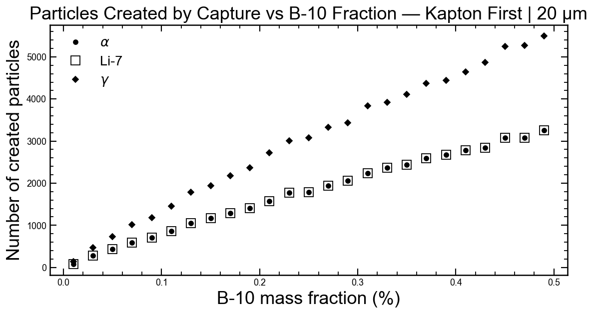
% Capture vs %Boron

Slide 24
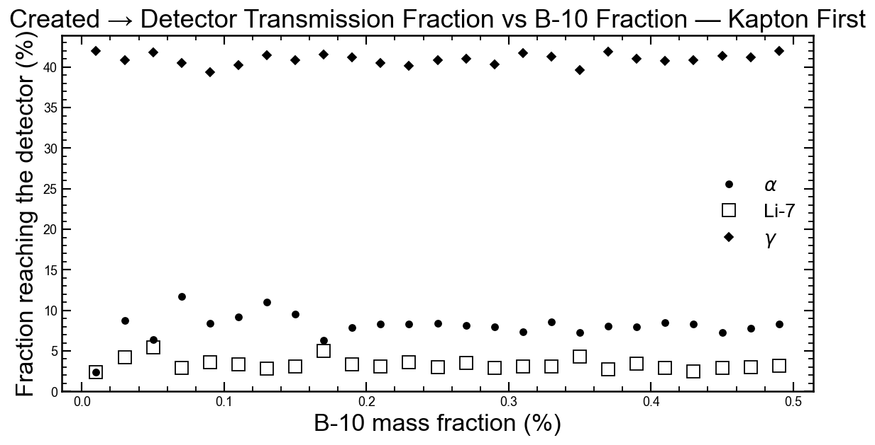
% Particles in detector vs %Boron

Slide 25
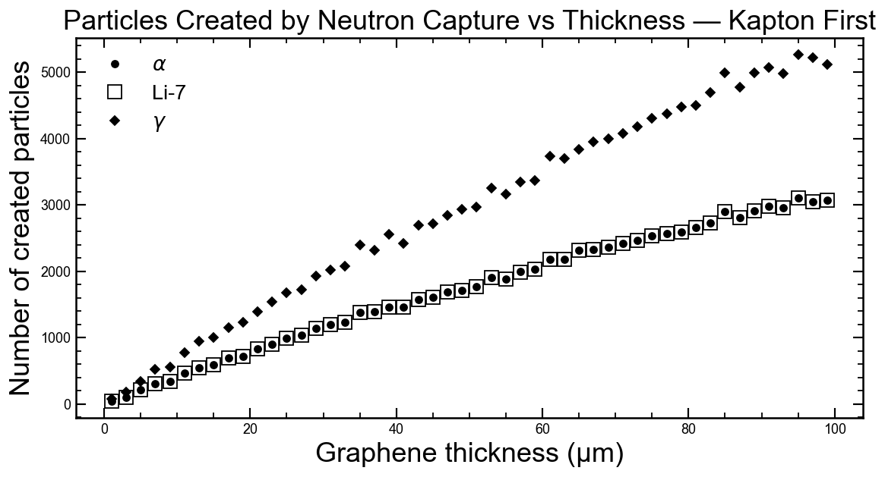
% Capture vs Graphene thickness

Slide 26
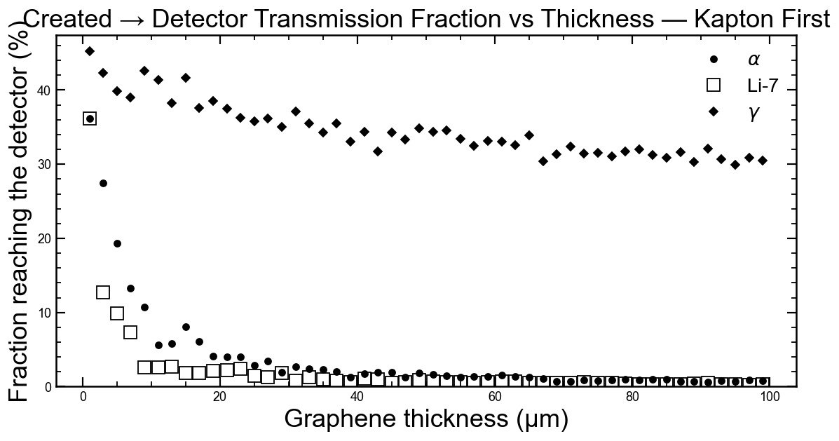
% Particles in detector vs Graphene thickness

Slide 27
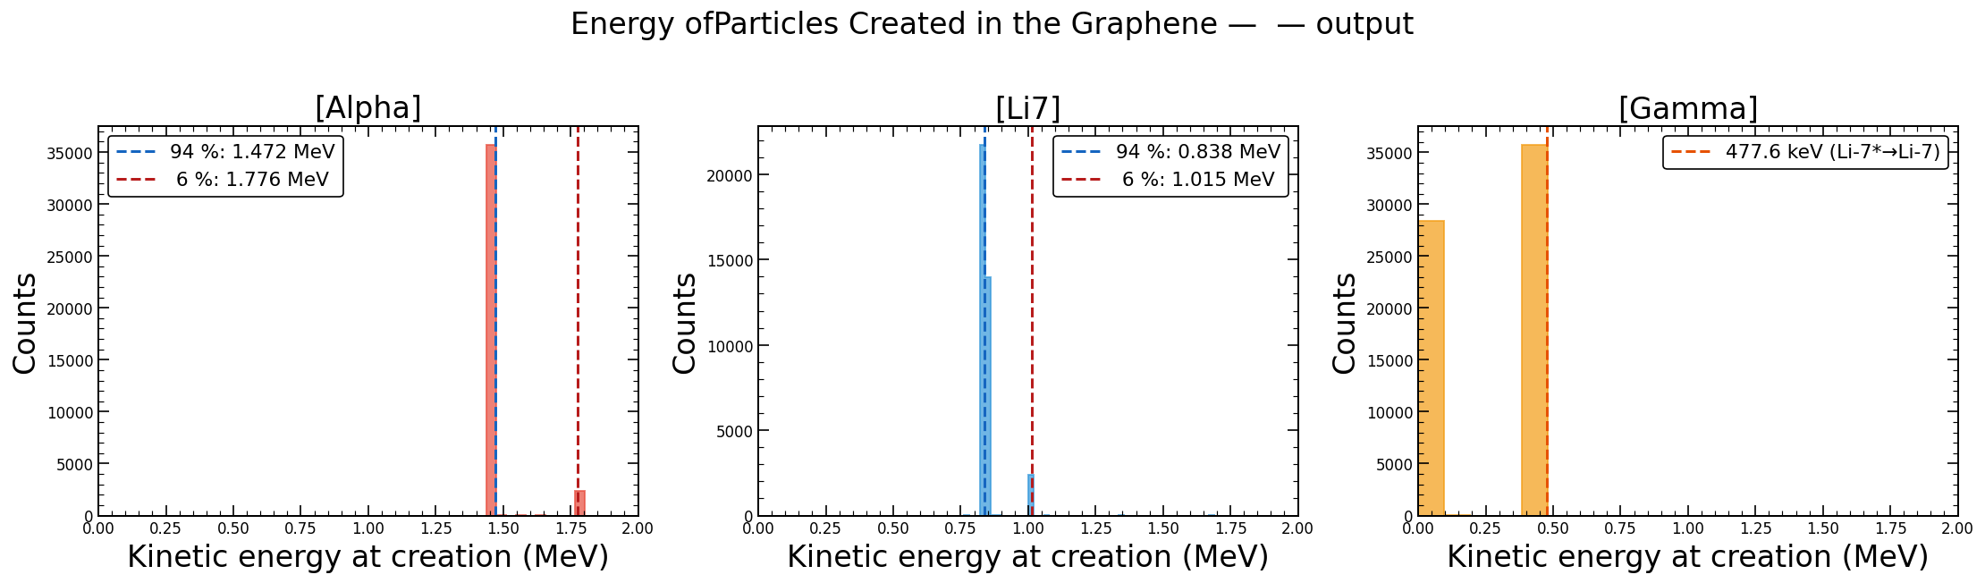
Neutron capture results – Particles created
Events for simulation:
1’000.000 events
(a)
(b)
(c)

Slide 28
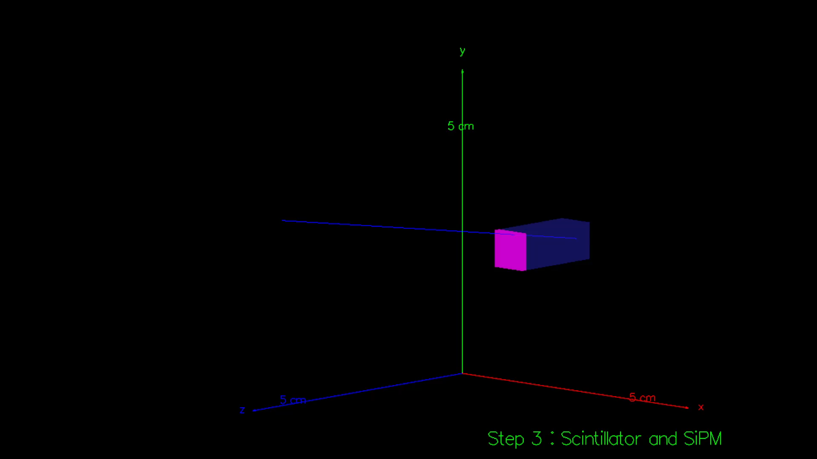
Scintillator and SiPM
Geometry:
Scintillator crystal BGO (6x6x15)mm3
SiPM (6x6)mm2
Physics:
FTFP_BERT + G4OpticalPhysics
Primary Generator Action:
Particles in detector of Phase 2 after capture

Slide 29
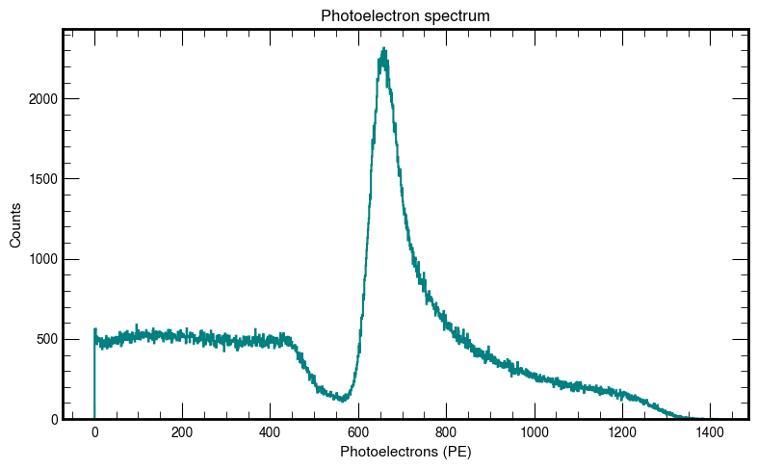
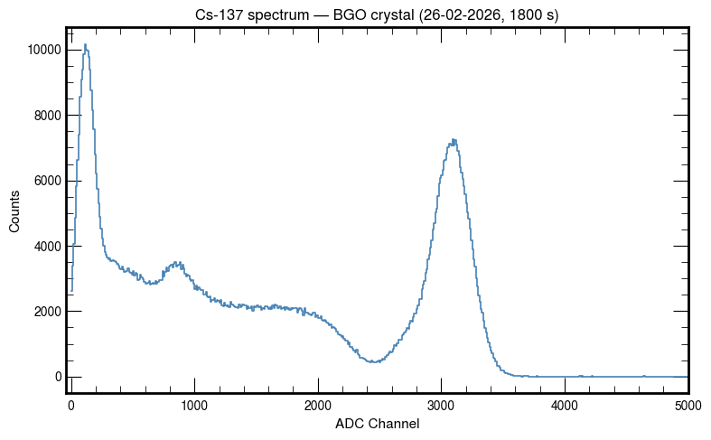
Scintillator and SiPM calibration
Simulation Cs137 (gamma-661.7Kev)
Experimental data Cs137 (gamma-661.7Kev)

Slide 30
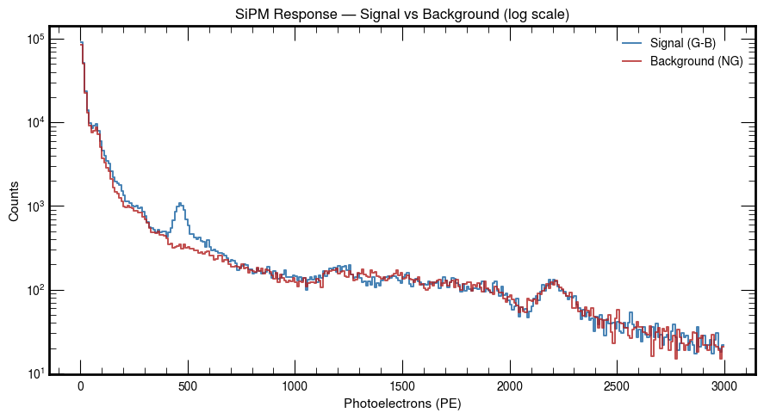
SiPM Response in PE

Slide 31
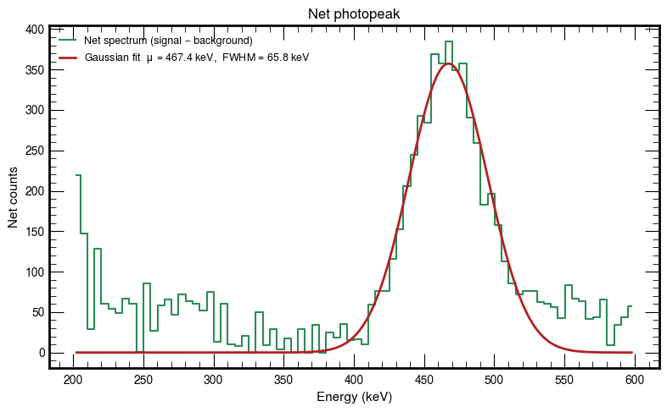
SiPM Response in PE

Slide 32
Conclusions
A three-step Monte Carlo model was successfully implemented to simulate the full detection chain of thermal neutrons.
The optimal geometry for thermalization was found to be a Paraffin block of 12 × 12 × 8 cm.
The boron-doped graphene film successfully produced the expected reaction products (α and 7Li). Additionally, the simulation revealed the presence of soft photons, which must be accounted for in the signal analysis.
The BGO Crystal generated a signal that allowed the background to be differentiated.

Slide 33
Future Work
Experimental Validation: Test the detection in laboratory conditions using the neutron source facilities at UPTC.
Simulate alternative scintillator materials (LYSO, NaI(Tl), CsI, Plastic) and compare their SiPM response in terms of light yield and energy resolution.

Slide 34
Acknowledgments
I would like to express my gratitude to:
The Nanomaterials Research Group at Universidad de los Andes for their collaboration on the material preparation and characterization on Boron doped graphene in particular Prof. Yenny Hernandez.
The High Energy Physics Group at Universidad de los Andes in special Prof. Carlos Avila.
The High Energy Physics Group at Universidad Antonio Nariño (UAN) for their academic support and resources.

Slide 35
References
C. Paganelli, D. Broggio, A. Zanini. Boron-10 and Boron-11 neutron cross-sections for BNCT: New data and evaluation. Applied Radiation and Isotopes, 147 (2019) 38–45.
S. Agostinelli et al. GEANT4 – A simulation toolkit. Nucl. Instrum. Meth. A 506 (2003).
J. Allison et al. Recent developments in Geant4. Nucl. Instrum. Meth. A 835 (2016).
ROOT Data Analysis Framework. CERN. https://root.cern
M. S. Dewji et al. Neutron detection principles and applications. Oak Ridge National Laboratory (2013).
David Cepeda. Simulación de la interacción neutrónica en películas de grafeno dopadas con boro usando geant4. Universidad Antonio Nariño, 2025.

Slide 36


Slide 37
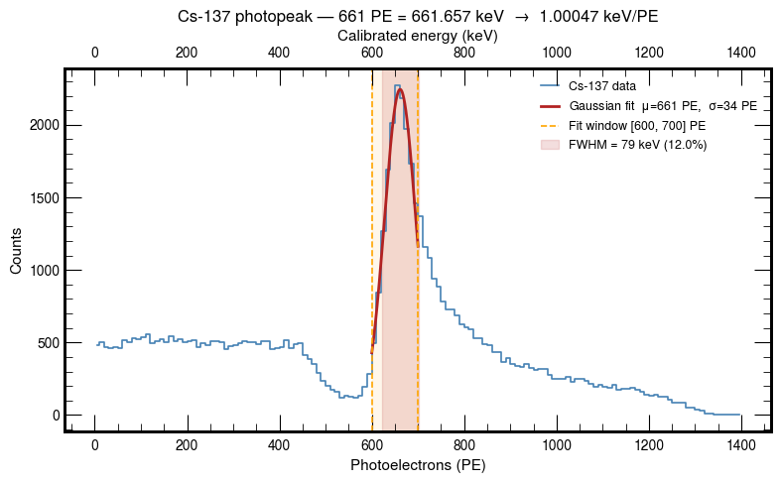
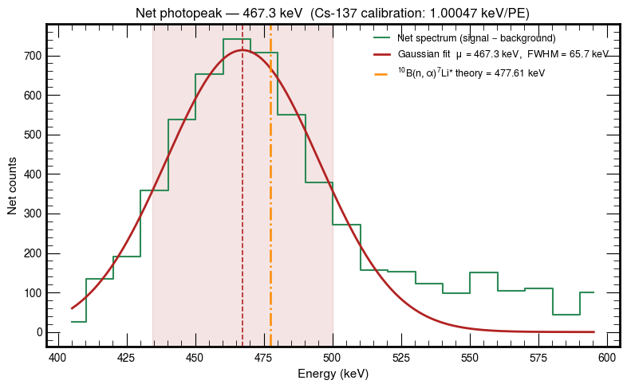
Backup

Slide 38
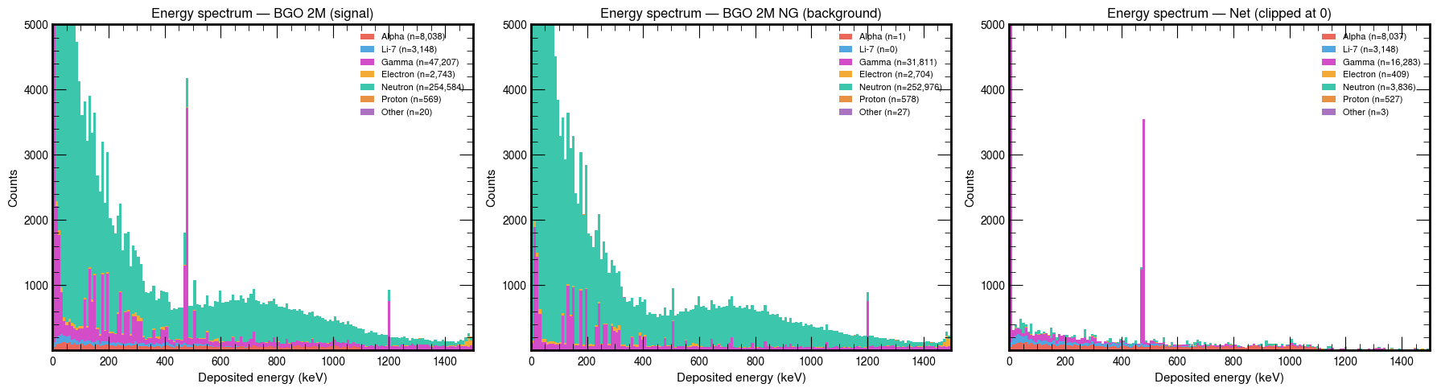
Backup

Slide 39
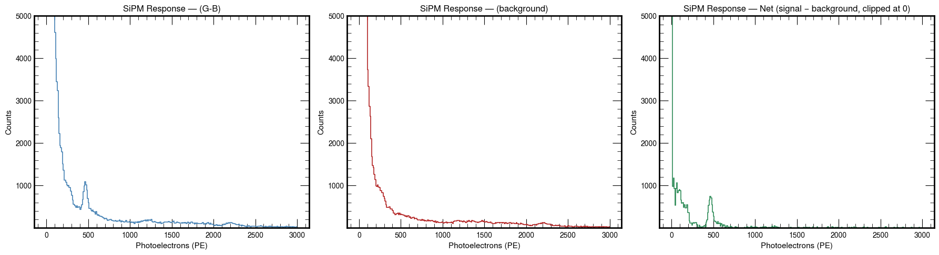
Backup

Slide 40
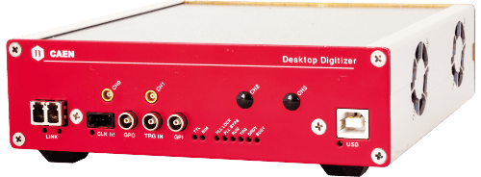
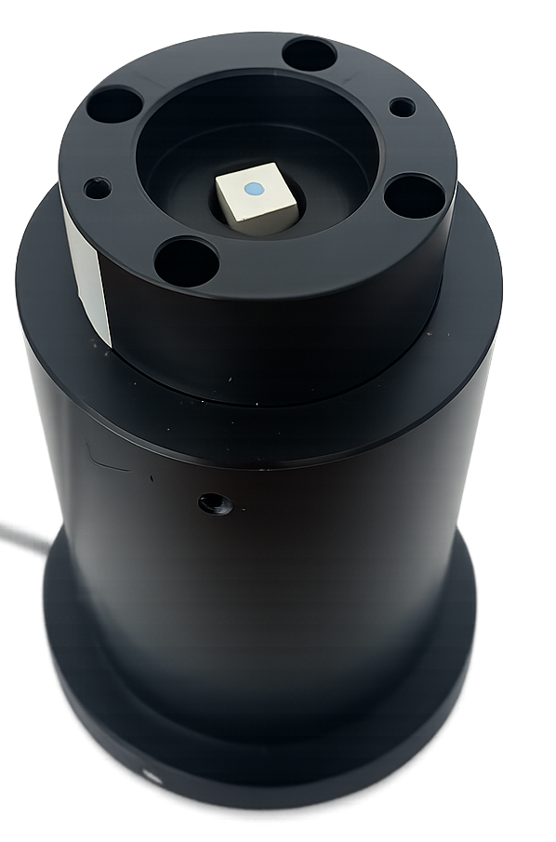
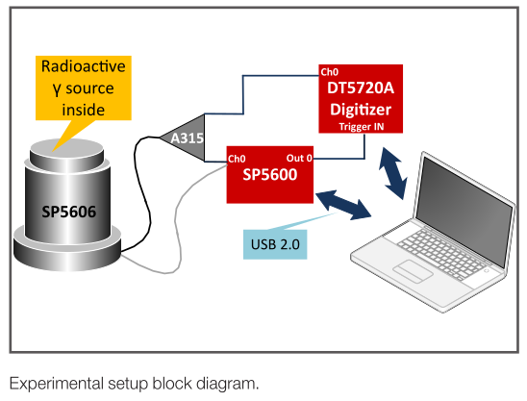
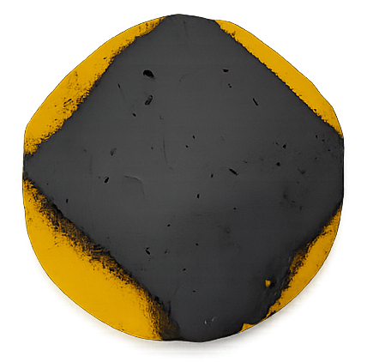
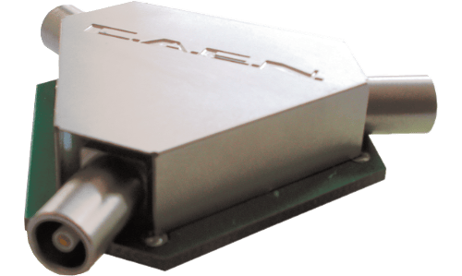
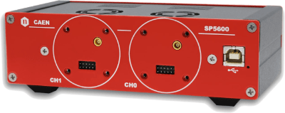
Backup
SP5600AN – Educational Kit – Premium Version

Slide 41
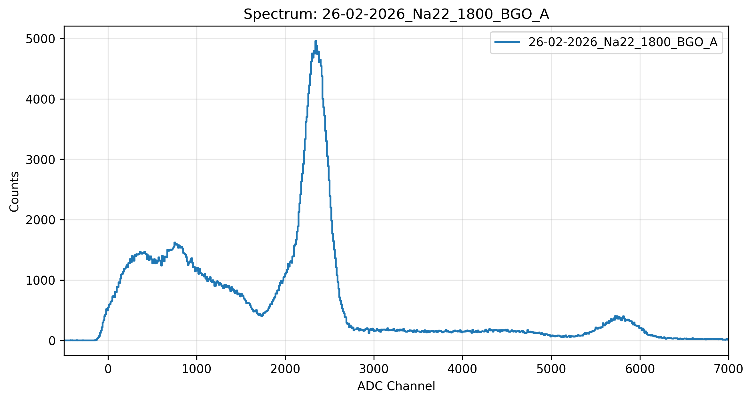
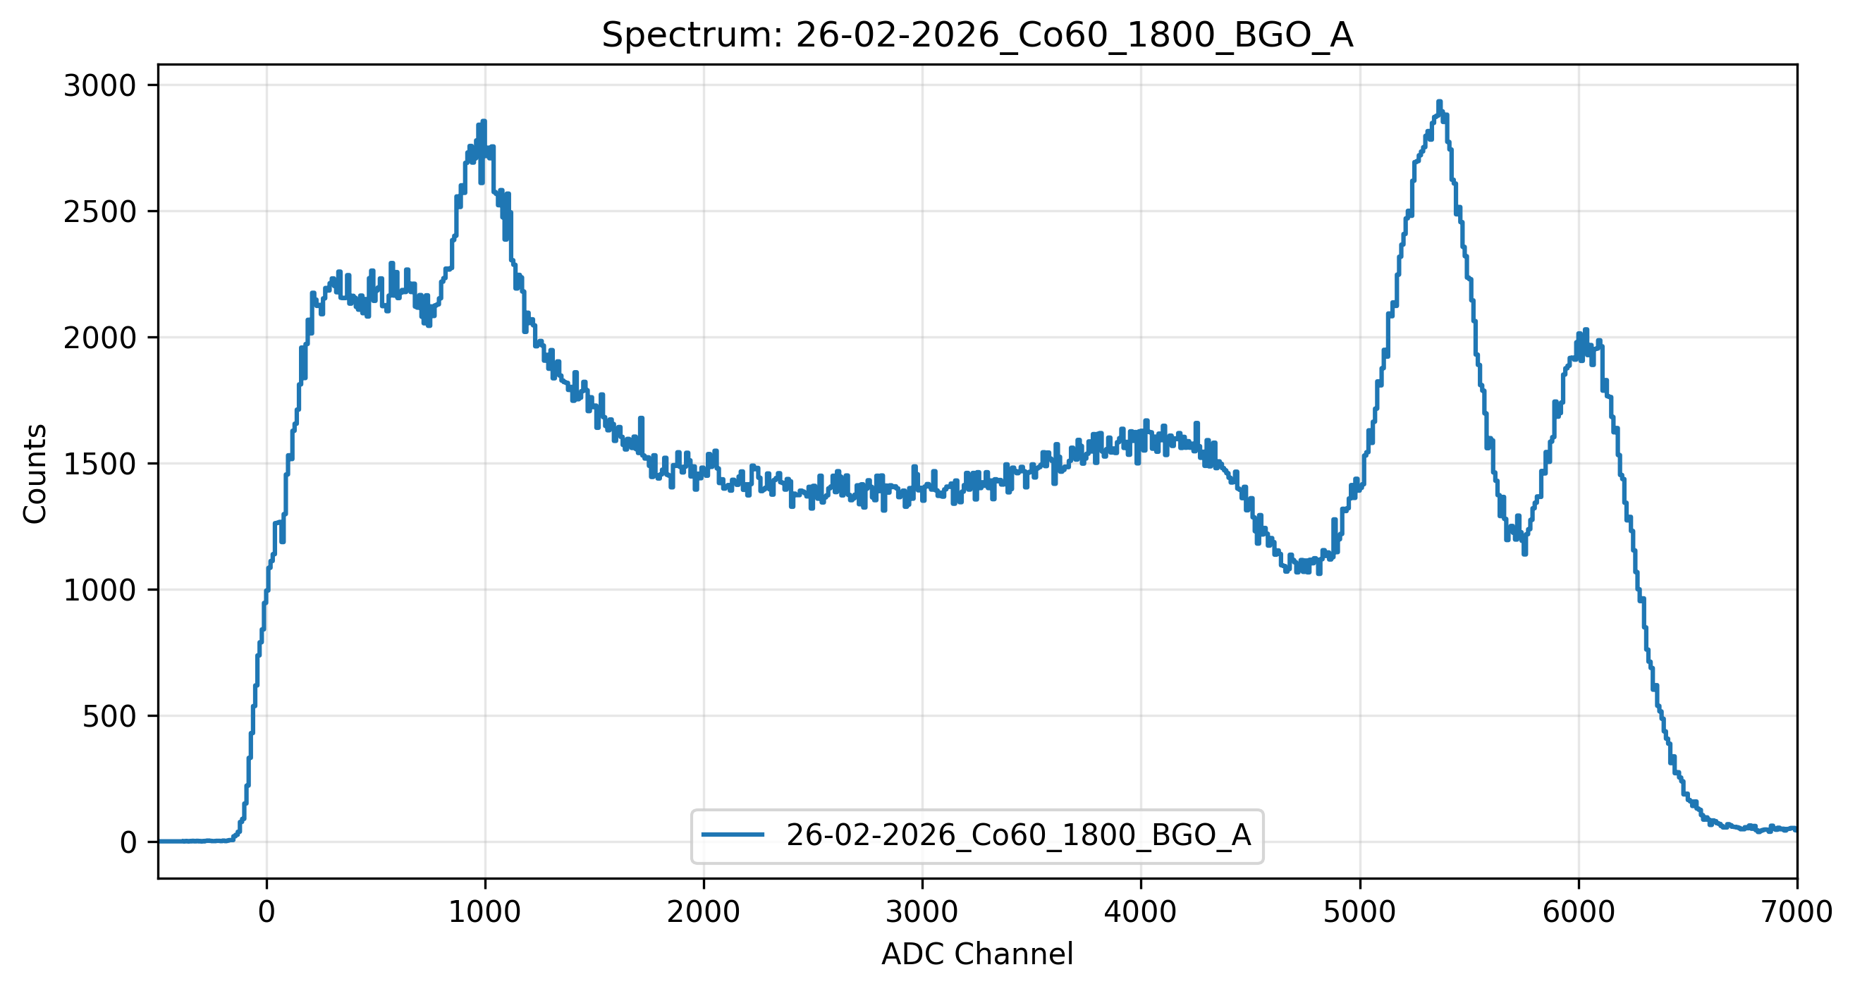
Backup

